Slide 1
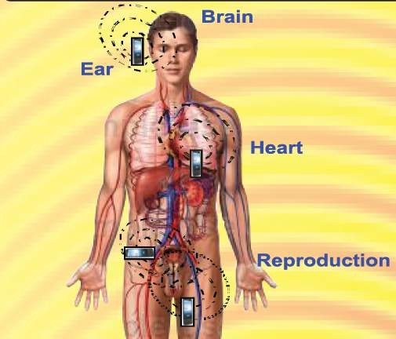


Radio Frequency Radiation and Human Health: Technical Studies from India
Dr. R. S. Sharma
Sr. Deputy Director General & Scientist-G
Division of RCH
Indian Council of Medical Research New Delhi –110 029

Slide 2
Scientific Hypothesis
Studies published from India
Policies & Guidelines in this area
Public concern

Slide 3
1. Health –
Health is a
state
of complete
physical, mental and social well-being and
not merely infirmity.
the absence
of disease or
Biological effects – Effects are measurable responses to a stimulus or to a change in the environment and are not necessarily harmful to our health
Health Hazard – Changes that are irreversible and stress the systems for long period of time.

Slide 4
Questions arise
What are these biological effects.
Can we ignore these effects, if they exist.
If not, then what measures we should take

Slide 5
Factors influence the EMF effect on human health
Environmental factors
Ambient temperature
Air velocity
Humidity
Electrical property of the environment
Altitude
Geo-pathic radiation
Biological factors
Mass, Shape and the size of the body
The orientation of the body with the field vectors
Electric property of the body
Age, gender, activity level
Muscles contents and fat contents
Bone Mineral Density
Debilitation and/ or other diseases would also contribute

Slide 6
(i) Scientific Hypothesis

Slide 7
Effects of Radio Frequency Radiation (RFR)
Every living and non-living things consists of a variety of atoms.
Atom contains electrons, protons, neutrons etc.
Every living and non-living thing is in a state of vibrational harmonic resonance.
Every system, organ, tissue, cell and molecule of the human body vibrates within a certain range of frequency.

Slide 8
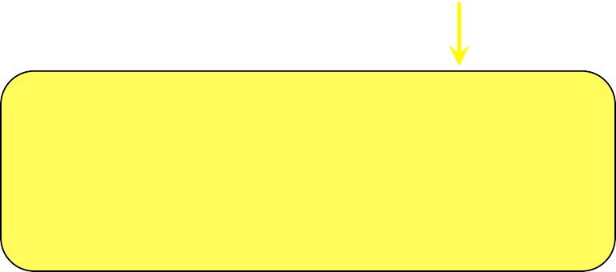

Electromagnetic Radiation
Thermal
Athermal

Slide 9
Vibration increases
High Energy
Molecules
Adverse health effect
Increase in temperature
Thermal effect
Goldstein et. al., Int. J Hyperthermia (2003): 19(3): 373-84

Slide 10
Vibration increases
Low Energy
Molecules
Which play an important role in biological regulatory pathways
Constant periodical exposure of low EMF influences biological oscillation
No sufficient increase in temperature
Reports
Low energy absorbed at molecular level manifests changes in vibration of the molecules producing various molecular transformations and alterations
Alteration in biological regulatory pathways
Biological Effect
Athermal Effect

Slide 11
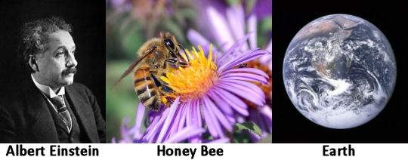
Impacts of RF on Honey Bees
If the bee disappeared off the surface of the globe then man would only have four years of life left. No more bees, no more pollination, no more plants, nor more animals, no more man.
Canadian Bee Journal in 1941

Slide 12
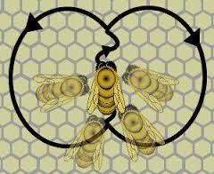
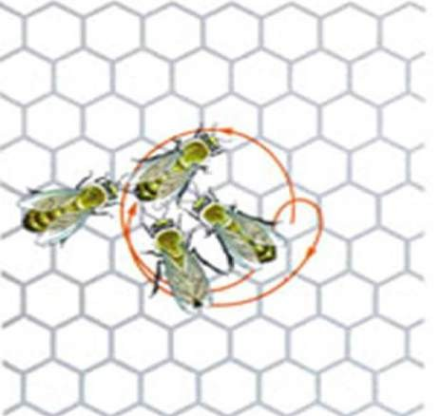
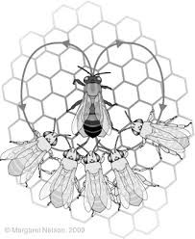
Decoding the language of the Honey Bees
Nobel Lecture, December 12, 1973 Karl Von Frisch
University of Munich, Federal Republic of Germany
Waggle Dance
Shacking Dance
Tremble Dance

Slide 13

Exposure to cell phone radiation produces biochemical changes in worker Honey Bees, Neelima et al., 2011
Controls, n=10
10 Min.
20 Min.
40 Min.
Extracted the Hemolymph
Cell Phone Exposed, n=10
10 Min.
20 Min.
40 Min.
Behavioral observation
Biochemical observation
Reduced motor activity
En masse migration
Carbohydrates
Glycogen
Glucose
Total lipid cholesterol protein
At 10 & 20 Min. exposure
At 40 Min. exposure
During initial quiet period rise in concentration of biomolecules due to stimulation of body mechanism to fight stressful condition.
At later stages there was decline in the concentration of biomolecules because the
body had adapted to the stimulus.
Neelima et. al. Toxicol. Int. 2011; 18:70-72

Slide 14
Electromagnetic radiation (EMR) damages Honey Bees (Sainudeen, 2011)
Control hives, n=3 No cell phone exposure
All workers return to hives
10 day
Test hives, n=3 Cell Phone exposure
for 10 min./day
After few days the workers never return to hives
10 day
Colony Collapse/ Disrupting Syndrome
Only queen, eggs & hive bounds immature worker bees
Thriving hives left with
S Sainudeen Sahib. Mun. Ent. Zool. 2011, 6:396-399

Slide 15
(ii). Genotoxicity Studies published from India

Slide 16
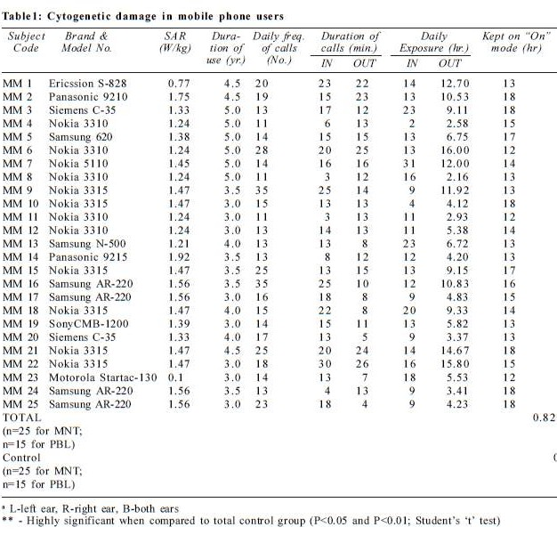
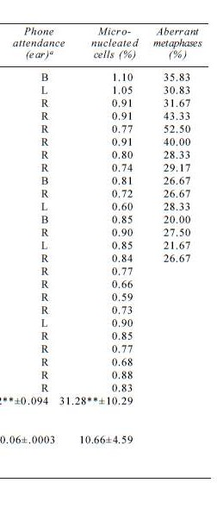
Cytogenetic Studies
1. Cytogenetic Damage in Mobile Phone Users: Preliminary Data
Gandhi & Singh, Int J Hum Genet (2005) 5:259-265 (25 users/25 controls)

Slide 17
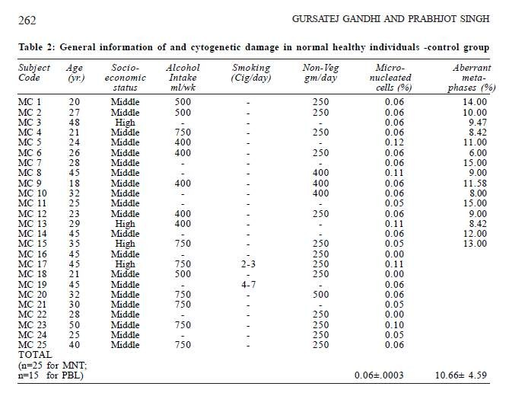

Gandi & Singh, Cytogenetic Data on Controls, 2005
Increased number of micro nucleated buccal cells and cytological abnormalities in cultured lymphocytes
Indicating the genotoxic response from mobile phone use.

Slide 18
Ranges of Cytogenetic Damage in non-users compared to heavy users of mobile phones (Gandhi & Singh 2005)
 | %Micro- nucleated cells | %Aberrant Metaphases
Control | 0.00-0.12% | 6.00-15.00%
Exposed | 0.59-1.10% range of values o | 20.00-52.50% btained highly significant

Slide 19
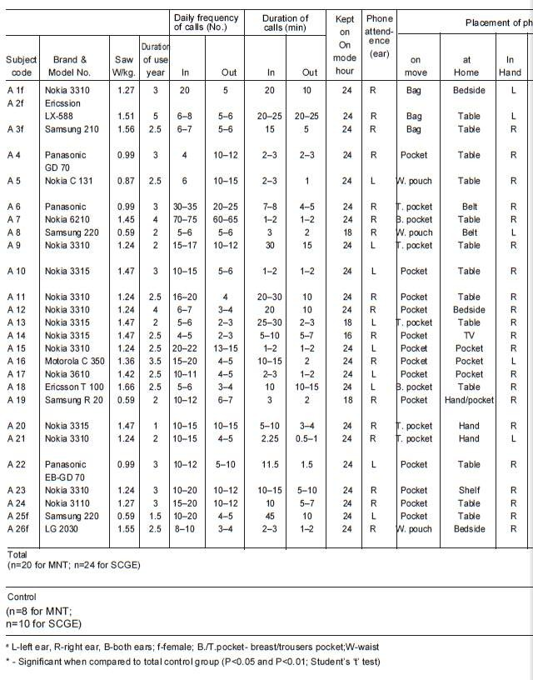
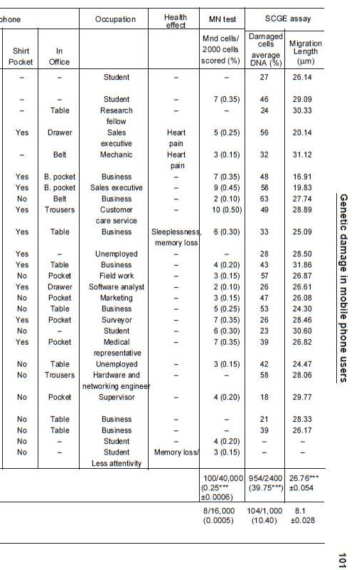
2. Genetic damage in mobile phone users: some preliminary findings Gandhi Gursatej, Ind J Hum Genet (2005) 11: 99-104 24 users/ 11 controls
A correlation between mobile phone use and DNA and chromosomal damage in lymphocytes of individuals was observed which may have long- term consequences in terms of neoplasia and/or age-related changes.

Slide 20
Genetic Damage in
Non-users vs. Mobile Phone Users
(Gandhi, 2005)
 | MN Test Mnd cells/ 2000 cells scored (%) | SGCE assay Damaged Cells average DNA (%) | SGCE assay Migration length (µm)
Control | 0.0005 | 10.40 | 8.1± 0.028
Exposed | 0.25± 0.0006 | 39.75 | 26.76± 0.054
non-overlapping range of values highly significant

Slide 21
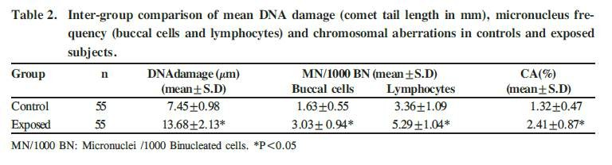
3. Comparison of genetic damage in cell phone users and non-users Rekhadevi et. al., Toxicol Int (2009) 16:09-19 (55 exposed/ 55 controls)
2 to 3 fold increased genetic damage of peripheral lymphocytes and buccal epithelial cells in mobile telephone users increased significantly, as compared with controls.

Slide 22
4. 2.45ghz (cw) microwave irradiation alters circadian organization, spatial memory, DNA structure in the brain cells and blood cell counts of male mice, Mus musculus
Chaturvedi et. al., Electromagnetics Research B (2011) 29: 23-42.
Male Mice exposed (2 h/day x 30 days, 2.45 GHz)
Increase in erythrocyte and leukocyte counts in mice exposed to RFR.
A significant DNA strand break in brain cells and the loss of spatial memory in mice.
This report for the first time provides experimental evidence that continuous exposure to low intensity microwave radiation may have an adverse effect on the brain function by altering circadian system and rate of DNA damage.

Slide 23
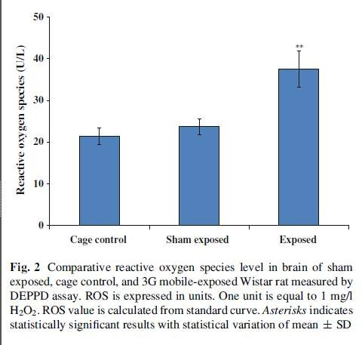

5. Effect of 3G Cell Phone on heat shock proteins/p38MAPK in Rat Brain Kesari et. al., Cell Biochem Biophys. 2014; 68(2):347-58.
Male Wistar Rats (2 h/day x 60 days, 3G mobile)

Slide 24
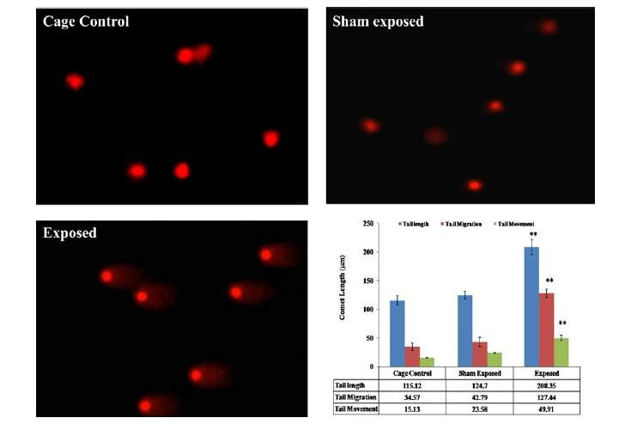
Kesari et al, 2014, rat brain comet assay

Slide 25
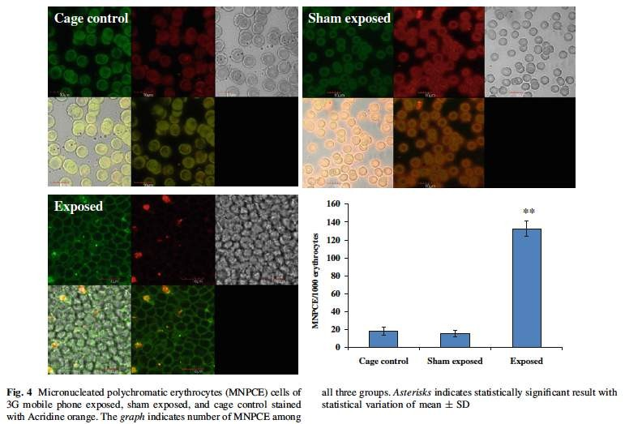
Kesari et al; 2014 – Micronucleated polychromatic erythrocytes rat

Slide 26
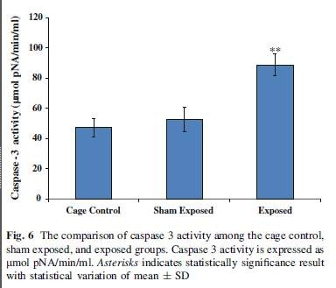

Kesari et al 2014 reduced caspase after cellphone exposure

Slide 27
Oxidative stress activates a variety of cellular signal transduction pathways.
Radiation emitted from 3G mobile induced DNA strand breaks in neurons.
phone
significantly
Significant increase in micronuclei, caspase 3 and apoptosis
Increase phosphorylation of hsp27, hsp70, and p38 mitogen- activated protein kinase (p38MAPK) leads to mitochondrial dysfunction-mediated cytochrome c release and subsequent activation of caspases and apoptosis.

Slide 28
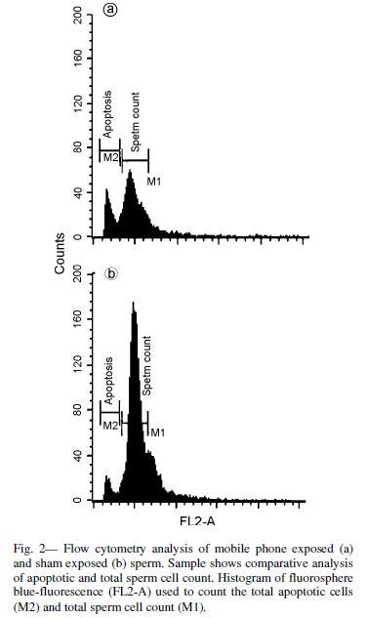



Reproductive Alteration
6. Mobile phone usage and male infertility in Wistar Rats
Kesari et. al., Indian Journal of Experimental Biology (2010) 47:987-992.
Chronic
exposure
to Radio
(RFR)
Frequency Radiation
imitated from cell phone causes a significant decrease in protein kinase C and total sperm count along with increase apoptosis in male wistar rats (2 h/day x 35 days at 0.9 W/kg SAR).
Significant reduction in testicular size, weight and sperm counts.

Slide 29
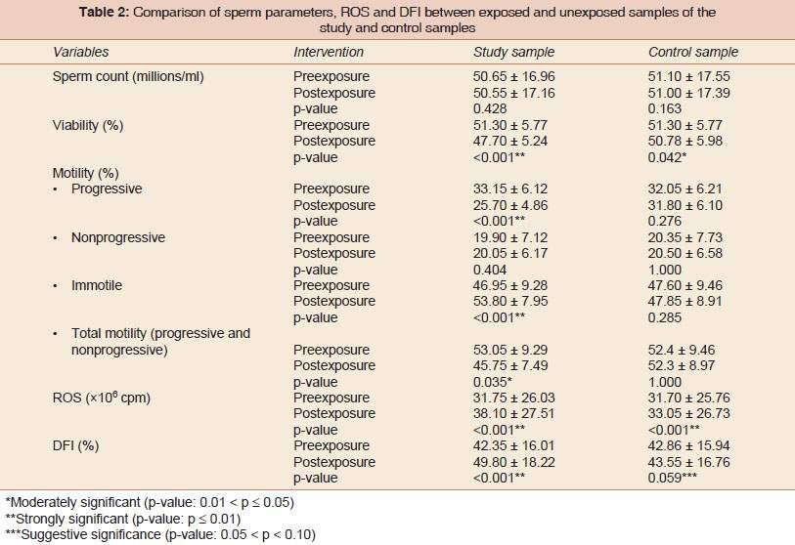
8. Mobile Phone Electromagnetic Waves and Its Effect on Human Ejaculated Semen: An in vitro Study
Veerachari SB, Vasan SS., Int J Infertility Fetal Med 2012;3(1):15-21.
n=20 Healthy Volunteers, semen sample exposed to 60 mins., cell phone kept at 2.5 cm

Slide 30

Human semen samples exposed to EMR showed a significant decrease in sperm motility and viability
Increase in reactive oxygen species (ROS) and DNA fragmentation index (DFI)
Study concluded that mobile phones emit electromagnetic waves which lead to oxidative stress in human semen and also cause changes in DNA fragmentation.

Slide 31
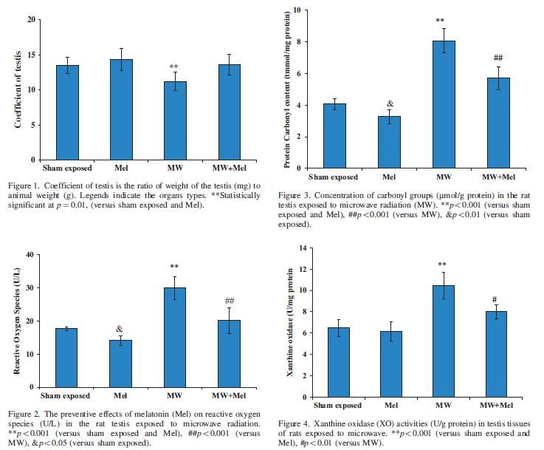

9. Melatonin reduces oxidative stress in male Wistar rats Meena et. al., Electromagn BioL Med. 2014; 33(2):81-91.
n=6 in each four groups, 2 hrs./day for 45 days with 2.45 GHz

Slide 32
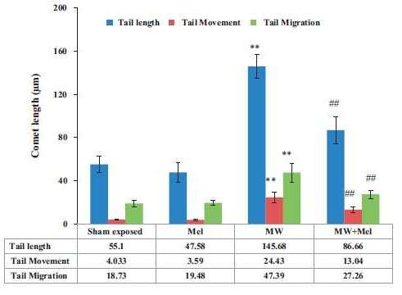




Slide 33
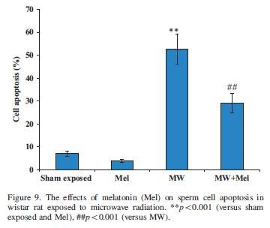
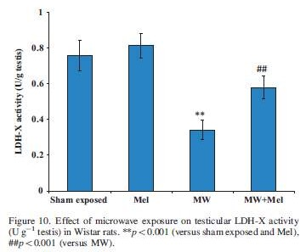


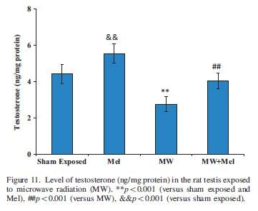
Melatonin prevents oxidative damage biochemically by significant increasing testicular LDH-X, decreased levels of melondialdehyde (MDA) and ROS in testis.
Melatonin reversed the effects of Micro Waves (MWs) on Xanthine Oxidase (XO), protein carbonyl content, sperm count, testosterone level and DNA fragmentation in testicular cells.
Melatonin has strong antioxidative potential against MW induced oxidative stress mediated DNA damage in testicular cells.

Slide 34
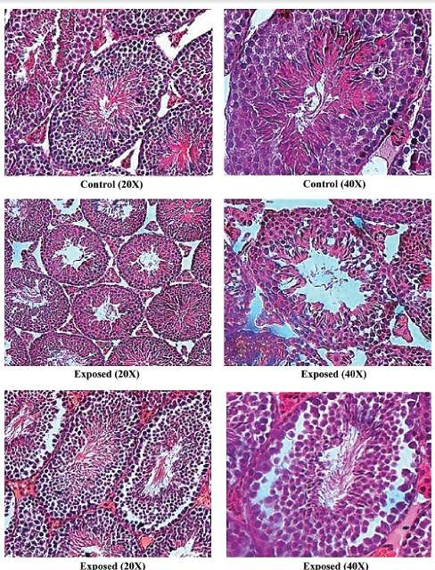

10. 2.45-GHz microwave irradiation adversely affects reproductive function in male mouse, Mus musculus by inducing oxidative and nitrosative stress Shahin et. al., Free Radic Res. 2014; 48(5):511-25.
n=20 in each two groups, 2 hrs./day for 30 days with 2.45 GHz

Slide 35
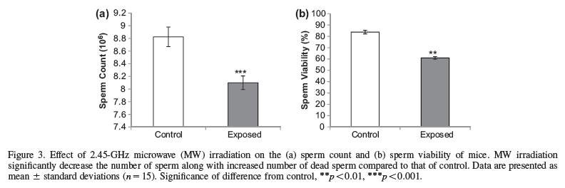


Microwave irradiation induced a significant decrease in sperm count and sperm viability along with a decrease in seminiferous tubule diameter and degeneration of seminiferous tubules in mice.
Reduced testicular 3β HSD activity and plasma testosterone levels
Increased expression of testicular induced Nitric Oxide Synthase (i- NOS)
These adverse reproductive effects suggest that chronic exposure to nonionizing MW radiation may lead to infertility via free radical species-mediated pathway.

Slide 36
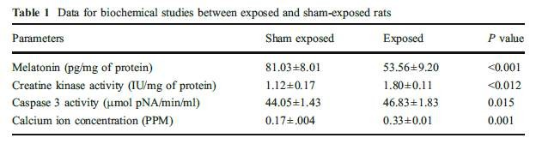

Biomarkers alteration
11.Pathophysiology of Microwave Radiation: Effect on Rat Brain Kesari et. al., Appl Biochem Biotechnology (2012) 166:379-388.
n=6 in each two groups, 2 hrs./day for 45 days with 2.45 GHz
A significant decrease in the level of pineal melatonin of exposed group (2h/day x 45 days at 2.45 GHz) as compared with sham exposed.
A significant increase in creatine kinase, caspase 3 and calcium ion concentration was observed in whole brain of exposed group of animals as compared to sham exposed.
The alteration in expression of these biomarkers clearly indicate possible health implication of such exposures

Slide 37

12. Biochemical Changes in Rat Brain Exposed to Low Intensity 9.9 GHz Microwave Radiation
Paulraj and Behari, Cell Biochem Biophys (2012) 63:97-102.
n=8 in each two groups, 2 hrs./day for 35 days with 9.9 GHz PD=0.125 mW/cm²
This study revealed that chronic exposure of radiation alter the activity of certain enzymes.
rat to microwave
Significant increases in calcium ion efflux and the Ornithine Decarboxylase (ODC).
Significant decreases in Protein Kinase C (PKC) activity.
activity of
Since these enzymes are related to growth, therefore any alteration in them may affect brain functioning and development.

Slide 38
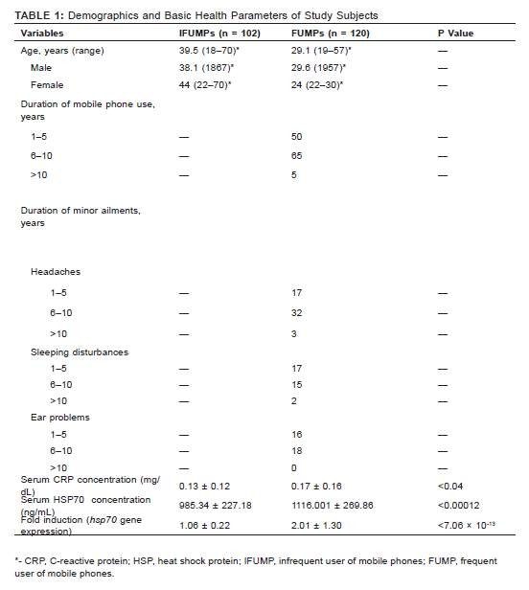

13. Hsp70 Is an Independent Stress Marker Among Frequent Users of Mobile Phones Balakrishnan et. al., J Environ Pathol Toxicol Oncol. 2014;33(4):339-47.
n=120 IT Employees FU
n=102 IFU non-IT Employees

Slide 39
The aim of this study was to measure the serum concentrations of heat shock protein (HSP) 70 and C-reactive protein (CRP) and the expression levels of the hsp70 gene among frequent users of mobile phones (FUMPs).
Highly significant higher concentrations of serum HSP70 and CRP were observed among more highly exposed compared to controls.
A higher level of hsp70 gene expression was also observed
Thus, the study convincingly demonstrated the role of serum HSP and CRP as systemic inflammatory biomarkers for
mobile phone-induced radiation

Slide 40
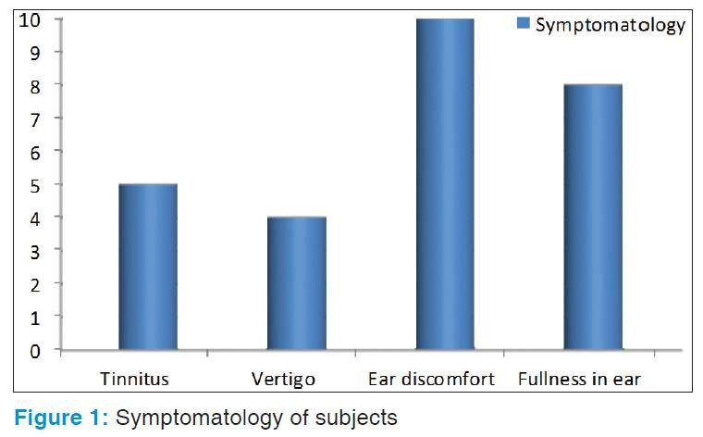
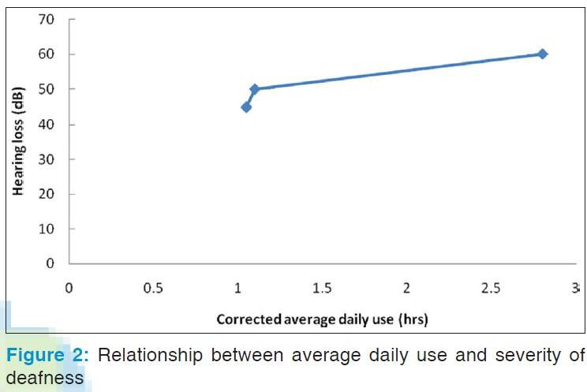


16. Prevalence of sensorineural deafness in habitual mobile phone users
Sahoo and Sebastian. Indian Journal of Otology (2011): 17 (3): 97-100.
Explored a possible relationship between prolonged mobile phone usage and sensorineural deafness in healthy volunteers in rural India.
A total of 100 (62 M and 38 F) persons between the age group of 20-45 years using mobile phone for at least 5 years were selected and screened for sensorineural deafness.

Slide 41

•The prevalence of sensorineural deafness was 3% and there is a linear relationship between the duration of mobile phone use and the degree of the severity of deafness.
•It is not clearly known whether mobile phone use is the direct cause of deafness in these subjects but the absence of other causes might point towards its etiological role.

Slide 42
ICMR Study
ICMR has initiated a multi-disciplinary, comprehensive, prospective, long term cohort study to find out adverse effects of RFR, if any, emitted from cell phone on adult Indian population.
Under this study efforts are going on to examine whether use of cell phone is associated with:
– Reproductive dysfunctions and infertility,
– Neurological disorders (cognitive behavior, depression etc.), | sleep | related | disorders,
– Cardiovascular disorders,
– Otorhinolaryngology (ENT) disorders
– Carcinogenic effect
– Hematological changes
– Biochemical changes
– Hormonal changes

Slide 43
(iii). Policies & Guidelines in this
area

Slide 44
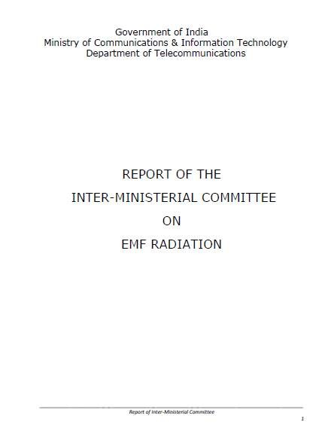

Slide 45
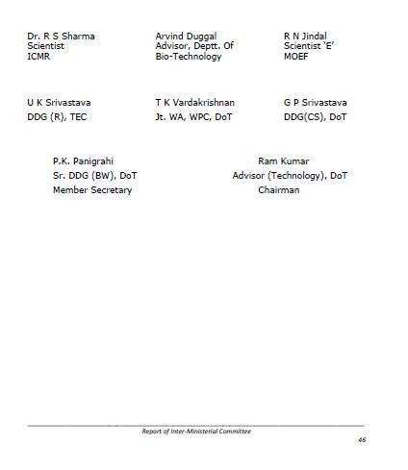
Members of the Inter-Ministerial Committee

Slide 46
Recommendations of the
Inter-Ministerial Committee 9/1/2012
Mobile Handsets: -
Adoption of SAR level for mobile handsets limited to 1.6 Watt/Kg, averaged over a 6 minutes period and taken over a volume containing a mass of 1 gram of human tissue as per the FCC norms of United States.
SAR value information is to be embossed and displayed in the handset.
Information on SAR values for mobile handsets should be readily available to the consumer at the point of sale so that one can make sure of the SAR value of the handset while buying a cell phone.

Slide 47
Recommendations of the
Inter-Ministerial Committee 9/1/2012
Mobile Handsets: -
Mobile hand set
manufactured and
sold
in India or
Imported from other countries should be checked for compliance of SAR limit
No hand sets of SAR value above the prescribed standard adopted in India should be manufactured or sold in the country.

Slide 48
Additional Recommendations 2012
To bring awareness, the manufacturer’s mobile handset booklet should contain the following for safe use:
Use a wireless hands-free system (headphone, headset) with a low power Bluetooth emitter to reduce radiation to the head
  When buying a cell phone, make sure it has a low SAR
  Either keep your calls short or send a text message (SMS) instead. This advice applies especially to children, adolescents and pregnant women.
  Whenever possible, use cell phone when the signal quality is good.
  People having active medical implants should keep their cell phone at least 30 cm away from the implant.

Slide 49
Mobile Base Stations Indian Government Advice: -
The RF exposure limits in India have been lowered to 1/10th of the some international standards (ICNIRP)
Apart from self certification for compliance of radiation norms on EMF, mobile service providers should also measure the radiation level of certain prominent places and display it for information of the general public.
Department of Telecommunications (DOT) should create a national data base with the information of all the base stations, their emission levels, and display on public domain for public information.
No mobile towers installed near high density residential areas, schools, playgrounds and hospitals.

Slide 50
14.For the future expansion of telecom network in the country use low power micro cell transmitters with in-building solutions
To conduct the long term scientific research related to health aspect of EMF radiation exposure and associated technologies in India in the following areas:
Health effect of RF exposure in children.
Health effect of RF exposure in Foetus, persons.
mothers
and elderly
Combined electromagnetic field radiation effect multiple antennas of a shared infrastructure sites
exposure
from
16.It is recommended for use of hands free and ear phone technologies such as blue tooth handsets and ear phone so as to minimize the contact of head with cell phone.
.

Slide 51
Public concern
(iv).

Slide 52
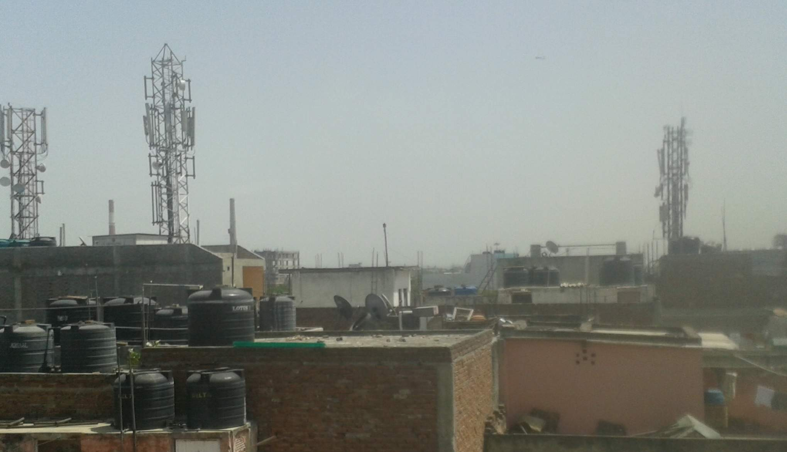
Pulprilhad Pur, New Delhi

Slide 53
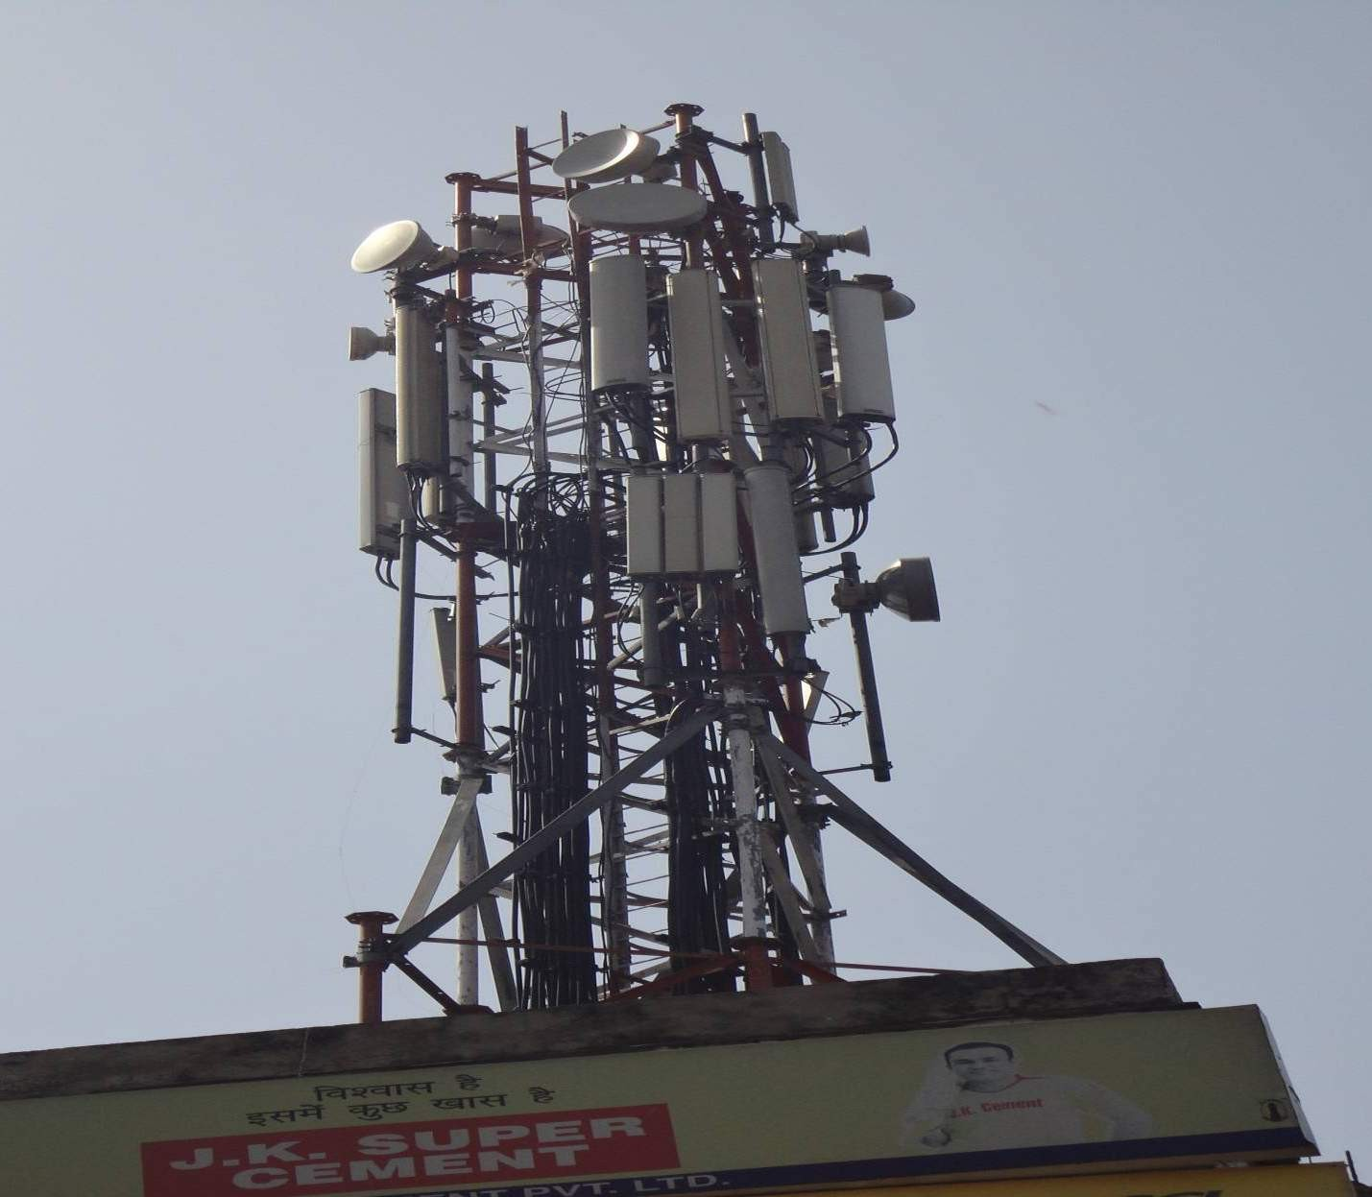
Rahugupta T-10B Pulprahilad Pur
New Delhi

Slide 54
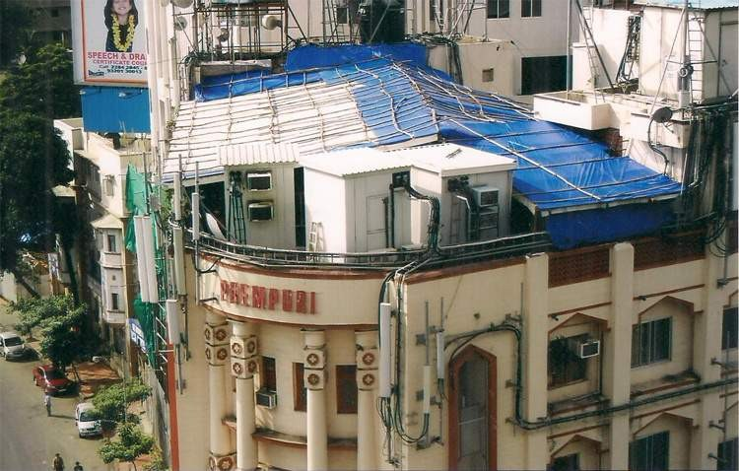

Slide 55
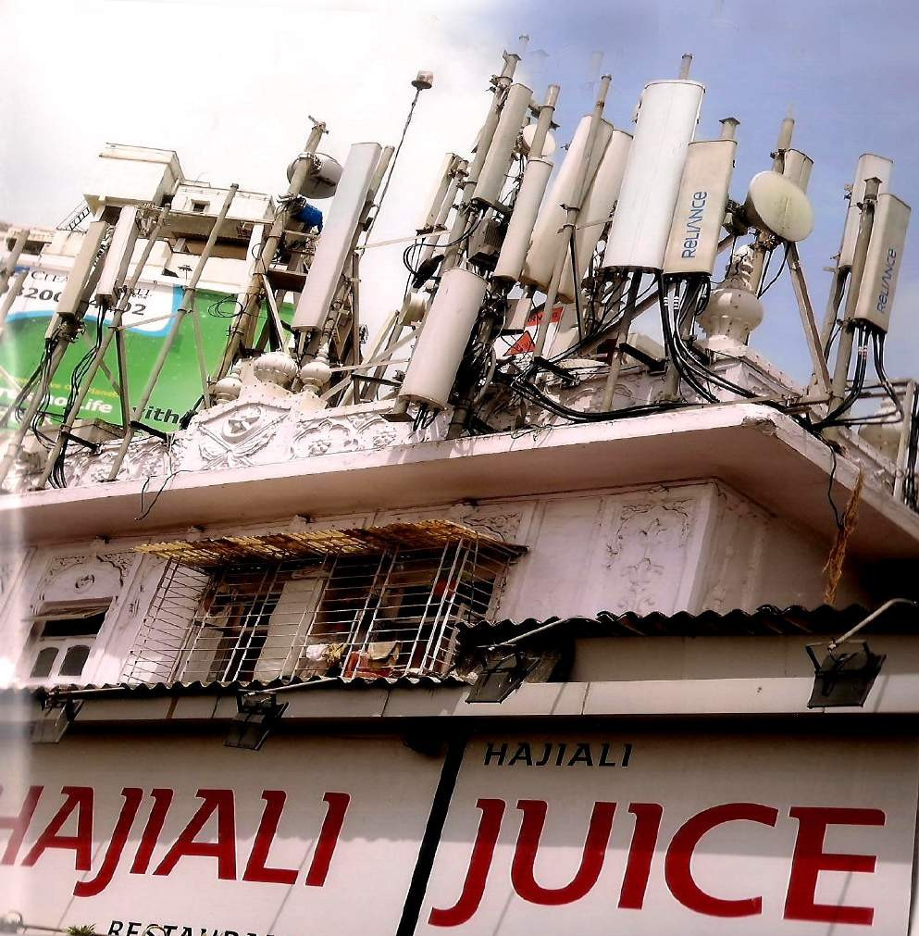

Slide 56
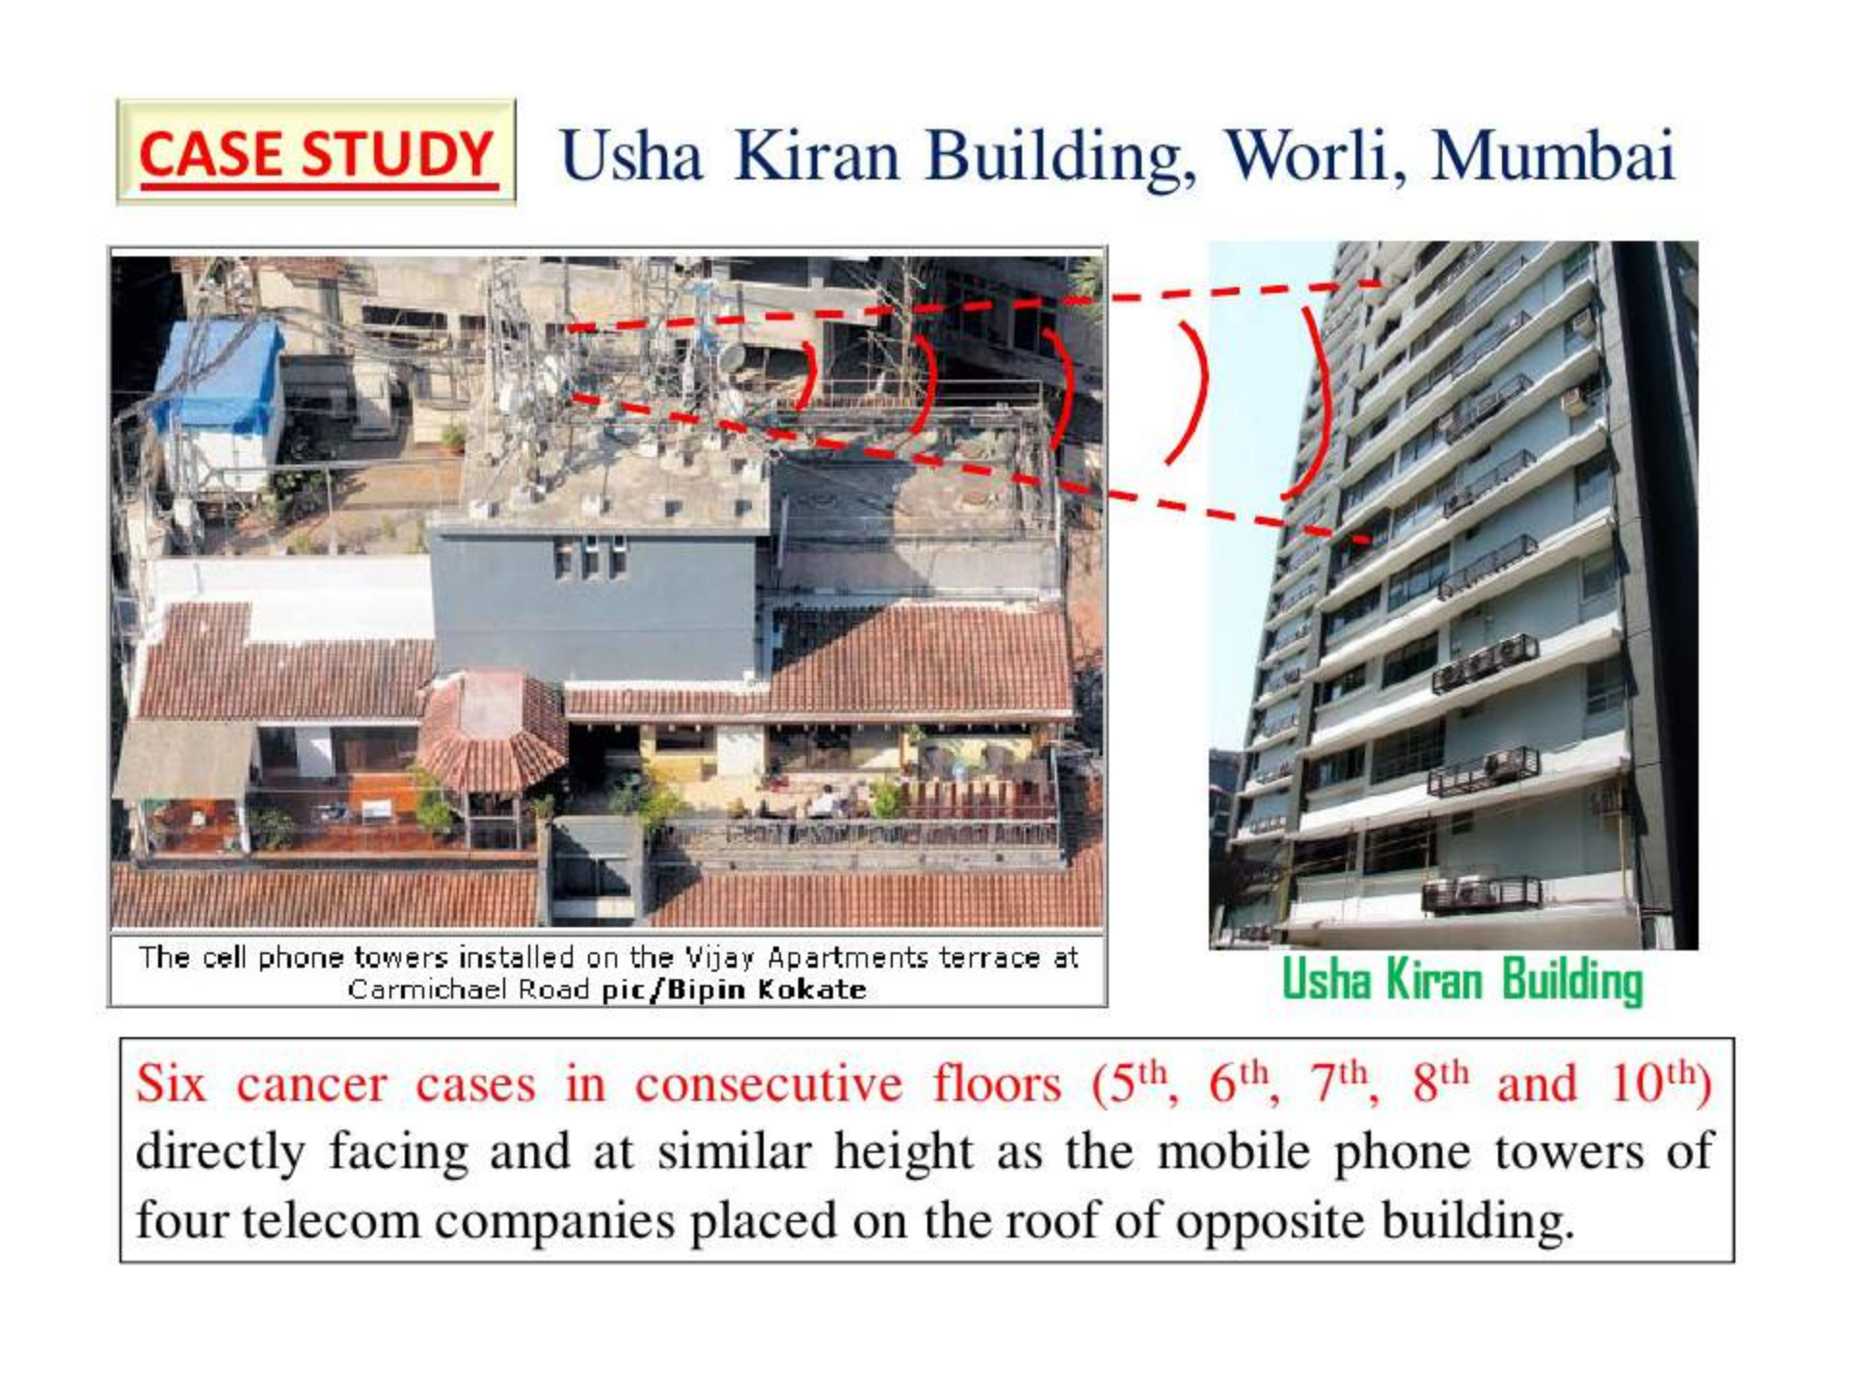

Slide 57





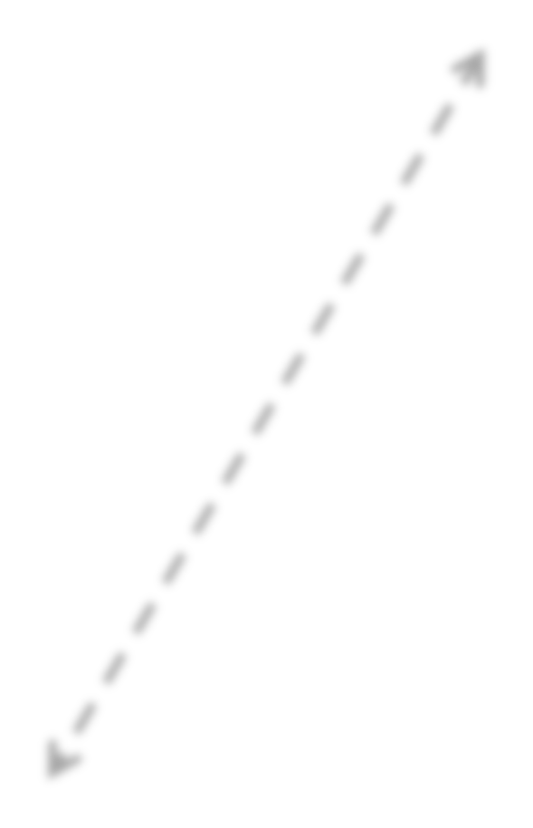
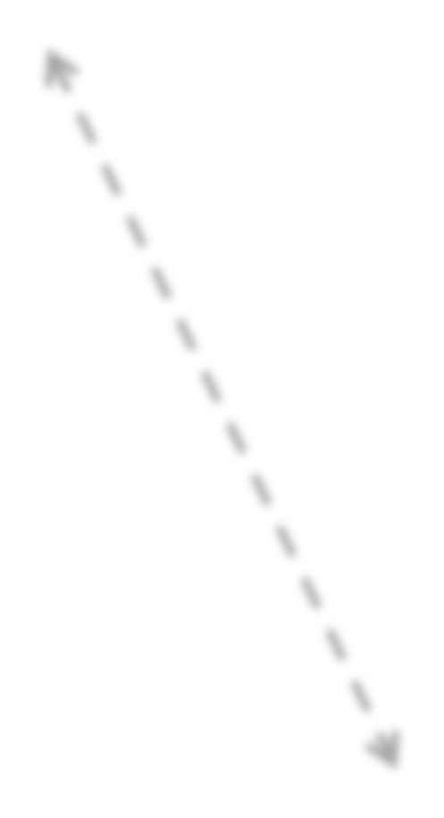



Disconnect
Engineers
Industry
Public
Biomedical Scientists

Slide 58
Cell Phone Biological Studies
—publication sponsorship bias?
 | Effect | No Effect | Total
I n d u s t r y Funded | 27 (29%) | 66 (71%) | 93 (30%)
Non-Industry Funded | 147 (69%) | 67 (31%) | 214 (70%)
Total | 174 (57%) | 133 (43%) | 307
Chris Busby and Roger Coghill (2006)

Slide 59
Conclusion
Authorities should acknowledge that cell phone and tower radiation has biological effects on humans and wildlife.
Need to conduct comprehensive multi disciplinary prospective long term cohort studies in different populations and different countries (But without private funding)
After these results are obtained, each country should develop health based precautionary guidelines to protect their population.
But till these results are available authorities should issue appropriate advisories to reduce or avoid adverse effects of radiation, if any.

Slide 60



