Slide 1


The Truth about Mobile Phone and Wireless Radiation:
What we know What we need to know What we can do now
Dr. Devra Davis
President, Environmental Health Trust Visiting Professor of Medicine:
Hebrew University Hadassah Medical School Ondokuz Mayis University Medical School
Co-sponsored by the Melbourne School of Engineering, the Melbourne Networked Society Institute, the Faculty of Medicine, Dentistry and Health Sciences, and the Faculty of Science.

Slide 2
Career highlights
Danforth Foundation Fellow, University of Chicago, 1967-71, PhD in Science Studies
National Cancer Institute Senior Post-Doctoral Fellow in Epidemiology, Johns Hopkins University, 1981-82, MPH
Founding Director Board on Environmental Studies and Toxicology, National Research Council, National Academy of Sciences
1983-93 (group advising bans on indoor smoking)
Clinton Presidential Appointee 1994-99 National Chemical Safety & Hazard Investigation Board, with bi-partisan Senate approval
Visiting Professor, Hebrew University, Hadassah Medical Center and Ondokuz Mayis Medical School, Samsun, 2015-16
More than 200 technical publications, 11 edited monographs, 3 popular books

Slide 3

Presentation overview
Laws and customs
Who is at risk?
  Brains child/adult
  Pregnancy
What’s the problem?
  Sperm
  Breasts
  Honey bees
Business opportunities/ Responsibilities
Global policy responses
copyright@ www.ehtrust.org permission granted only for limited use with attribution to Environmental Health Trust copy to info@ehtrust.org

Slide 4
Show and tell—hidden safety advice
For iPhone go to
  Settings
  About
  Legal
  RF exposure
For all other smartphones go to www.showthefineprint.org

Slide 5
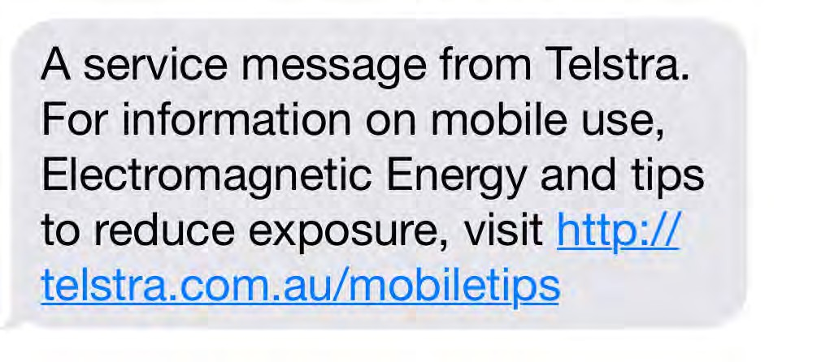
Telstra safety message being texted regularly to mobile customers in Australia
The WHO provides the following information on how to reduce mobile phone exposure
Use hands free device to keep mobile phone away from the head & body
Limit the number and length of calls
Use the phone in areas of good reception

Slide 6
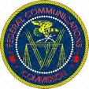

Standards for cell phones based on outdated assumptions
1997 typical user was military, medical, or business
Employs the head of a 220 lb male at the top 98% of military recruits in 1989
Designed to avoid heating after 6 minute call
Does not consider growing evidence of non- thermal impacts from chronic exposures

Slide 7
Since 1997 secondary insurers do not cover health damages from wireless
Lloyds of London denies coverage for health damages from wireless devices
Swiss Re 2014 rates electromagnetic fields as one of the 6 top risks businesses face today, above things like Mad Cow Disease.
“Risk from dangers linked to EMF can be classified as an emergent risk”-- the same category once occupied by asbestos
General Insurance Exclusions: Electromagnetic fields directly or indirectly arising out of, resulting from or contributed to by electromagnetic fields, electromagnetic radiation, electromagnetism, radio waves or noise.

Slide 8
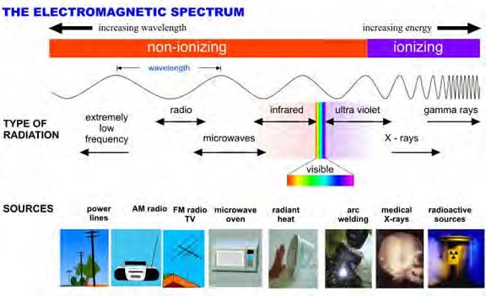
Electromagnetic Spectrum
Image credit: ARPANSA

Slide 9
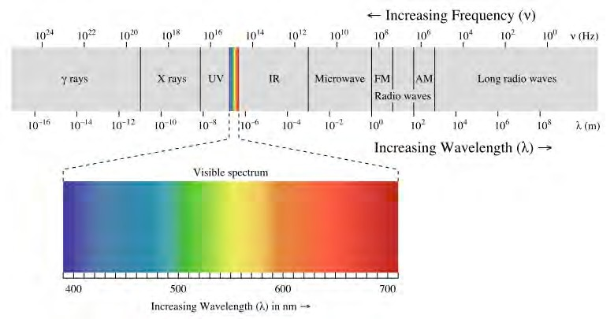

Electromagnetic Spectrum
Source:
Wikipedia (2008)
Microwaves:
Ovens
Cellphones (GSM-3G UMTS)
Cordless phones
Wi-Fi (WLAN)
Phones
Do not take without permission

Slide 10
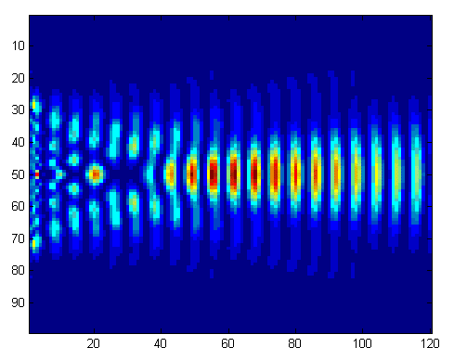
The impact of any form of radiation depends on the nature of the waves
Frequency
Amplitude
Pulse
Wavelength/Form
Information

Slide 11
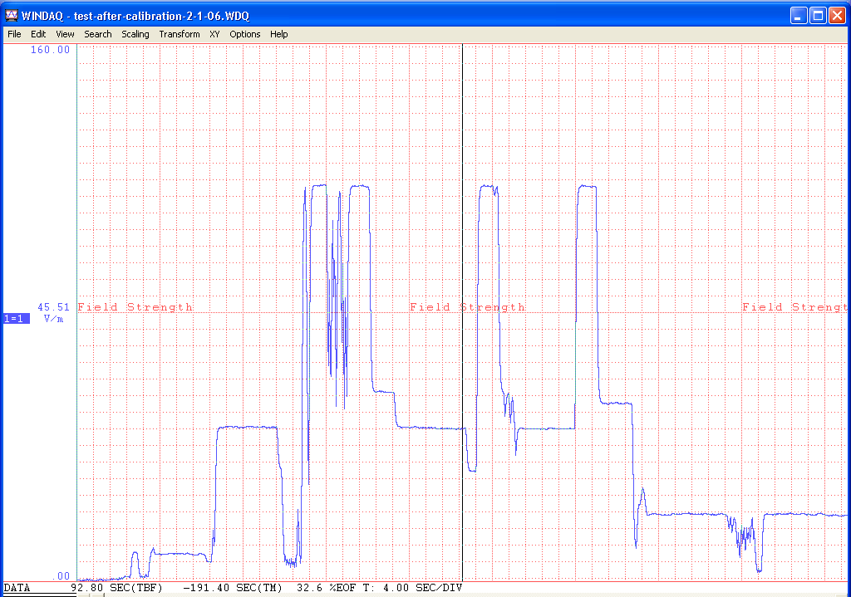

INTENSITY
V/m
SPEAKING
LISTENING
END OF CALL
RINGING
STAND-BY
Time 4 sec/division

Slide 12

Sunlight exposure is distinct from absorbed dose
Identical sunlight exposure results in different UV dose to my red- haired blue-eyed granddaughter and my darker daughter

Slide 13
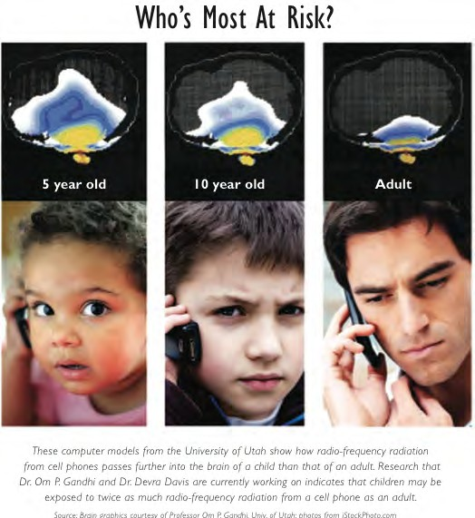
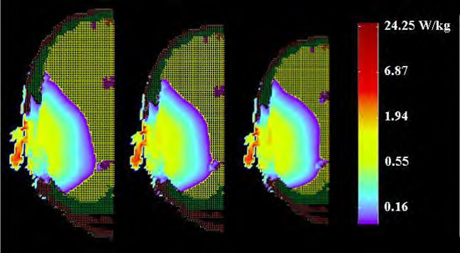
2-D modeling showed that children & smaller adults absorb more radiation than larger adults (1996, 2002)
Gandhi 1996 scaled relative absorption in child/adult, questioning whether the adult model adequately predicted child exposure
Gandhi and Kang 2002 confirmed proportionally greater absorption in smaller head

Slide 14
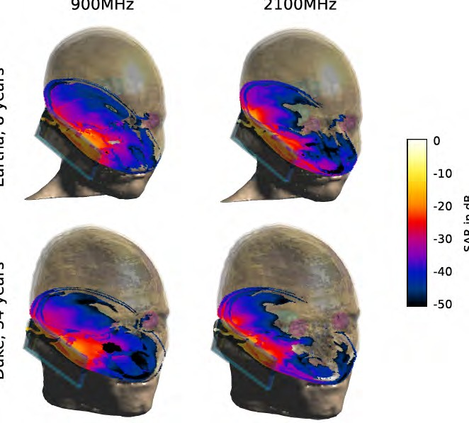
3-D anatomically based modeling reveal proportional diffe
in radiation dose in 8 & 34 year old heads
Fernandez et al, 2013

Slide 15
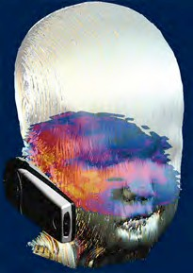
3-D modeling of dose at target tissue infant
exposure

Slide 16
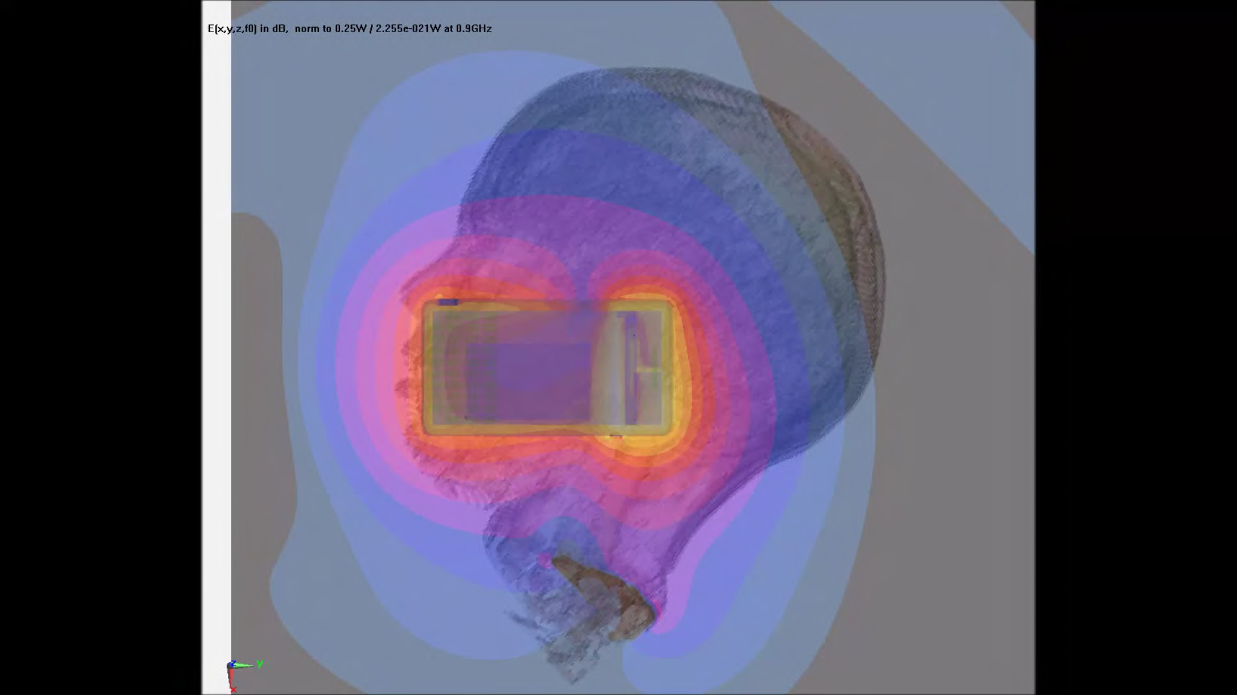
Modeled microwave radiation dose of six-year old showing greater levels to frontal and temporal lobes, eyes and cheek, extending into brainstem

Slide 17
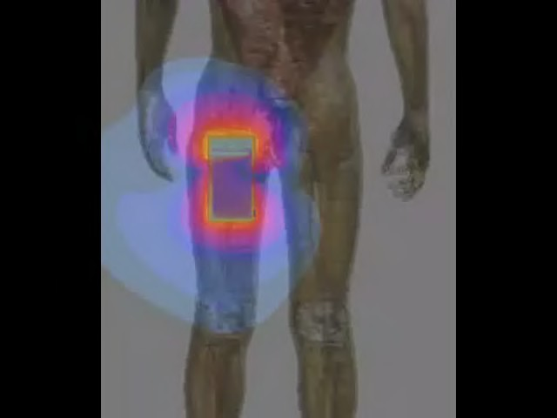
Mobile Phone in Pocket
Exposes Reproductive Organs and Bone Marrow

Slide 18
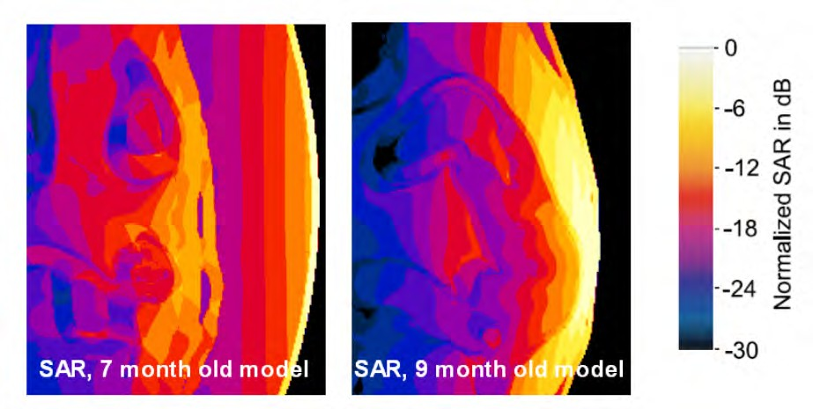
Greatest exposure occurs to fetal head/spinal cord Normalized SAR when 9 mos fetus exposed to a dipole antenna in front of abdomen
(courtesy Andreas Christ, IT’IS, 2013)

Slide 19

Cell phone radiation absorption in adult brain

Slide 20
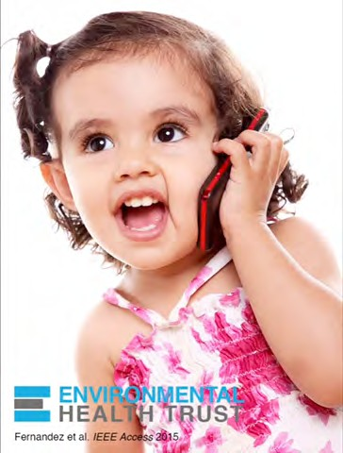
Relatively greater absorption into fast growing tissue

Slide 21
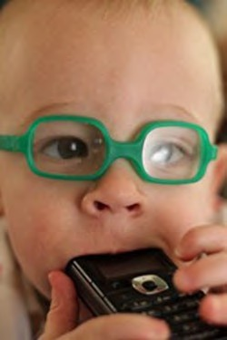
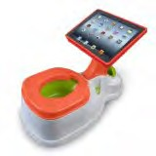
Repeated calls for ‘research’ on infants, toddlers, young children, pregnancy
Best Baby Apps parents.com calls iPad ‘best babysitter’
https://www.youtube.com/watch?v=U2Rrb9-­‐9NiQ

Slide 22






ATHENS UNIVERSITY
GAZI UNIVERSITY
Experimental Studies of Wireless Radiation Exposure
Pregnancy in Rats & Rabbits
Prof. Nesrin Seyhan
Chairman, Gazi University Faculty of Medicine Biophysics Department Ankara, Turkey
EHT Conference
Convened In collaboration with Turkish Ministry of Health, Istanbul
May, 2011

Slide 23
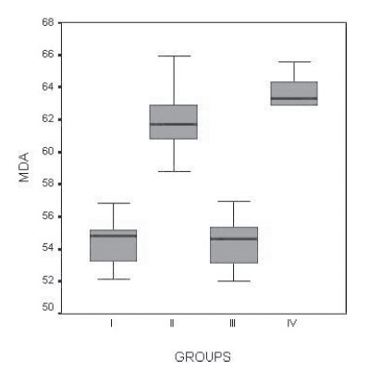
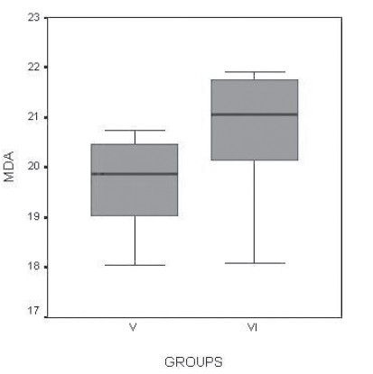
Biomarker of cellular damage increased in prenatally exposed compared to control groups
1800 MHz GSM-like RF radiation for 15min/day, 7 days.
Control Groups 1, III, and V show significantly less DNA damage than exposed
To wireless transmitting devices
Changes in the liver
Malondialdehyde
(MDA, nmol/g tissue) level.
All values are
expressed as median (IQR) values.

Slide 24
Prenatal exposure to microwave transmitting devices reduces brain & testes growth
Prof. Süleyman KAPLAN Department of Histology-Embryology Dean Medical School
Ondokuz Mayıs University skaplan@omu.edu.tr www.stereoloji.org/skaplan

Slide 25
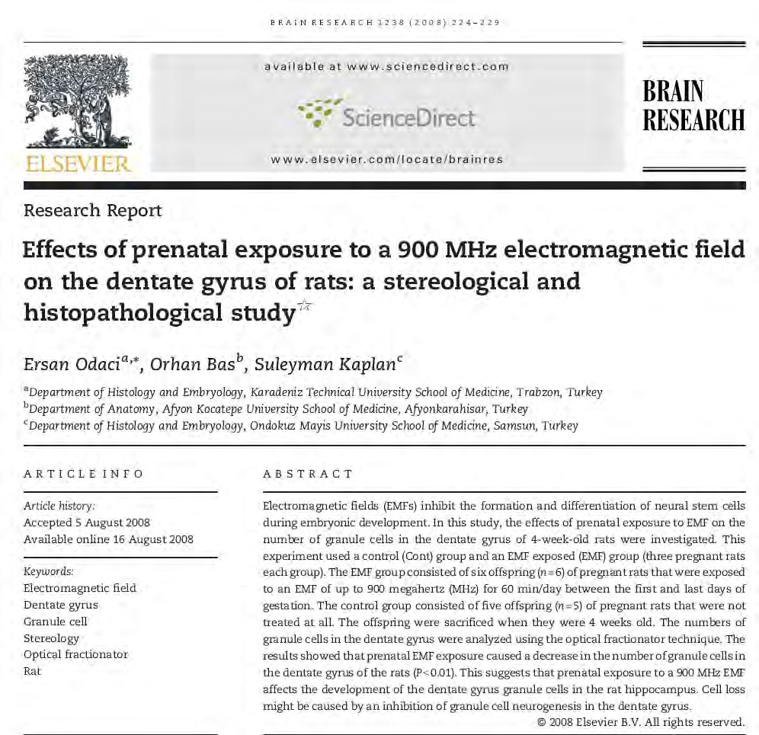
Prenatal 900 MHz EMF exposure decreased hippocampal granular cell number in the dentate gyrus of newborn rats

Slide 26

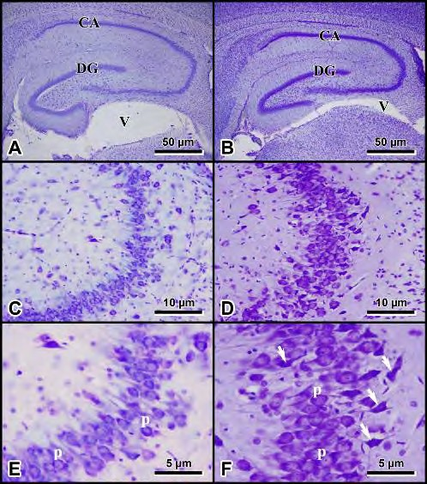
Prenatal exposure of 900 MHz EMF induces pyramidal cell loss in the hippocampus of newborn rats
Exposed Controls
RESULTS:
Prenatal exposure to wireless radiation damages cells of rat hippocampus –the thinking and memory Section of the brain (Odaci et al., 2008)

Slide 27
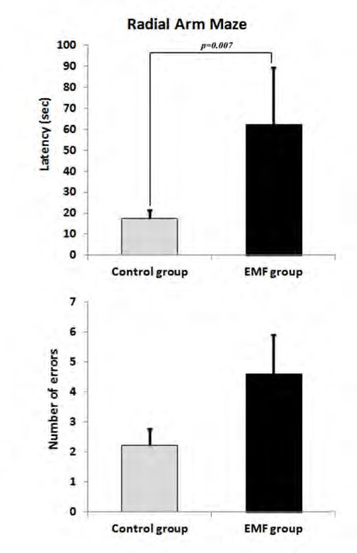
Prenatally exposed newborns have impaired memory and learning
Figure 2. Radial arm maze test results from the newborn control and newborn electromagnetic field (EMF) groups.
Exposed newborns took three times as long to find their way out of an experimental maze and made twice as many errors (p=0.007)

Slide 28
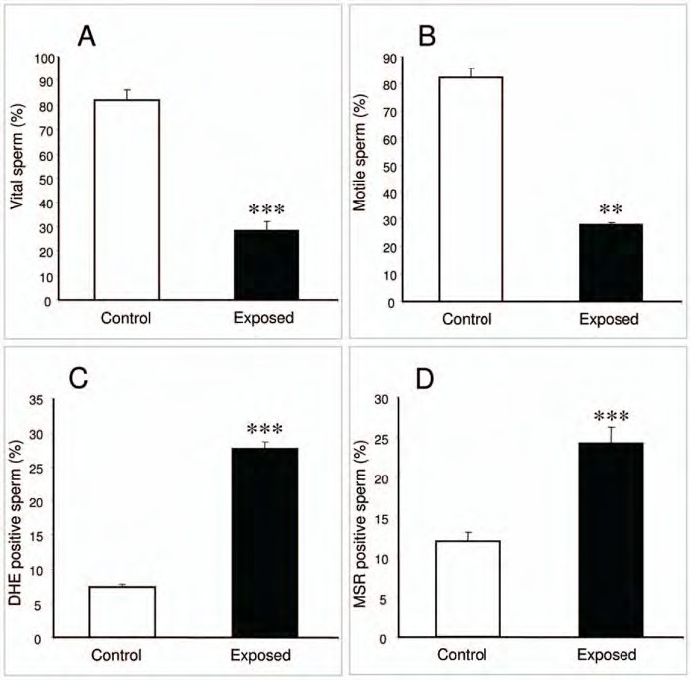

Experimental studies find mobile-phone exposed human sperm more damaged than controls
Do not take without permission
De Iuliis et al, 2009 with Laureate Professor John Aitken, Newcastle

Slide 29
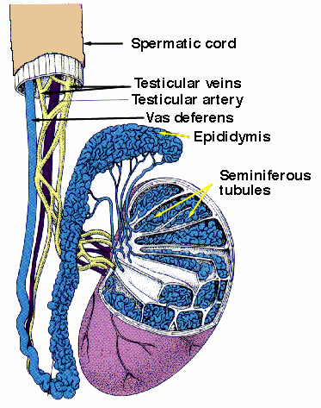
Heavier cell phone users have reduced sperm count
Sperm count
No Use 2 h/day 2h/day 4 h/day
Ashok Agarwal MD PhD, Cleveland Clinic, 2008; and seven other studies

Slide 30
Evidence for mobile phone radiation exposure effects on reproductive pattern of male rats: role of Reactive Oxygen Species
70 day old male rats exposed to cellphone radiation (middle- aged) 2 hours a day for 45 days
Lower testosterone
Increased enzyme tied with DNA damage (caspase-3)
Overall lower fertility with offspring showing diminished male reproductive capacity
Kesari KK¹, Behari J. 2012

Slide 31


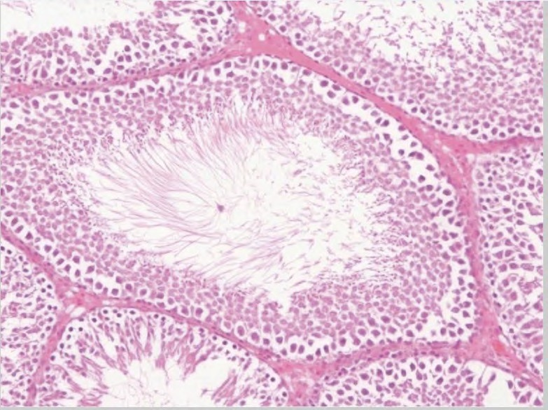

Slide 32
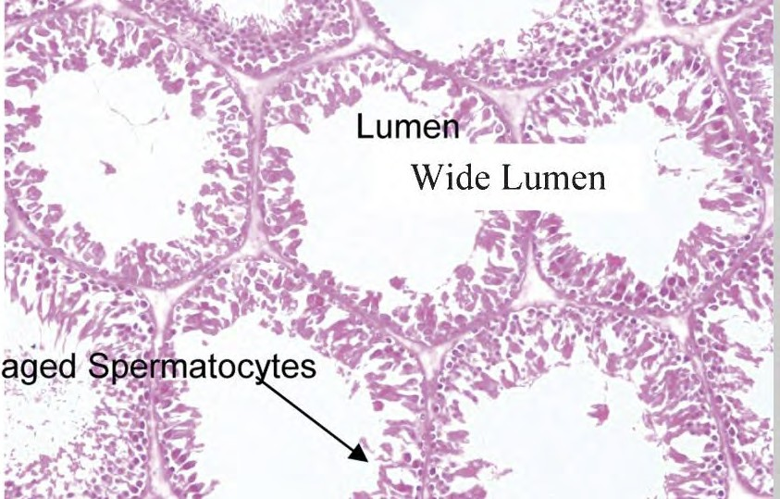

Slide 33
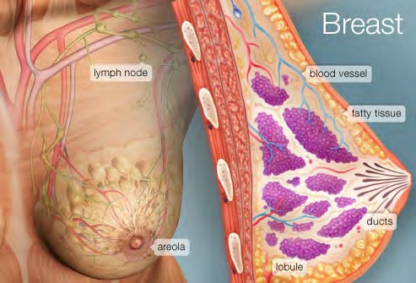
Fat and fluid cook in microwave oven Breast = chiefly adipose and fluid

Slide 34
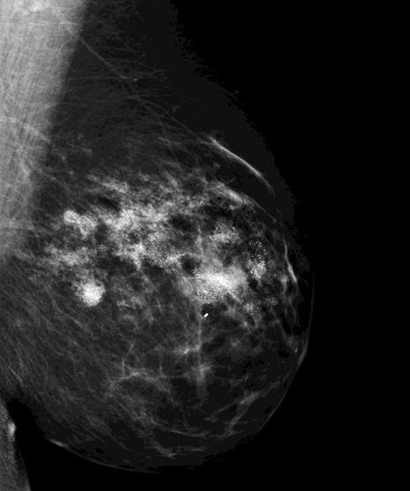
Caveat - first case report, 2009
Invasive multiple primary tumors in 34 year old, avid runner Chinese-American woman who used cell phone 4 hours a day in her bra for 10 years
—reported by Robert Nagourney, MD, PhD

Slide 35
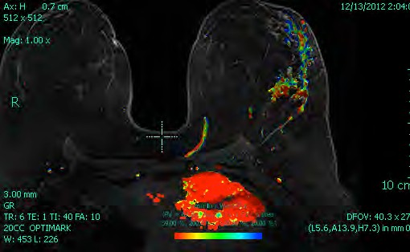
Case Reports - 21 yr old multi-focal tumors tied with cellphones kept in bra
John West et al

Slide 36
Summary of 38+ Cases
Negative for BRCA1/2—NO known genetic risks
No family history or other risk factors
Multi-focal tumors occur directly under phone antennas with mix of tubular/solid patterns of identical nuclear morphology & grade
No significant histology in ductal and lobular units away from the areas of cellular phone use
Two with metastases at young ages

Slide 37
Yale University studies report prenatally exposed mice do not develop normal brains or behavior
Fetal Radiofrequency Radiation Exposure From 800-1900 Mhz-Rated Cellular Telephones Affects Neurodevelopment and Behavior in Mice Scientific Reports, March 2012
Tamir S. Aldad, Geliang Gan ,Xiao-Bing Gao and Hugh S. Taylor (slides courtesy of Prof. Taylor)

Slide 38
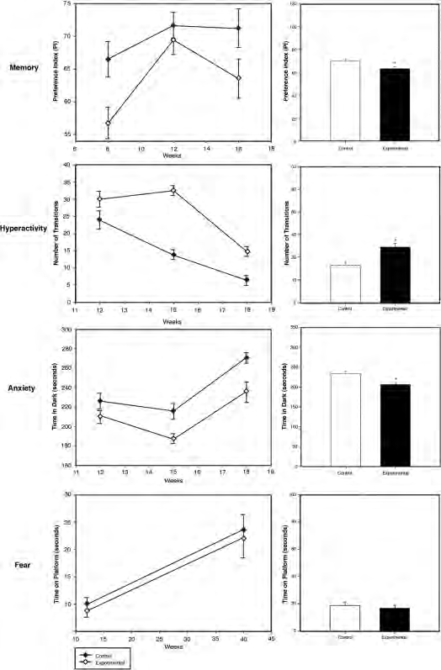
Prenatal RF-Exposure causes significant behavioral impacts in adults
Memory
Hyperactivity Anxiety
Fear

Slide 39
IARC RF working group: Press conference May 30, 2011, Lyon, France
Committee Chair Jonathan Samet: "the evidence, while still accumulating, is strong enough to support a conclusion and the 2B classification. The conclusion means that there could be some risk, and therefore we need to keep a close watch for a link between cell phones and cancer risk."
IARC Director Christopher Wild: "it is important that additional research be conducted into the long-term, heavy use of mobile phones. Pending the availability of such information, it is important to take pragmatic measures to reduce exposure such as hands-free devices or texting."

Slide 40
Cell phone radiation a “Human Carcinogen”
International Agency for Research on Cancer of the World Health Organization, 2011: declared cell phone and other wireless radiation:
“Possible Human Carcinogen”
EHT Experts, 2013
“Probable Human Carcinogen”
International Journal of Oncology

Slide 41
Increased Glioma risk 3 found in all case-control studies published since IARC 2011
 | Interphone (2010) | Interphone (App. | Hardell (2013) | CERENAT (2014)
 |  | 2)
 |  | (2010)
1640+ hours | 1.40* | 1.82* | 1.75* | 2.89* (896+ hrs)
10+ yrs | 0.98 | 2.18* | 1.79* | 1.61
20+ |  |  | 4-8* | 3+
*those beginning to use phones as teens have greatest risks

Slide 42
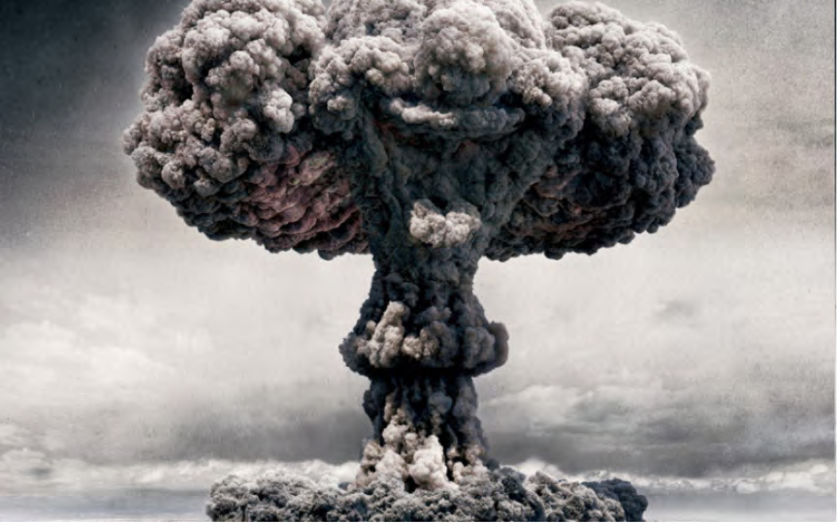
Atomic Bombs Japan, 1945
No increase in brain tumors was found in survivors
until 40 years later

Slide 43
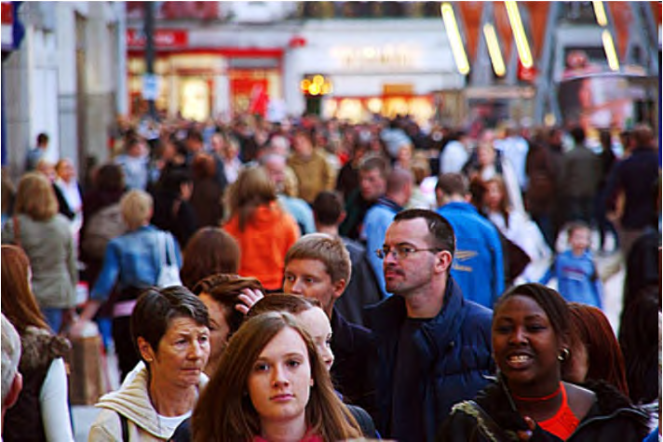
In most epidemiological studies, cell phones do not increase brain cancer
until after at least ten years of heavy use

Slide 44
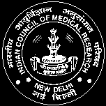
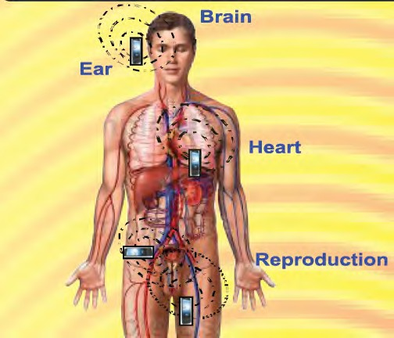

Radio Frequency Radiation and Human Health: Technical Studies from India
Dr. R. S. Sharma
Sr. Deputy Director General & Scientist-G Division of RCH
Indian Council of Medical Research New Delhi –110 029

Slide 45
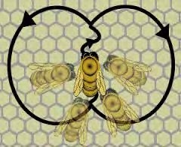
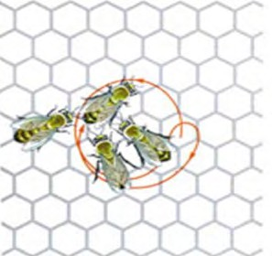
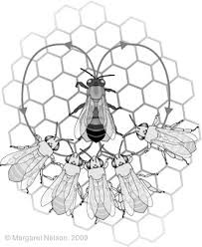
Decoding the language of the Honey Bees
Nobel Lecture, December 12, 1973 Karl Von Frisch
University of Munich, Federal Republic of Germany
Waggle Dance
Shacking Dance
Tremble Dance

Slide 46
Electromagnetic radiation (EMR) damages Honey Bees (Sainudeen, 2011)
Control hives, n=3
All workers return to hives
10 day
Test hives, n=3
After few days the workers never return to hives
10 day
Colony Collapse/ Disrupting Syndrome
Only queen, eggs & hive bounds immature worker bees
Thriving hives deserted

Slide 47

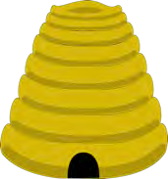
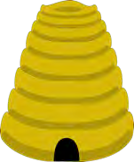


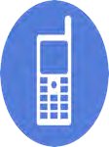
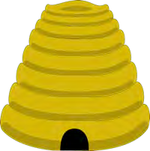
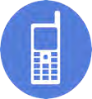
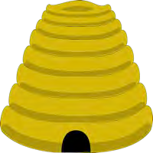


Wireless Repels Honey Bees
After 10 minutes of cell phone radiation. daily for 10 days worker bees did not return to test colonies.
3 Hives Exposed 3 Hives Controls
Sainudeen Sahib.S, Electromagnetic Radiation (EMR) Clashes with Honey Bees, INTERNATIONAL JOURNAL OF ENVIRONMENTAL SCIENCES Volume 1, No 5, 2011

Slide 48
Why so many inconsistent results?
It is truly complicated
Different cells studied, i.e., adult lymphocytes compared to neuronal stem cells
Different exposures used (CW/Digital)
Sponsored research can induce publication bias, i.e., most industry sponsored research finds no effect and while independent research finds an effect (Lai et al, 2008)
Secret Industry memo in 1994 to conduct “war-games” to discredit the scientists and the science

Slide 49
Policy Responses
Right to Know Laws & Policies
  Labeling
  Headsets Provided with all phones
Changes in Hardware/Antennae
Changes in Software/OS
Challenges to Evidentiary Burden of Proof
  Daubert
  Frye

Slide 50
What is to be done?
Standardized metrics for evaluating personal exposures (OGC)
Opportunistic cross-sectional surveys
  Memory
  Reaction time/accuracy
  Reproductive health
Promoting wired school programs with mobile tablet banks
Public educational programs sharing ‘fine print’ advisories
  Parents
  Teachers
  Health professionals

Slide 51
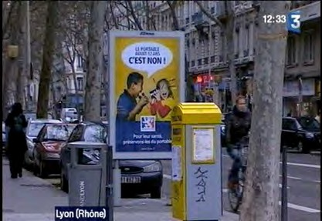
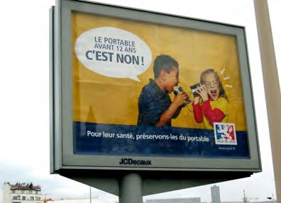
May 2010 French House of Deputies and Senate Chamber passed law
Bans on advertising to young children
All cell phones sold with ear pieces
Labeling of SAR on phone
Restrictions for childrens’ use
Warnings for all users overall to reduce direct radiofrequency
Radiation to the brain
FRANCE, DECEMBER 2008

Slide 52
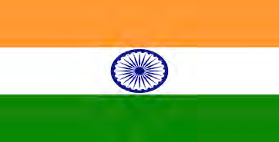
India
2012 Exposure Limits lowered to 1/10 of ICNIRP SAR labeling mandated on phones.
Official Guidelines For Cell Phone Use
Use Headsets or Speakerphones
Limit cell use and choose landlines
Increase distance from devices
EMF Webpage of Ministry of Communications and Information Technology educates the public to reduce cell phone radiation exposure in detail.
2013: Indian Supreme Court upheld Rajasthan State Court decision to remove all cell towers from the vicinity of schools, hospitals and playgrounds because of radiation “hazardous to life.”

Slide 53
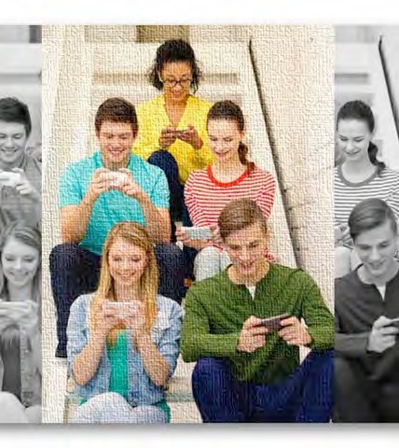
Israel has national institute on non-ionizing radiation
No Wi-Fi in kindergarten
Prefer wired over wireless in schools
All phones come with headsets and information about safety
No advertising with children

Slide 54


Belgium Law Implemented 2014
No phones designed or sold for children under age 7
All handsets sold with headsets
Safety Information Readily available
SAR publicly accessible wherever mobile phones are sold as well as on the Internet
Children’s mobile phones may no longer be sold. Besides this, the speciﬁc absorption rate (SAR) has to be listed for every mobile phone at the point of sale.
As of 1 March 2014, the sale of mobile phones that have been specially manufactured for young children (under 7s) will be prohibited.

Slide 55

Canada
Health Canada’s Official “Practical Advice” on reducing exposure to wireless radiation.
Limit the length of cell phone calls,
Replace cell phone calls with text, use "hands-free" devices and
Encourage children under the age of 18 to limit their cell phone usage
2015: National Bill 648: An Act Respecting the Prevention of Potential Health Risks From Radiofrequency Electromagnetic Radiation”
2015: Canadian Parliament Report “Radio Frequency EMF and the Health of Canadians” 12 recommendations
  Awareness campaign on cell phones and Wi-Fi
  Policy measures on the marketing to children
  Funding for research.

Slide 56
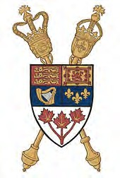
Canadian Parliamentary Health Committee urges that test system be updated & public educated about risks
Based on flawed modeling of total head absorption and inaccurate analyses using homogenous liquid (Morris et al, 2015, IEEE/Access in press)
Does not take into account
  Dose at the target tissue of brain
  Developmental immaturity of young brain
  Non-thermal biological impacts
  Impacts on pregnancy, sperm and nervous system
  Proliferation of apps for infants and toddlers
  microwave radiation is now a "serious public health issue” June 18, 2015

Slide 57
US. District Court ruling 2014
“If there is even a reasonable possibility that cell phone radiation is carcinogenic, the time for action in the public health
and regulatory sectors is upon us. Even though the financial and social cost of restricting such devices would be significant, those costs pale in comparison to the cost in human lives from doing nothing, only to discover thirty or forty years from now that the early signs were pointing in the right direction. If the probability of carcinogenicity is low, but the magnitude of the potential harm is high, good public policy dictates that the risk should not be ignored.”

Slide 58
Cell Phone Right To Know Ordinance
Unanimously passed by City of Berkeley California defended by Harvard Law Professor Lawrence Lessig and Yale Law Dean Robert Post
May 2015: requires cell phone retailers provide a fact sheet
"The City of Berkeley requires that you be provided the following notice:
To assure safety, the Federal Government requires that cell phones meet radio frequency (RF) exposure guidelines. If you carry or use your phone in a pants or shirt pocket or tucked into a bra when the phone is ON and connected to a wireless network, you may exceed the federal guidelines for exposure to RF radiation. Refer to the instructions in your phone or user manual for information about how to use your phone safely."

Slide 59
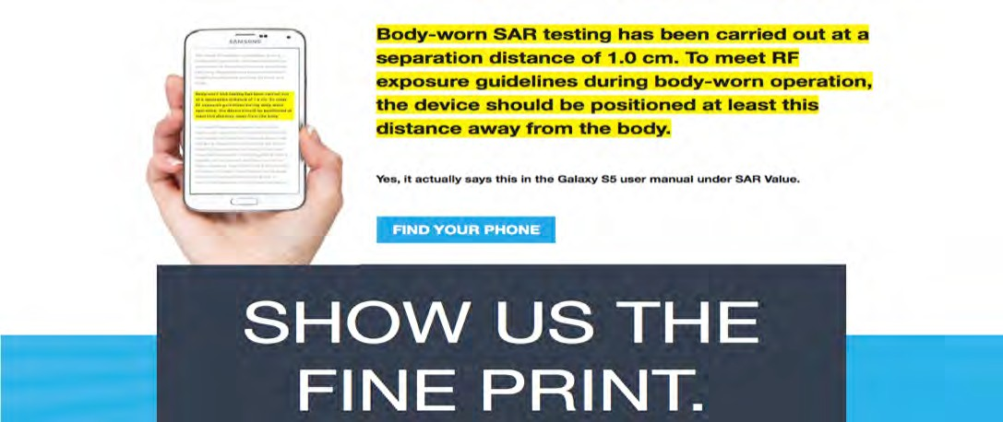
showthefineprint.org

Slide 60
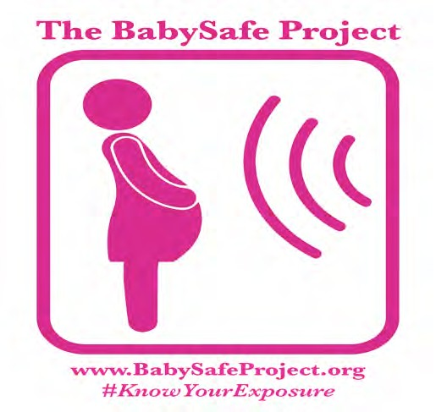
Baby Safe Project Underway Globally to Promote Precautions During Pregnancy
“As a research scientist and physician...I am deeply concerned about the growing exposure to cell phone and other wireless radiation”
Hugh Taylor, MD PhD
Chief Yale- New Haven Hospital

Slide 61
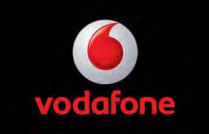
VODAFONE
FORM 20-F
(Annual and Transition Report (foreign private issuer))
Filed 06/10/14 for the Period Ending 03/31/14
“Principal Risks Factors and Uncertainties # 7: Our business may be impacted by actual or perceived health risks associated with the transmission of radio waves from mobile telephones, transmitters and associated equipment.
Risk: Concerns have been expressed that electromagnetic signals emitted by mobile telephone handsets and base stations may pose health risks. Authorities including the World Health Organization (‘WHO’) agree there is no evidence that convinces experts that exposure to radio frequency fields from mobile devices and base stations operated within guideline limits has any adverse health effects.
A change to this view could result in a range of impacts from a change to national legislation, to a major reduction in mobile phone usage or to major litigation.”

Slide 62

China Mobile Limited
UNITED STATES
SECURITIES AND EXCHANGE COMMISSION FORM 20-F 2014
“Actual or perceived health risks associated with the use of mobile devices could materially impair our ability to retain and attract customers, reduce wireless telecommunications usage or result in litigation.”
“...we cannot be certain that future studies, irrespective of their relative reliability or trustworthiness, will not impute a link between electromagnetic fields and adverse health effects.”
“Research into these issues is ongoing by government agencies, international health organizations and other scientific bodies in order to develop a better scientific understanding and public awareness of these issues…”
http://www.chinamobileltd.com/en/ir/reports/ar2014/2014_20f.pdf

Slide 63

AT&T
2014 Annual Report
“Unfavorable litigation or governmental investigation results could require us to pay significant amounts...”
As we deploy newer technologies, especially in the wireless area, we also face current and potential litigation relating to alleged adverse health effects on customers or employees who use such technologies including, for example, wireless handsets.
We may incur significant expenses defending such suits or government charges and may be required to pay amounts or otherwise change our operations in ways that could materially adversely affect our operations or financial results.”
http://www.att.com/Investor/ATT_Annual/2014/downloads/att_ar2014_annualreport.pdf

Slide 64
Would you give two cents?*
*Monthly fee on all devices, users, IP providers to support:
Cross-disciplinary training programs in bioelectromagnetics for engineers, docs & computer scientists
Identify data gaps and R & D needs re hardware/software reconfigs & research priorities
Monitoring of special populations similar to drug surveillance for biological impacts of mobile phones and wireless,
  hearing, memory, reaction time, insomnia, & other behavioral endpoints
  Sperm count & other measures of reproductive health

Slide 65
So how can you minimise exposure?
Avoid carrying your mobile phone on your body (e.g. in a pocket or bra)
Avoid holding any mobile phone against your body when in use (i.e against your head)
Use your mobile phone on loud speaker or with an “air tube” headset
Put your mobile phone on ‘airplane mode’ when not in use
Avoid using your mobile phone in cars, trains or elevators
Keep mobile phones away from you when you are asleep (out of the bedroom)

Slide 66
Materials used with permission- thank you!
Ashok Agarwal MD PhD, Cleveland Clinic
John Aitken, MD, Laureate Prof. and Pro Vice-Chancellor, Newcastle
Frank Clegg, former President Microsoft Canada
Alvaro De Salles, Claudio Fernandez, Brazilian Federal Universities,Rio Grande de Sul
Joel Moskowitz, PhD, University of California Berkeley
Nesrin Seyhan, Suleyman Kaplan, Gazi and Ondokuz Mayis Universities
Robert Nagourney MD PhD, Rational Therapeutics, John West MD, Orange County Breast Center
Lisa Bailey MD, former President American Cancer Society/California, breast surgeon
Lloyd Morgan,BSEE, Robert Morris,MD, PhD, Environmental Health Trust
R.S. Sharma, MD, PhD India Council of Medical Research
Hugh Taylor MD PhD, Yale University
Lukas Margaritis, MD University of Athens

Slide 67
The world is not dangerous because of those who do harm, but because of those who look at it without doing anything
- Albert Einstein

Slide 68
Questions?
ehtrust.org
facebook.com/EHTrust
Mobile Phones & Wi-Fi Devices Emit Pulsed Microwave
Radiation
@saferphones
@devraleedavis
eh

Slide 69
Slides for discussion
copyright@ www.ehtrust.org permission granted only for limited use with attribution to Environmental Health Trust copy to info@ehtrust.org
11/29/15
69

Slide 70

Scientiﬁc Collaborators
Prof. Claudio Enrique Fernandez-Rodriguez , Federal Institute for Education, Science and Technology of Rio Grande do Sul – IFRS, Canoas, RS, Brazil
Prof. Alvaro Augusto A. de Salles , Electrical Engineering Department, Federal University of Rio Grande do Sul – UFRGS Porto Alegre, RS, Brazil,
Prof. Emeritus, Anthony B. Miller MD, FRCP, FRCP (C), FFPH, FACE, Univ of Toronto
Annie Sasco, MD DrPH, former Unit Chief of Epidemiology for Cancer Prevention at the International Agency for Research on Cancer (IARC) in Lyon, France, Prof. INSERM
Robert D. Morris, MD, PhD, and Lloyd Morgan B.S. Electrical Engineer, EHT Sr Scientists Siegal Sadetzki MD MPH, Prof. Gertner Institute of Epidemiology, Tel Aviv

Slide 71

Digital Dementia Diagnosed in South Korean Children
Dr. Byun Gi-Won a cognitive expert from the Balance Brain Center in Seoul, South Korea states, “Young People who are heavy technology
users are likely to have a properly developed left hemisphere of the brain while the right hemisphere will be unused and underdeveloped.”
71

Slide 72

Korean government studies on digital addiction and dementia
72

Slide 73

operability now!
Time to agree on a commonly used and widely blessed vocabulary and grammar for EMF!
copyright@ www.ehtrust.org permission granted only for
use with attribution
Environment
73

Slide 74
We lack uniform standards for measuring Electromagnetic Fields (EMF)
Radio frequency spectrum is a limited (though instantly renewable) natural resource essential to modern civilization, yet there is no common language to describe it!
Many domains need to record and process data about real world EMF emissions and measurements.
Wireless provider operations
Bioelectro- magnetics research
Wireless technology R&D
Defense & Intel. signal intelligence
Physics research
Government regulation of EMF use | Remote sensing operations and R&D | Others? Future uses …?
3. Data communication requires standards.
Open standards maximize opportunities for communication between systems. A standard data model provides a basis for standard interfaces and/or Semantic Web best practices.
A standard data model supports efficient publishing, discovery, assessment, access, aggregation and use of data.
A standard data model provides a template for rigorous and useful data collection and aggregation. In research, this enables comparison, verification, averaging of results, longitudinal studies, cross-disciplinary studies etc.
Open standards create opportunities for innovation and new markets. Convergence of digital and wireless is still new, still ripe for innovation.
copyright@ www.ehtrust.org permission granted only for limited use with attribution to Environment
74

Slide 75



An open standard would open up opportunities for cloud analytics and apps
details
75

Slide 76



Open Geospatial Consortium
Not-for-profit, international consortium of 500+ industry, government, and university members, including Google
Founded in 1994
Work based on collaboration and consensus
Members set policies and procedures.
Many alliance partners: W3C, OASIS, ITU, ISO, Smart Grid Interoperability Panel, buildingSMART International, etc.
OGC Mission
Deliver geospatial data encodings,interface standards and best practices that are openly and freely available for global use.
copyright@ www.ehtrust.org permission granted
only for limited use with attribution to Environmental
76
Heal¹th¹T/r²u⁹st/c¹o⁵py to info@ehtrust.org

Slide 77












































Abstract models and implementation models
Implementation models model how features, phenomena and relationships are to be encoded for a particular software implementation platform.
SQL
CSV
XML
Abstract and/or conceptual model models what needs to be described/modeled in software (location, orientation, time, signal type, frequency, pulsing characteristics,
energy intensity max/min, etc.). Includes relationships and units of measurement.
copyright@ www.ehtrust.org permission granted only for limi₁t₁e/d₂₉u_{/1}s₅e with attribution to Environmental Health Trust copy
77

Slide 78

Example OGC standard: OGC WaterML 2.0
SITUATION: Nations seek to provide integrated national and cross-border views of fresh water resources. Also, there is increased need for the exchange of hydrologic data to improve our understanding of complex environmental processes, such as climate change.
PROBLEM: 2005 Global Climate Observing System (GCOS) report: “There are no established international standards on the
acquisition of river data, the set of required metadata, data formats, and transmission modes.”…
CSIRO (Australia)
San Diego Supercomputer Center (US)
Australian Bureau of Meteorology Geological Survey of Canada, Nat. Resources Canada
USGS (US)
KISTERS AG (Private sector – Germany)
APPROACH
WMO (World Meterological
Organization , an International team of hydrologic organizations came together to form the OGC WaterML 2.0 Standards Working Group. They used OGC’s rapid prototyping process to develop the WaterML 2.0 standard.
NOAA (US)
Deltares (Independent institute - Netherlands) Federal Waterways Engineering and Research Institute
disy Informationssysteme GmbH (Germany)
German Federal Institute of Hydrology International Office For Water – Sandre (France)
htrust.org permission granted only for limited use with attribution t
SOLUTION: WaterML2.0 is a standard information model for the representation of water observations data, with the intent of allowing the
exchange of such data sets across information systems. Based on existing OGC standards, it is used to address a range of exchange requirements.
copyright@ www.e
o Environment
78

Slide 79
Collaboration is needed to address complexity.
Complexity makes data integration and communication difficult.
Collaboration make integration and communication possible.
EMF are complex:
_Frequency or frequencies
_Modulation type & other pulse details (waveform parameters)
_Polarization
_Energy intensity max/min.
_Energy intensity ave.
_Location & orientation
_Time
_Unique source ID?
_Sensor or emitter specs
_Etc.
Spatial data are complex:
_Vector, raster, point clouds and other types data
_Diverse Earth coordinate reference systems & Earth shape models (geodesy)
_ 2D, 3D, 4D and nD
_Conﬂating semanticly diﬀerent data
_Conﬂating precise and imprecise data
_Harmonizing with other standards for spatial features and phenomena
_Navigating IT trends, e.g. database > services > linked data etc.
OGC members who are EMF domain experts will bring this expertise to working group meetings.
OGC staff and OGC members who are spatial technology experts will bring this expertise.
copyright@ www.ehtrust.org permission granted only for limited use with attribution to Environment
79

Slide 80
Why the Open Geospatial Consortium (OGC)?
EMF instances are inherently spatial. All
  have a point or region of origin. All EMF instances that we observe have one or more points at which observations are collected.
  are aﬀected by the media they travel through.
  are absorbed, reﬂected, and refracted by the objects and phenomena they impinge upon.
  have eﬀects on the objects and phenomena they impinge on.
The OGC focuses on spatial and temporal encoding and interface standards.
  Historically, OGC’s focus was solely geospatial.
  Recently, OGC members are working with other standards organizations on convergence of geospatial data & technology with data & technologies used to model the built environment.
  Basic principles of modeling macrospatial and mesospatial features and phenomena can be extended to microspatial and nanospatial (and nanotemporal) features and phenomena.
The OGC’s standards poroolio includes a comprehensive poroolio of standards for description and management of sensors and sensor data.
The OGC’s membership includes a broad range of companies and organizations that might participate in developing an EMF standard.
copyright@ www.ehtrust.org permission granted only for limited use with attribution to Environment
80

Slide 81

Martha Herbert MD, PhD, Harvard Medical School Concerned About RF Increasing Autism Risk, 2013
“With dramatic increases reported in autistic spectrum disorders coincident in time with the deployment of wireless technologies, we need aggressive investigation of potential …EMF/RFR links. The evidence is sufficient to warrant new public exposure standards benchmarked to low-intensity (non- thermal) exposure levels now known to be biologically disruptive, and strong, interim precautionary practices are advocated.”
copyright@ www.ehtrust.org permission granted only for
11/29/15 limited use with attribution to Environmental Health Trust copy 81
to info@ehtrust.org

Slide 82


Worldwide Cell Phone Advisories
Belgium 2013:
The Public Health Minister bans cell phone sales both in shops and online
to children under 7 years old. Cell phone advertisements are also banned during children’s TV programs.
Australia 2013:
The federal government’s Australian Radiation Protection and Nuclear
Safety Agency (ARPANSA) has created a fact sheet providing citizens ways to reduce exposure from wireless devices. The agency advises that parents limit children’s exposure to cell phones.
82

Slide 83


Worldwide Cell Phone Advisories
Italy 2012:
On October 12th, 2012 the Italian Supreme Court ruled in favor of
an Italian business man who claimed that his brain tumor developed from using cell phone 5-6 hours a day
France 2013:
The French National Assembly bans Wi-Fi in schools until it is proven to be safe for human consumption and in nurseries.
83

Slide 84

Worldwide Cell Phone Advisories
Turkey 2013:
Governor Aksoy Huseyin, of the Samsun province is launching a cell
phone campaign using EHT’s pamphlets and health/science materials.
84

Slide 85

85

Slide 86

86

Slide 87

Melatonin Protects Against 1800 MHz RF Radiation Damage
Xu et al
Brain Research, 2010
87

Slide 88
Precautions Noted by the FCC, FDA, and ACS as of September, 2010
Use an earpiece or headset.
Avoid continually wearing a wireless earpiece
Keep wireless devices away from your body when they are on
Use speakerphone
or purchase a low SAR phone to reduce exposure to the head.
Consider texting rather than talking, but donʼt text while you are driving.
Can limit talk time
88

Slide 89

We protect children in car seats
Different carseats and distances at different ages
Am Acad. Pediatrics recommends
89

Slide 90

Radiation Risks of CT Scans
Equivalency in chest x- rays*
Approximate Equivalent Dose to Relevant Organ (mSv)
Machine Setting
Relevant Organ
Exam Type
.15-.01 mSV
Pediatric Head CT Scan | Unadjusted¹ | Brain | 60 | 400-6000
Pediatric Head CT Scan | Adjusted² | Brain | 30 | 200-3000
Pediatric Abdominal CT Scan | Unadjusted | Stomach | 25 | 166-2500
Pediatric Abdominal CT Scan | Adjusted | Stomach | 6 | 40-600
Chest X-ray (PA/lateral) | n/a | Lung | 0.01/0.15 | 1
90

Slide 91
As Low as Reasonably Achievable in Pediatric CT Scans
Children ten times more vulnerable than adults to radiation (Int’l Com Radiol Prot, 1991)
Quality of CT image better with higher radiation
Many unnecessary tests ordered in children and adults
Slovis, Pediatric Radiology, April 2002
91

Slide 92


Recommendations
Avoid carrying your cell phone on your body (e.g. in a pocket or bra).
Avoid holding any wireless device against your body when in use.
Use your cell phone on speaker setting or with an “air tube” headset.
Avoid using your wireless device in cars, trains or elevators.
Avoid cordless phones, especially where you sleep.
92

Slide 93


How to Practice Safe Tech
#PracticeSafeTech
Whenever possible, connect to the internet with wired cables.
When using Wi-Fi, connect only to download, then disconnect and disable Wi-Fi.
Avoid prolonged or direct exposure to nearby Wi-Fi routers.
Unplug your home Wi-Fi router when not in use (e.g. at bedtime).
Sleep as far away from wireless utility meters (i.e. “smart” meters) as possible.
93

