Slide 1

The Business & Scientific Case for Precautions with Microwave Radiation:
Why & How to Ensure Safer Technology
Devra Davis, PhD MPH
President, Environmental Health Trust September 21, 2015
Wireless Communication 2015 Conference Baltimore, Maryland

Slide 2
Career Highlights
Danforth Foundation Fellow, University of Chicago, 1967-71, PhD in Science Studies
National Cancer Institute Senior Post-Doctoral Fellow in Epidemiology, Johns Hopkins University, 1981-82, MPH
Founding Director Board on Environmental Studies and Toxicology, National Research Council, National Academy of Sciences
1983-93 (group advising bans on indoor smoking)
Clinton Presidential Appointee 1994-99 National Chemical Safety & Hazard Investigation Board, with bi-partisan Senate approval
Visiting Professor, Hebrew University, Hadassah Medical Center and Ondokuz Mayis Medical School, Samsun, 2015-16
More than 200 technical publications, 11 edited monographs, 3 popular books,currrently Visiting Professor Hebrew University/ Hadassah Medical Center and Ondokuz Mayis Medical School

Slide 3

Presentation Overview
Regulatory Context & Secondary Insurance
Modeling Exposures
  Brains Child/Adult
  Pregnancy
Demonstrated Health Impacts
  Sperm Damage
  Pregnancy
  Genotoxicity
  Brain & Head Cancers
Breast Cancer Case Series
Honey Bee Impacts
Safety & Policy responses
R & D
Marketing opportunities
3

Slide 4
The Big Question
Is microwave radiation from mobile devices dangerous?

Slide 5
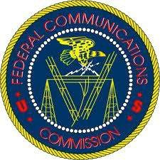
FCC standards for cell phones unchanged for 19 years
1997 typical user was military, medical, or business
Average call took less than 6 minutes
Employs the head of a 220 lb male at the 98% of military recruits in 1989
Designed to avoid heating after short period of time Does not consider growing evidence of nonthermal impacts
from chronic exposures

Slide 6
Secondary Insurers do not cover health damages from wireless
Since 1997 Lloyds of London denies coverage
Swiss Re 2014 rates electromagnetic fields as one of the 6 top risks businesses face today, above things like Mad Cow Disease.
“Risk from dangers linked to EMF can be classified as an emergent risk—” the same category once occupied by asbestos“
General Insurance Exclusions: Electromagnetic fields directly or indirectly arising out of, resulting from or contributed to by electromagnetic fields, electromagnetic radiation, electromagnetism, radio waves or noise.

Slide 7
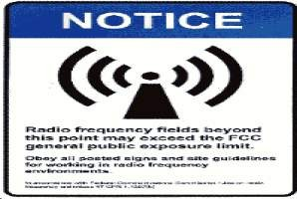
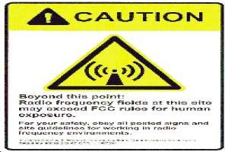
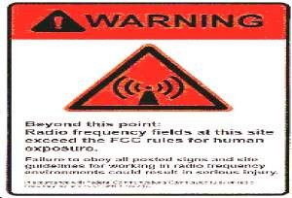
Typical Warning Signage for Antennas Not Uniformly Used

Slide 8
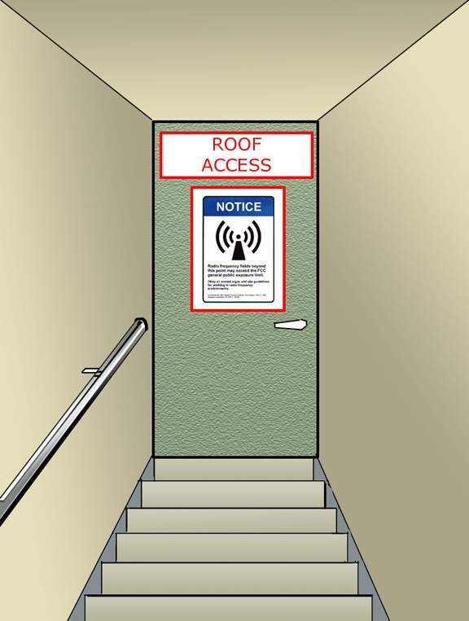
Sign at entrance to next exposure Category.

Slide 9
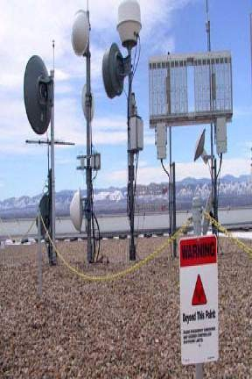
Warning Sign: “Beyond this point: Radio Frequency Exposure May Exceed Controlled Exposure Limits”

Slide 10
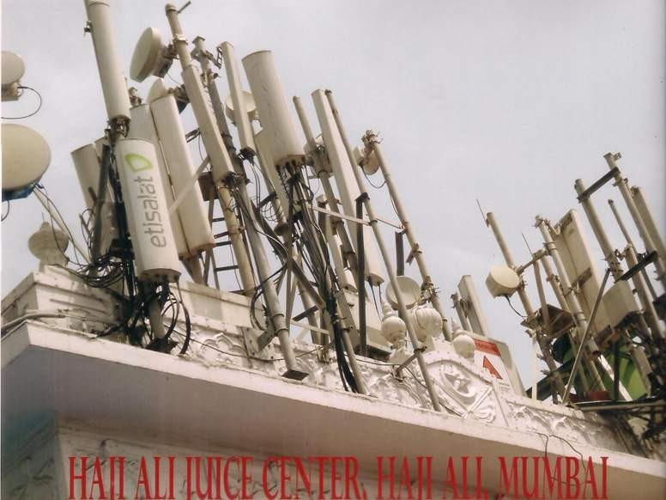
HAJI ALI JUICE CENTER

Slide 11
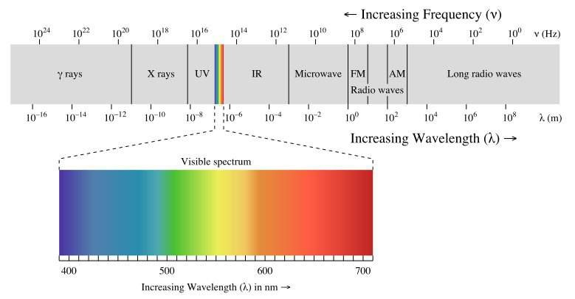
Radiation Electromagnetic Spectrum
Microwaves:
Ovens
Cellphones (GSM-3G UMTS)
Cordless phones
Wi-Fi (WLAN)
Cellphones Emit Pulsed Microwave radiation
Do not take without permission

Slide 12
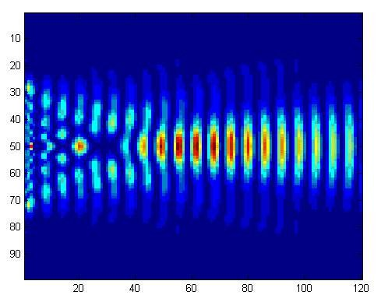
The impact of any form of radiation depends on the nature of the waves
Frequency
Amplitude
Pulse
Wavelength/ Form
Information
Do not take without permission

Slide 13
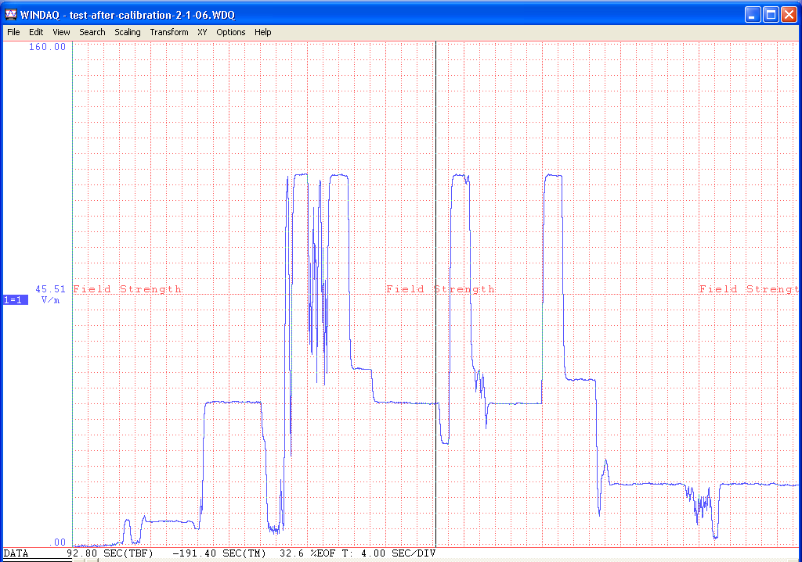


INTENSITY
V/m
SPEAKING
LISTENING
END OF CALL
RINGING
STAND-BY
Time 4 sec/division
Do not take without permission

Slide 14
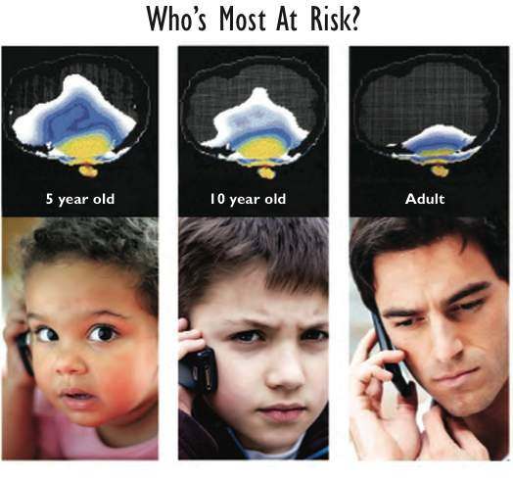

Gandhi 1996 scaled relative absorption in child/adult, questioning whether the adult model adequately predicted child exposure
Do not take without permission

Slide 15
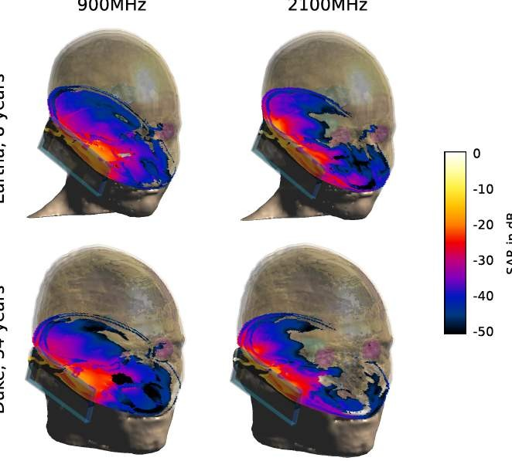
Sophisticated modeling shows anatomically based differences in radiation exposure from cell phones in 8 & 34 year old heads(Fernandez,
2013)
900 MHz
2400 MHz

Slide 16
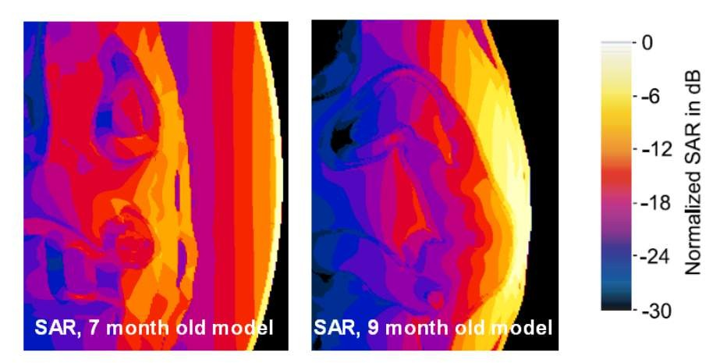
Greatest exposure occurs to 9 month fetus occurs when head is at the surface of the abdomen Normalized SAR for the mother and the fetus exposed to a dipole antenna in front of the abdomen
(courtesy Andreas Christ, IT’IS, 2013)

Slide 17
Claims that children/adults absorb the same amount of radiation
Foundation of current test system
Based on flawed modeling of total head absorption and inaccurate analyses (Morris et al, 2015, in press)
Does not take into account
  Dose at the target tissue of brain
  Developmental immaturity of young brain
  Non-thermal biological impacts

Slide 18
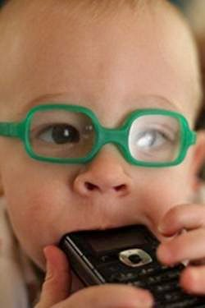
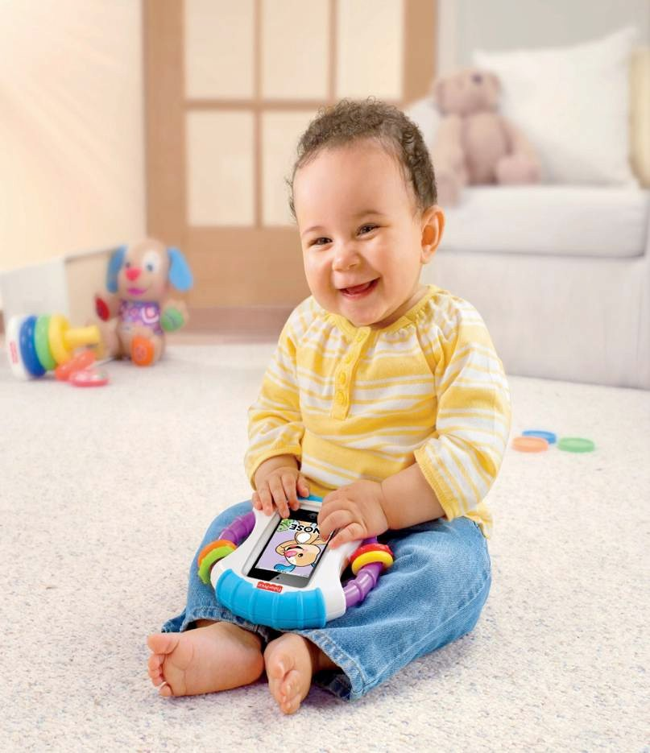
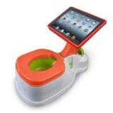
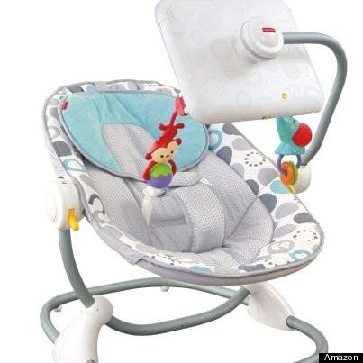
No long term studies on infants, toddlers or young children
https://www.youtube.com/watch?v=tzea37niEV0

Slide 19
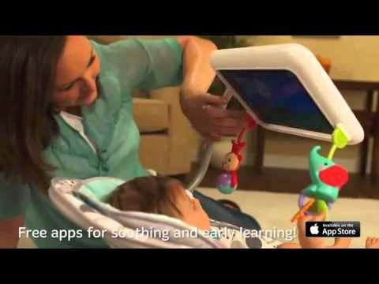

Slide 20
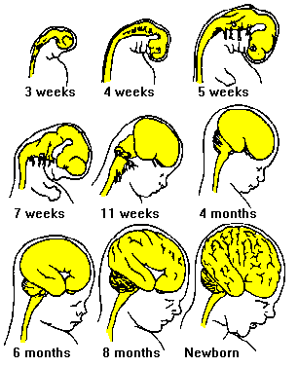
Brain grows rapidly throughout embryonic & early life so that child brain differs qualitative from adult
Hugh Taylor, 2013

Slide 21



Microwave Radiation
Positive Impacts
Treats liver cancer
Stops bleeding
Enhances uptake of drugs to brain
Detects cancer
Negative Impacts
Damages DNA
Disrupts blood brain barrier
Weakens & damages sperm
Changes brain metabolism
Do not take without permission

Slide 22
Breakthrough Applications
100 nanosecond pulsed non-thermal RF induces apoptosis in otherwise inoperable tumors (Nuccitelli et al 2015)
– Slated for human trials 2015
Electro-chemotherapy
Electro-immunology of vagus nerve (New Yorker, May 18, 2015)
Scientific American, 2015, clinical trials to treat rheumatoid arthritis with EMF/RF

Slide 23
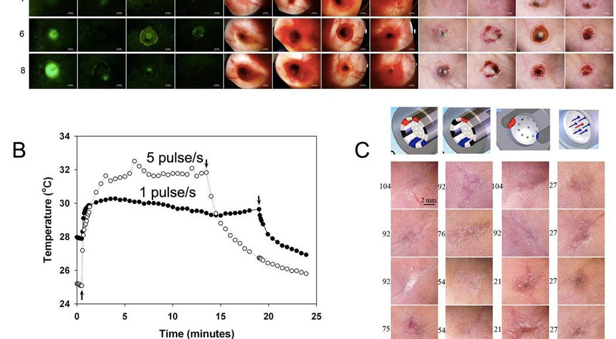
Melanoma Apoptosis induced by nanosecond electroporation, Nucitelli et al., 2015

Slide 24
Fetal Radiofrequency Radiation Exposure From 800-1900 Mhz-Rated Cellular Telephones Affects Neurodevelopment and Behavior in Mice
Tamir S. Aldad
Geliang Gan
Xiao-Bing Gao
Hugh S. Taylor
Scientific Reports, published March 2012 from Yale University Medical School

Slide 25
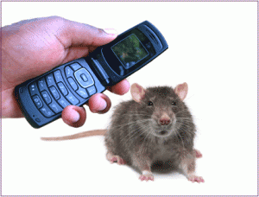
Fetal Brain Programming
Radiation-exposed 33 pregnant mice
42 pregnant controls

Slide 26
Study Design
A muted and silenced 800–1900Mhz cellular phones with a SAR of 1.6W/kg was used.
The phones were positioned above each cage over the feeding bottle area at a distance of 4.5–22.3 cm from each pregnant mouse.
Mice exposed as fetuses were tested as adults.

Slide 27
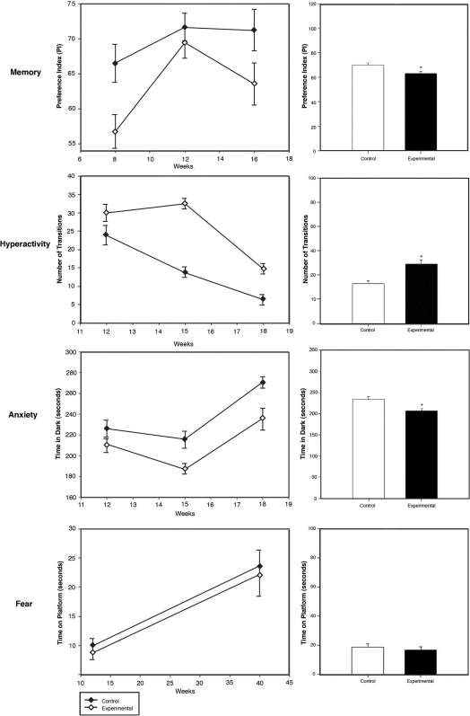
Prenatally RF-Exposed Adults Evidence
Significant Behavioral Impacts
Memory
Hyperactivity Anxiety
Fear

Slide 28
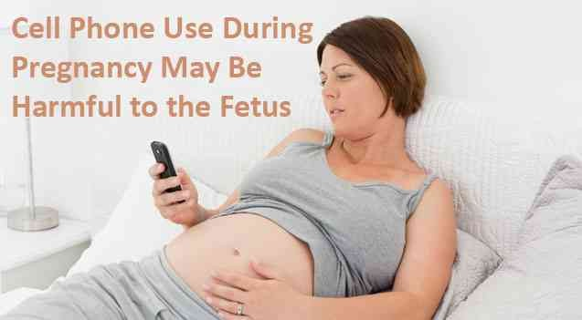
Women should be advised NOT to use cell phones near their abdomens
Hugh Taylor MD PhD Yale University www.babysafeproject.org

Slide 29
Prenatal 900 MHz EMF Exposure Decreased Hippocampal Granular Cell Number in the Dentate Gyrus of Newborn Rats
The research question:
Do prenatal electromagnetic fields (EMFs) affect adult brains

Slide 30

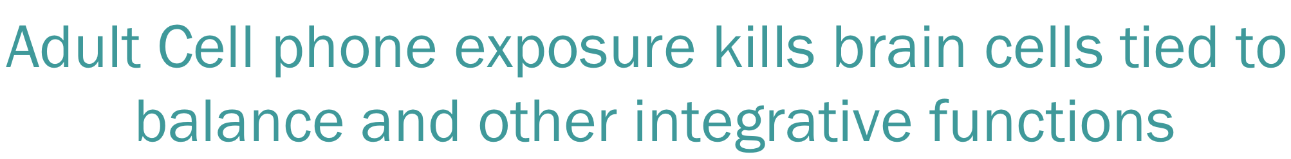
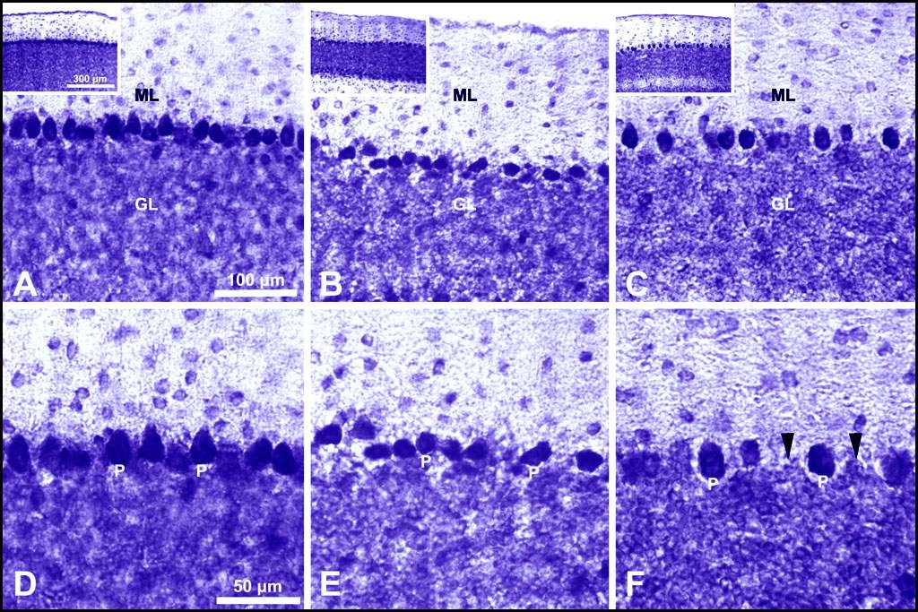
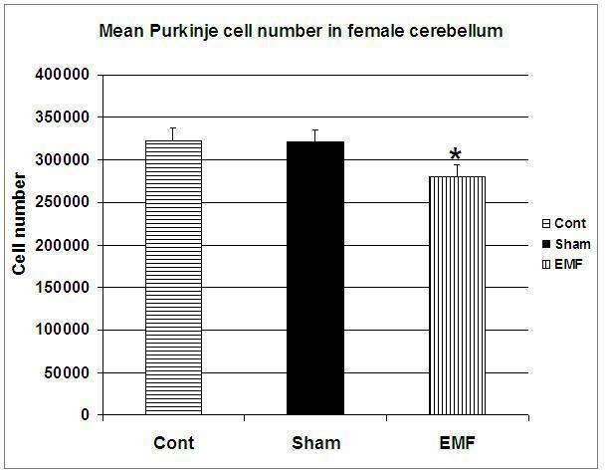
Adult Cell phone exposure kills brain cells tied to balance and other integrative functions
RESULTS:

Slide 31
Prenatal 900 MHz EMF Exposure Decreased Hippocampal Granular Cell Number in the Dentate Gyrus of Newborn Rats
The research question:
Do prenatal electromagnetic fields (EMFs) affect adult brains

Slide 32
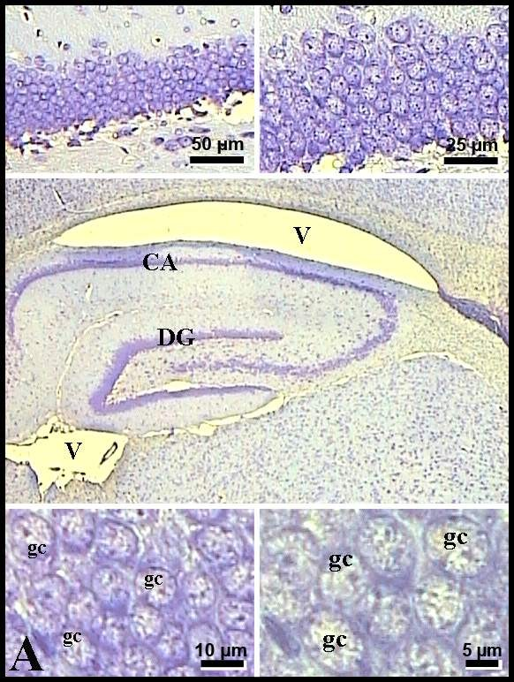
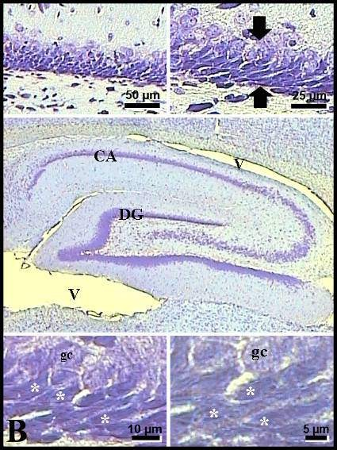
Prenatal 900 MHz EMF exposure decreased hippocampal granular cell number in the dentate gyrus of newborn rats
Controls Exposed

Slide 33
Prenatal 900 MHz EMF exposure decreased hippocampal granular cell number in the dentate gyrus of newborn rats
CONTROLS EXPOSED

Slide 34
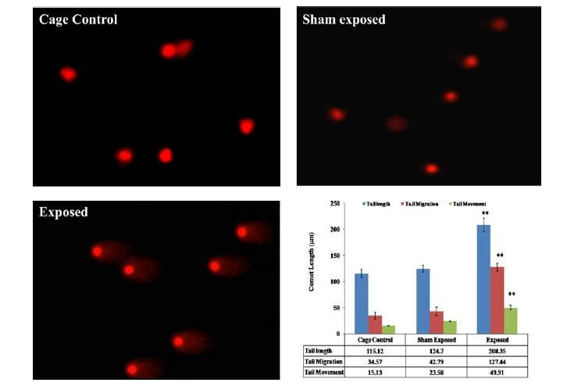
Kesari et al, 2014, rat brain comet assay

Slide 35
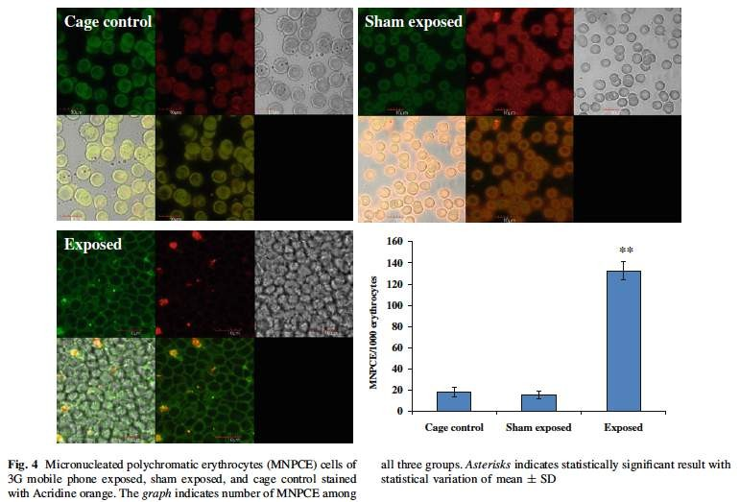
Kesari et al; 2014 – Micronucleated polychromatic erythrocytes rat

Slide 36
Genetic Damage in
Non-users vs. Mobile Phone Users
(Gandhi, 2005)
 | MN Test Mnd cells/ 2000 cells scored (%) | SGCE assay Damaged Cells average DNA (%) | SGCE assay Migration length (µm)
Control | 0.0005 | 10.40 | 8.1± 0.028
Exposed | 0.25± 0.0006 | 39.75 | 26.76± 0.054

Slide 37
Ranges of Cytogenetic Damage in non-users compared to heavy users of mobile phones (Gandhi & Singh 2005)
 | %Micro- nucleated cells | %Aberrant Metaphases
Control | 0.00-0.12% | 6.00-15.00%
Exposed | 0.59-1.10% | 20.00-52.50%
37

Slide 38
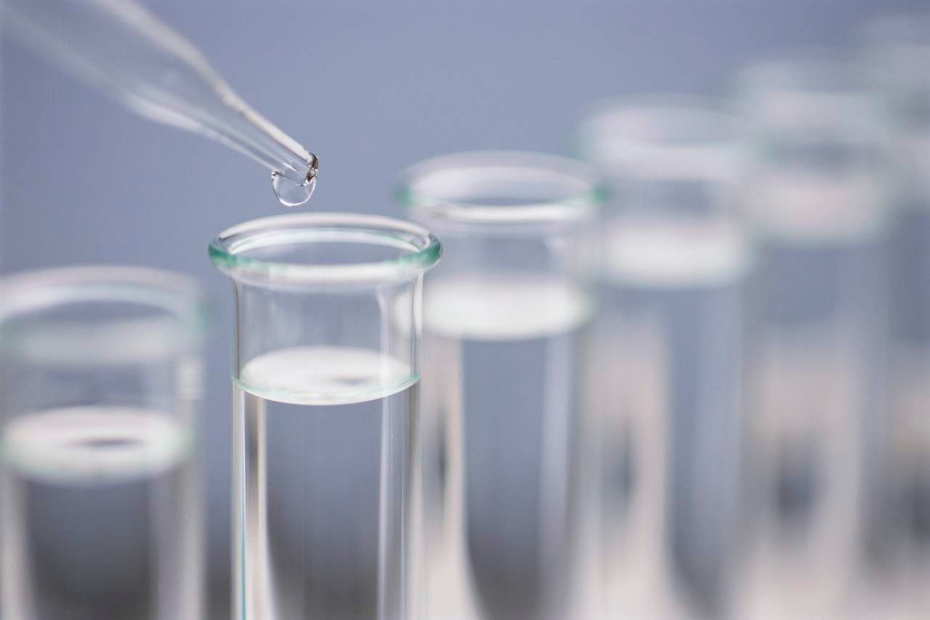



Experiments with Human Sperm show effects not tied with heating
Not Exposed
Do not take without permission

Slide 39
Danielle please get newer data & pictures of results from newer sperm studies

Slide 40
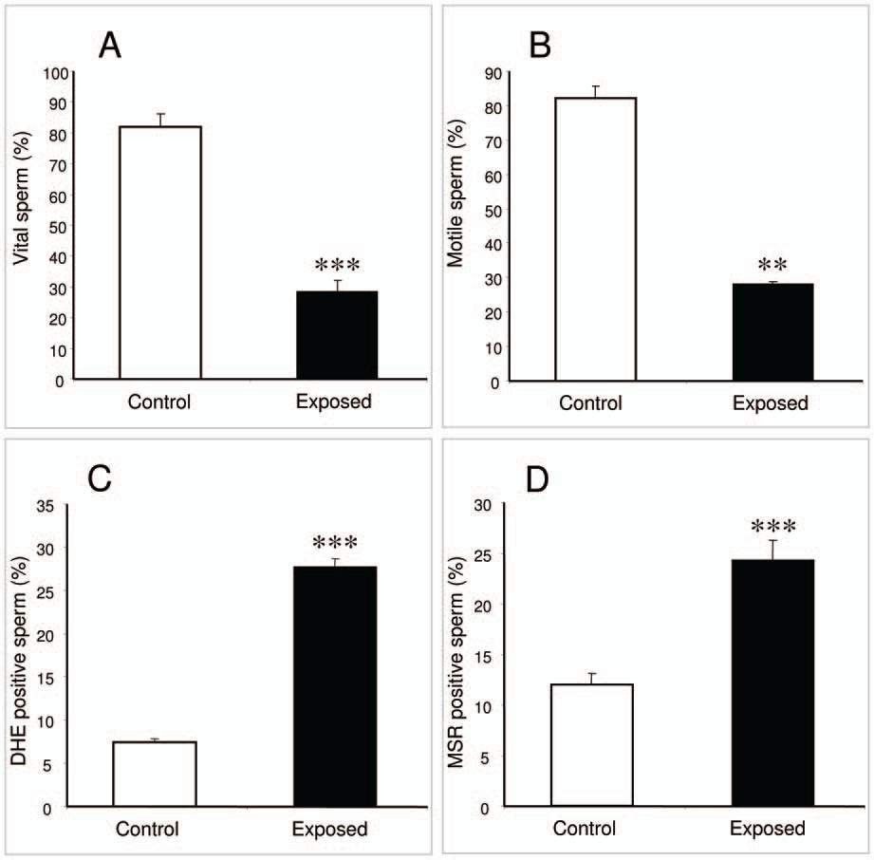


Cell Phone Exposed Sperm Significantly Reduced
& Damaged
Do not take without permission
Laureate Professor John Aitken

Slide 41
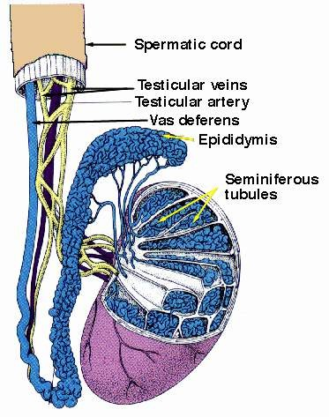
Heavier Cell Phone Users Have Reduced Sperm Count
No Use 2 h/day 2h/day 4 h/day
Ashok Agarwal MD PhD, Cleveland Clinic, 2008; and seven other studies
Do not take without permission

Slide 42
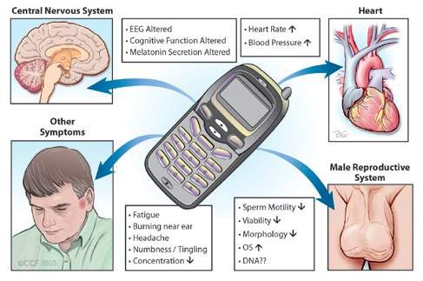
Mobile Phone Radiation Causes Testicular Dysfunction
(Agarwal et al., 2011)

Slide 43


Mobile Phone Use and Cancer Risk: Research on a Group 2B Carcinogen
Joel M. Moskowitz, Ph.D., Director
Center for Family and Community Health UC Berkeley Prevention Research Center School of Public Health
University of California, Berkeley
CDC Webinar October 29, 2014
SaferEMR.com

Slide 44
IARC RF Working Group, 2011 found experimental and human evidence of carcinogenic mechanisms
Weak evidence in humans
Evidence for genotoxicity: effects on immune function, gene and protein expression, cell signaling, oxidative stress, apoptosis, & blood- brain barrier.

Slide 45
Cell Phone Radiation a
“Human Carcinogen”
International Agency for Research on Cancer of the World Health Organization, 2011: declared cell phone and other wireless radiation:
“Possible Human Carcinogen”
EHT Experts, 2013,
“Probable Human Carcinogen”
International Journal of Oncology
45

Slide 46
IARC RF working group: Press conference May 30, 2011, Lyon, France
Committee Chair Jonathan Samet: "the evidence, while still accumulating, is strong enough to support a conclusion and the 2B classification. The conclusion means that there could be some risk, and therefore we need to keep a close watch for a link between cell phones and cancer risk."
IARC Director Christopher Wild: "it is important that additional research be conducted into the long-term, heavy use of mobile phones. Pending the availability of such information, it is important to take pragmatic measures to reduce exposure such as hands-free devices or texting."

Slide 47
Journal of Pathophysiology,
2013
Mobile phone radiation should be classified as a “probable human carcinogen,” based on new evidence since the IARC 2011 review

Slide 48
Hardell & Interphone studies: ipsilateral results
 | Hardell (2013) | Interphone (2010) | Combined
Glioma: overall | 1.78* | 0.84 | 1.22
Glioma: ≥1640 hours | 2.94* | 1.96* | 2.29*
Acoustic neuroma: overall | 1.78* | 0.77 | 1.16
Acoustic neuroma: ≥1640 hours | 3.10* | 2.33* | 2.55*

Slide 49
Hardell Research Group: New case-control studies (2013)
Wireless phone use ≥ 25 years (2007- 2009).
– Glioma: OR = 3.3 (95% CI: 1.6 – 6.9).
• Wireless phone use ≥ 20 yrs (1997-2003, 2007-2009).
– Acoustic neuroma: OR = 4.4 (95% CI: 2.2 – 9.0).

Slide 50
CERENAT French National case-control study, 2014
• France: 4 areas (2004-2006).
253 gliomas, 194 meningiomas, 892 matched controls.
Cumulative call time ≥ 896 hours.
glioma
meningioma
OR = 2.89 (1.41, 5.93).
OR = 2.57 (1.02, 6.44).
Coureau et al. Occup. Environ. Med. 7:514-522. 2014.

Slide 51
Glioma risk consistency:
3 recent case-control studies
 | Interphone (2010) | Interphone (App. 2) (2010) | Hardell (2013) | CERENAT (2014)
1640+ hours | 1.40* | 1.82* | 1.75* | 2.89* (896+ hrs)
10+ years | 0.98 | 2.18* | 1.79* | 1.61

Slide 52
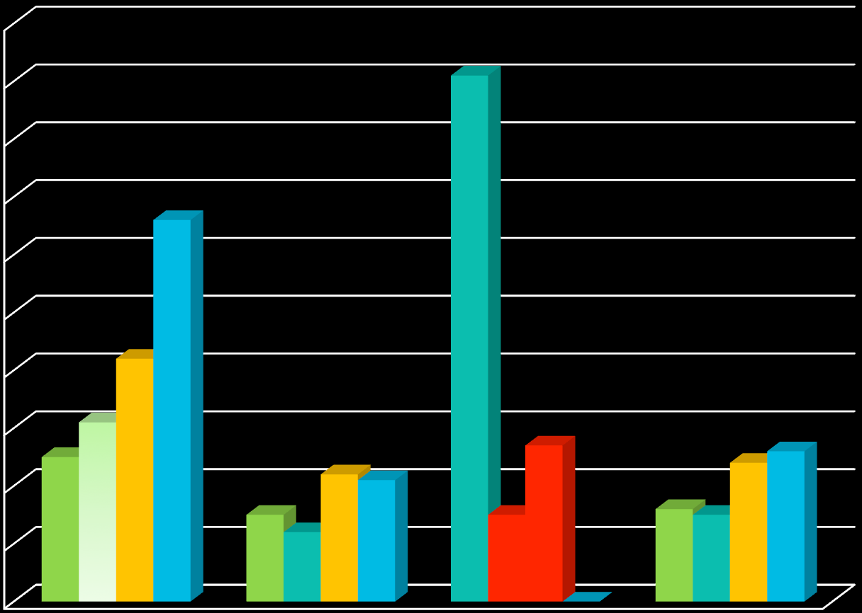
Greatest Risk of Acoustic Neuroma for Longest and Heaviest Users
Hardell et al 2013
Odds ratio (OR) for dose-­‐response between use of wireless phones and acoustic neuroma
10.0
9.0
First quartile Second quartile Third quartile Fourth quartile
8.0
Odds Ratio
7.0
6.0
5.0
4.0
Approaching Statistical Signiﬁcance
3.0
2.0
1.0
Not Signiﬁcant
0.0
Analogue OR, CI (Ca/Co)
Digital (2G) OR, CI (Ca/Co)
Digital (UMTS, 3G) OR, CI
(Ca/Co)
Mobile phone, total OR, CI
(Ca/Co)
Wireless Radiation Exposure, by Type

Slide 53
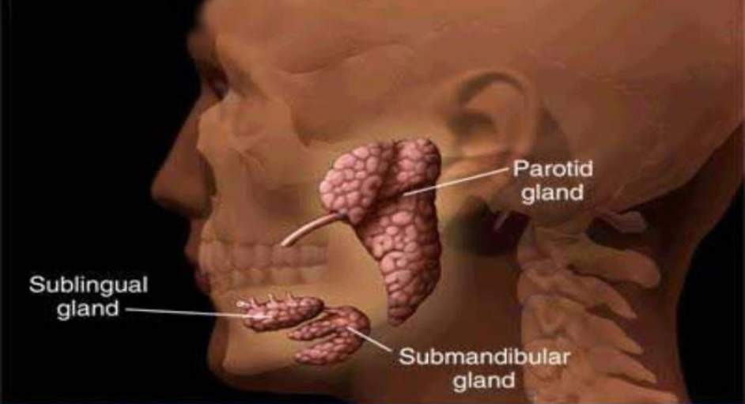
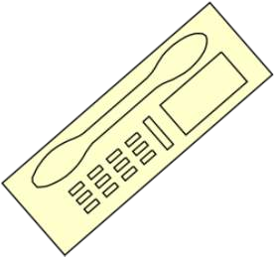

Parotid or Salivary Gland Tumors Tripled in Israel: 1 in 5 under age 20
Do not take without permission

Slide 54
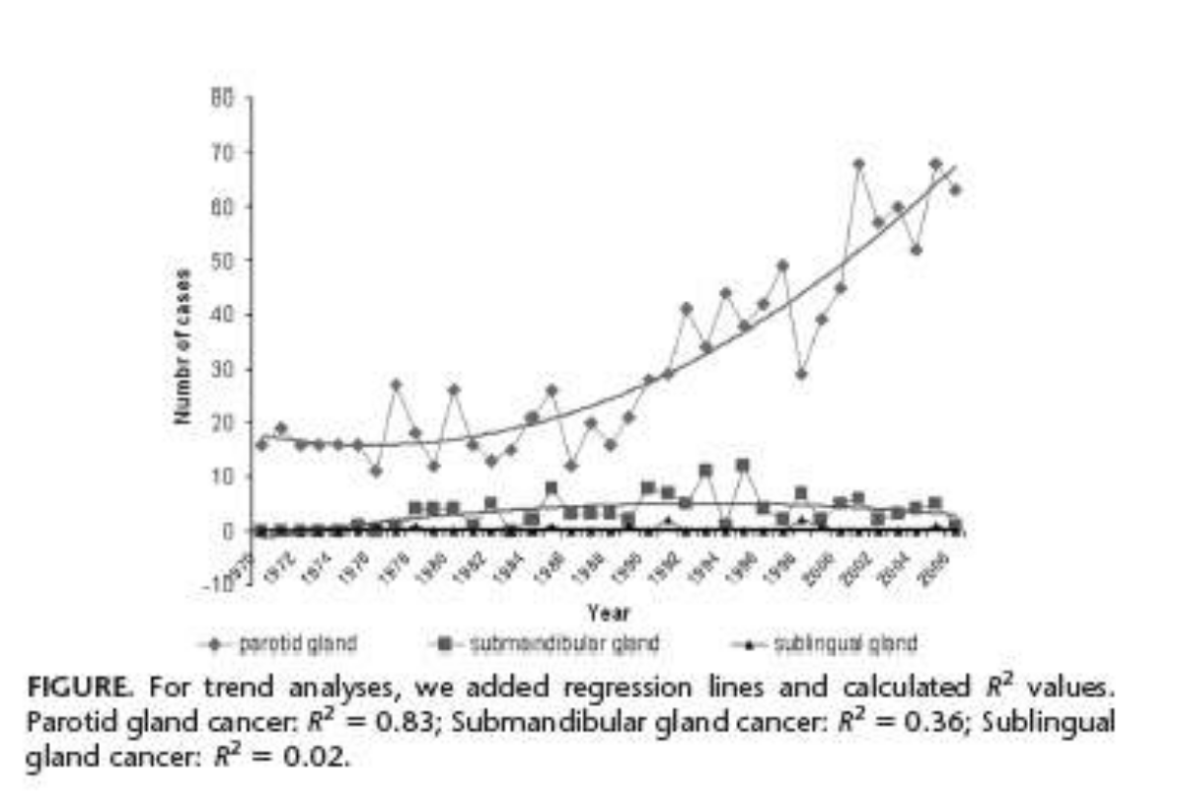
Increase in Parotid Gland Tumors in Israel Over the Last 30 Years
Source: Epidemiology, 22, p.130, January 2011
Do not take without permission

Slide 55
2007 Israeli case control finding: Association Between Tumors and Cell Phone Use
“Based on the largest number of benign [parotid gland tumors]
patients reported to date, our results suggest an association between cellular phone use and PGTs.”
Recommend continued research and implementation of precautionary measures by governments until further evidence becomes available.
Sadetzki et al. Am. J. Epidemiol. (2008) 167 (4): 457-467.

Slide 56
Israeli Dental Association Warning
One in every five rare malignant tumors of the cheek occurs in someone under age 20
Young people should limit direct exposure of the head to microwave radiation from cell phones
Do not take without permission

Slide 57
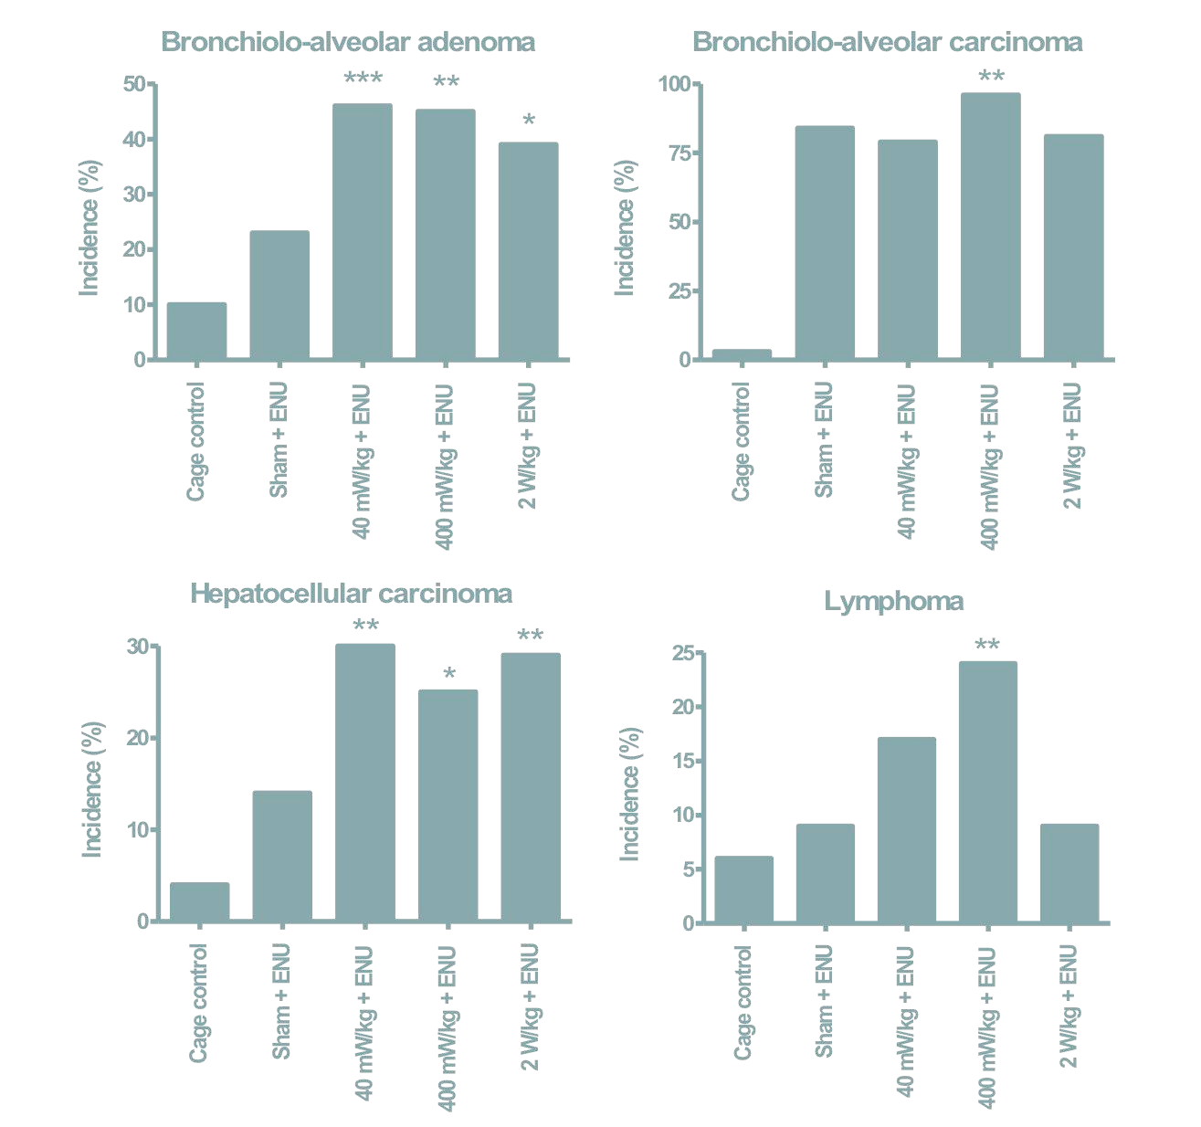
Lerchl German Government Sponsored Findings on Tumor Promotion 2015
Confirmed and extended others’ findings that radiofrequency
radiation amplifies effect of a carcinogen to cause liver and lung cancers.
(0.04 and 0.4 W/kg SAR)

Slide 58
Unusual Breast Cancers in Women Keeping Cellphones in their bras—a preliminary case series
John West, Lisa Bailey, Robert Nagourney, & other leading breast cancer specialists

Slide 59
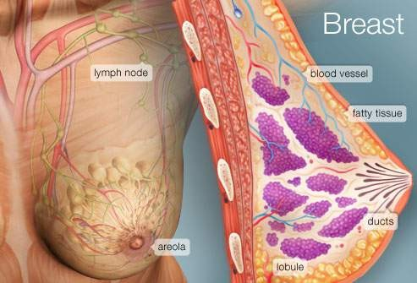
Fat and fluid cook in microwave oven Breast = chiefly adipose and fluid

Slide 60
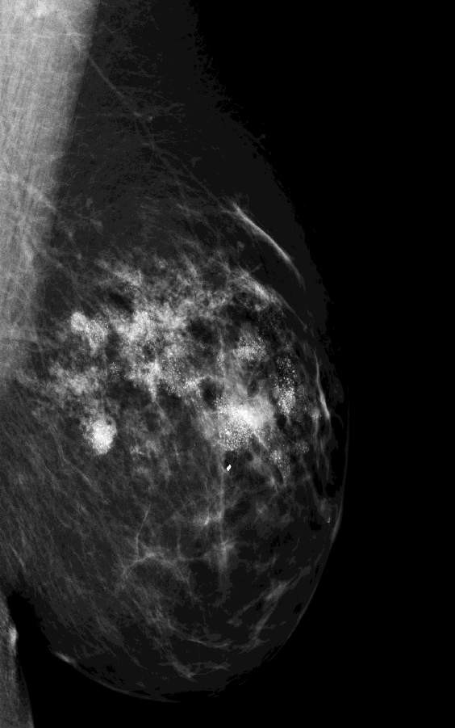
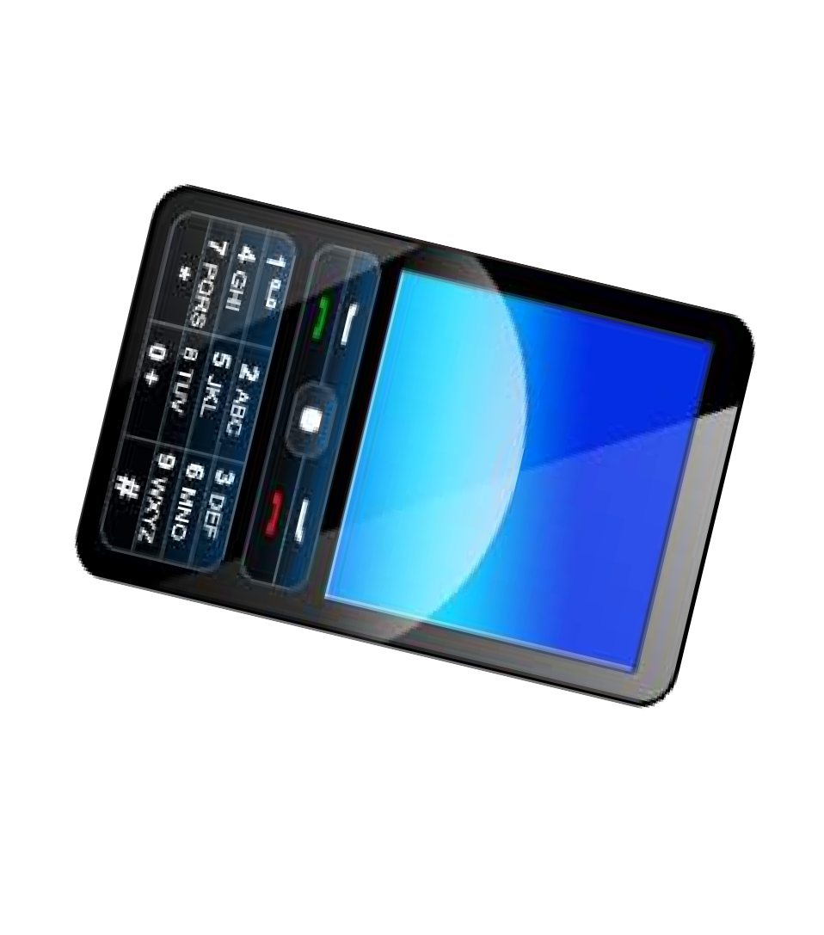
Caveat - first case report, 2009
Invasive multiple primary tumors in 34 year old, avid runner Chinese-American woman who used cell phone 4 hours a day in her bra for 10 years
—reported by Robert Nagourney, MD, PhD

Slide 61
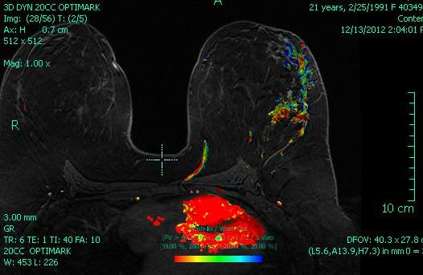
Case Reports - 21 yr old multi-focal tumors tied with cellphones kept in bra
John West et al

Slide 62
Summary of 38+ Cases
Negative for BRCA1/2
No family history or other risk factors
Unusual location of multi-focal tumors where phones were kept with mix of tubular/solid patterns of identical nuclear morphology & grade
No significant histology in ductal and lobular units away from the areas of cellular phone use
Two with metastases

Slide 63
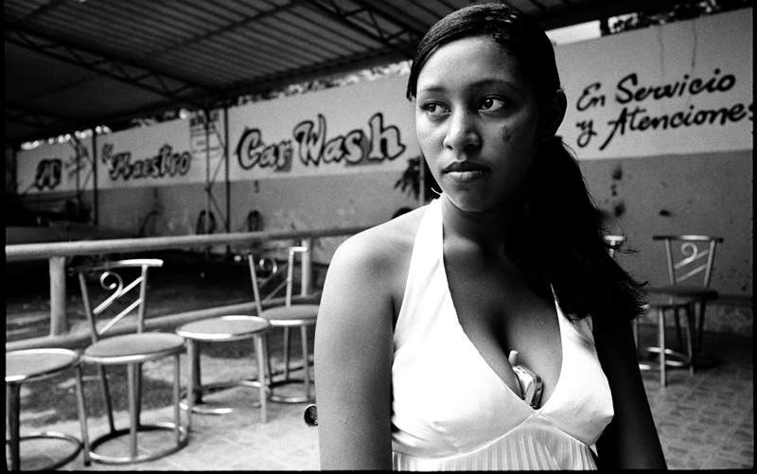
Latinas put phones in bras
Dominican Republic, Credit Thos Robinson, 2010

Slide 64
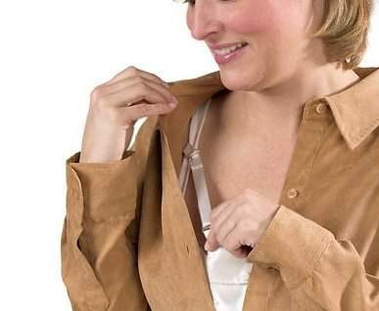

Marketing for Cell Phones and Gear in Bras

Slide 65
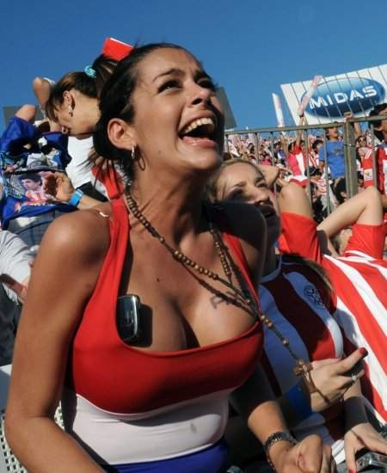
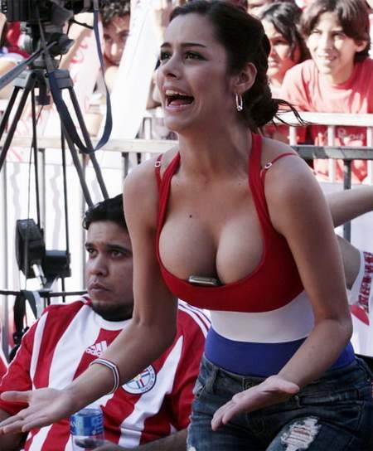
Brazilian Examples

Slide 66
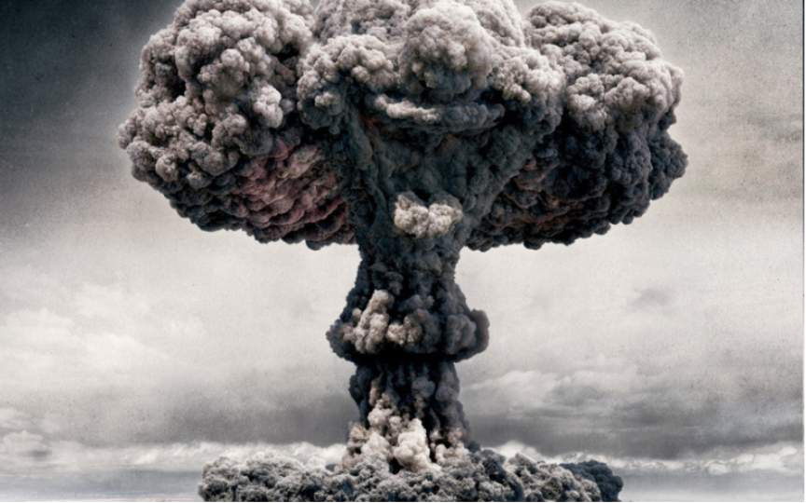
Atomic Bombs in Japan, 1945
No increase in brain tumors was found in survivors
until 40 years later
Do not take without permission

Slide 67
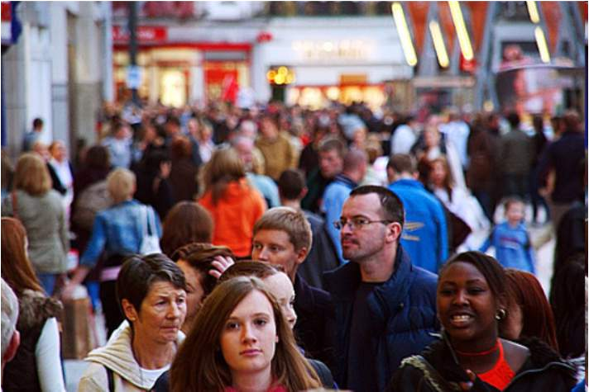
Until after at least ten years of heavy use
Do not take without permission

Slide 68
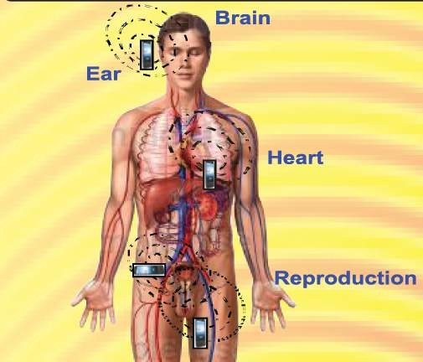


Radio Frequency Radiation and Human Health: Technical Studies from India
Dr. R. S. Sharma
Sr. Deputy Director General & Scientist-G
Division of RCH
Indian Council of Medical Research New Delhi –110 029

Slide 69

Impacts of RF on Honey Bees
If the bee disappeared off the surface of the globe then man would only have four years of life left. No more bees, no more pollination, no more plants, nor more animals, no more man.

Slide 70



Decoding the language of the Honey Bees
Nobel Lecture, December 12, 1973 Karl Von Frisch
University of Munich, Federal Republic of Germany
Waggle Dance
Shacking Dance
Tremble Dance

Slide 71

Exposure to cell phone radiation produces biochemical changes in worker Honey Bees, Neelima et al., 2011
Controls, n=10
10 Min.
20 Min.
40 Min.
Extracted the Hemolymph
Cell Phone Exposed, n=10
10 Min.
20 Min.
40 Min.
Behavioral observation
Biochemical observation
At 10 & 20 Min. exposure
At 40 Min. exposure
During initial quiet period rise in concentration of biomolecules due to stimulation of body mechanism to fight stressful condition.
At later stages there was decline in the concentration of biomolecules because the body had adapted to the stimulus.

Slide 72
Electromagnetic radiation (EMR) damages Honey Bees (Sainudeen, 2011)
Control hives, n=3
All workers return to hives
Test hives, n=3
After few days the workers never return to hives
Colony Collapse/ Disrupting Syndrome
Only queen, eggs & hive bounds immature worker bees
Thriving hives deserted

Slide 73

Why inconsistent results in vitro
wrong cells studied, i.e., adult lymphocytes compared to neuronal stem cells
Wrong exposures used (CW/Digital)
Publication bias
©2013 The Institute for Functional Medicine

Slide 74

Fine Print Warnings

Slide 75


Fine Print Warnings (iPhone 4)

Slide 76
Showthefineprint.org

Slide 77
Blackberry and Pacemakers
Always keep the BlackBerry device more than 7.88 inches (20 cm) from the pacemaker when the BlackBerry device is turned on.
Do not carry the BlackBerry device in your breast pocket.

Slide 78


American Academy of Pediatrics Recommends Children Under Age Two Have Limited to no Screen Time

Slide 79

Demise of the Landline
US Households* (Jul-Dec 2013
41.0% wireless- only
16.1% wireless- mostly
NHIS. NCHS, CDC. Jul., 2014.
http://bit.ly/wireless0714

Slide 80
We lack uniform standards for measuring Electromagnetic Fields (EMF)
Radio frequency spectrum is a limited (though instantly renewable) natural resource essential to modern civilization, yet there is no common language to describe it!
Many domains need to record and process data about real world EMF emissions and measurements.
Wireless provider operations
Data communication requires standards.
  Open standards maximize opportunities for communication between systems. A standard data model provides a basis for standard interfaces and/or Semantic Web best practices.
  A standard data model supports efficient publishing, discovery, assessment, access, aggregation and use of data.
A standard data model provides a template for rigorous and useful data collection and aggregation. In research, this enables comparison, verification, averaging of results, longitudinal studies, cross-disciplinary studies etc.
Open standards create opportunities for innovation and new markets. Convergence of digital and wireless is still new, still ripe for innovation.
© 2015 Open Geospatial Consortium
Bioelectro- magnetics research | Wireless technology R&D | Defense & Intel. signal intelligence | Physics research | Government regulation of EMF use | Remote sensing operations and R&D | Others? Future uses …?

Slide 81


An open standard would open up opportunities for cloud analytics and apps
es r

Slide 82

Interoperability now!
Time to agree on a commonly used and widely blessed vocabulary and grammar for EMF!
© 2015 Open Geospatial Consortiu

Slide 83
Make slides on Indian bee studies put in two hives with cordless phones dropping into them and bees not returning to one with phone turned on
©2013 The Institute for Functional Medicine

Slide 84
IARC/WHO, EHT & other Groups Advise How to Protect Your Family
France, Finland, Israel, and the European Environment Agency advise cellphone precautions
Use speakerphone
Use earpieces
Do not keep phone on body/in pocket
Avoid use in areas of weak signals
Protect abdomens—pregnant, adolescent and men wishing to become fathers
Do not take without permission

Slide 85
R & D fruit on the ground
Wired is faster, safer, & more secure
Program devices to power down when not in use
Develop software that automatically extends battery life, reduces power & exposures
Create on-off switches for routers as successful Chinese model does
Design phones that only work with headsets or speakers
Improve antenna and router design
  Directional vs. symmetrical
  Standby mode as default

Slide 86
What is to be done?
Would you give two cents?
Monthly fee* on all devices, users, IP providers to support:
Cross-disciplinary training programs in bioelectromagnetics for engineers, docs & computer scientists
Identify data gaps and R & D needs re hardware/software reconfigs & mods & research priorities
*for eight years
Monitoring of special populations similar to drug surveillance for biological impacts of wireless, such on hearing, reaction time, insomnia, & other behavioral endpoints TBD

Slide 87
What is to be done?
Standardized metrics for evaluating personal exposures (OGC)
Opportunistic cross- sectional surveys of re
  Memory
  Reaction time/accuracy
  Reproductive health
Promoting wired school programs with mobile
tablet banks
Public educational programs sharing ‘fine print’ advisories
  Parents
  Teachers
  Health professionals

Slide 88
The world is not dangerous because of those who do harm but because of those who look at it without doing anything.
- Albert Einstein
www.ehtrust.org

Slide 89
Thank you!
Frank Clegg, former President Microsoft Canada
Joel Moskowitz, PhD, UCBerkeley
Suleyman Kaplan, Ondokuz Mayis University
Ashok Agarwal MD PhD, Cleveland Clinic
Robert Nagourney MD PhD, Rational Therapeutics
John West MD, Orange County Breast Center
Lisa Bailey MD, former President American Cancer Society/California, breast surgeon
Lloyd Morgan, Robert Morris, Environmental Health Trust
Igor Belyaev, PhD, DSc, Cancer Institute Moscow/ Bratislava
Hugh Taylor MD PhD, Yale University

Slide 90
Social Media
@saferphones
@DevraLeeDavis
Ehtrust.org
Facebook/CampaignforSaferPhones
Facebook/EnvironmentalHealthTrust

Slide 91
For discussion slides
91

Slide 92
EHT Senior Advisors
Frank Clegg, former President Microsoft Canada/North America
R Blank, CEO VideoRx, technologist
Anthony B. Miller MD, Prof Emeritus University of Toronto, IARC Senior Advisor
Annie Sasco MD PhD, former chief of cancer epid WHO, IARC
Robert D. Morris MD PhD, EHT
Om Gandhi, PhD, Prof. Emeritus E.E.
Radhey Shyam Sharma, Indian Council of Medical Research
Suleyman Kaplan, PhD, Dean, Ondokuz Mayis University, Turkey

Slide 93

Digital Dementia Diagnosed in South Korean Children
Dr. Byun Gi-Won a cognitive expert from the Balance Brain Center in Seoul, South Korea states, “Young People who are heavy technology users are likely to have a properly developed left hemisphere of the brain while the right hemisphere will be unused and underdeveloped.”

Slide 94

Korean government studies on digital addiction and dementia

Slide 95






Open Geospatial Consortium
Not-for-profit, international consortium of 500+ industry, government, and university members, including Google
Founded in 1994
Work based on collaboration and consensus
Members set policies and procedures.
Many alliance partners: W3C, OASIS, ITU, ISO, Smart Grid Interoperability Panel, buildingSMART International, etc.
OGC Mission
Deliver geospatial data encodings,interface standards and best practices that are openly and freely available for global use.
© 2015 Open Geospatial Consortium

Slide 96














































Abstract models and implementation models
Implementation models model how features, phenomena and relationships are to be encoded for a
particular software implementation platform.
Abstract and/or conceptual model models what needs to be described/modeled in software (location, orientation, time, signal type, frequency, pulsing characteristics, energy intensity max/min, etc.). Includes relationships and units of measurement.
SQL
CSV
XML
© 2015 Open Geospatial Consortium

Slide 97


Example OGC standard: OGC WaterML 2.0
SITUATION: Nations seek to provide integrated national and cross-border views of fresh water resources. Also, there is increased need for the exchange of hydrologic data to improve our understanding of complex environmental processes, such as climate change.
PROBLEM: 2005 Global Climate Observing System (GCOS) report: “There are no established international standards on the acquisition of river data, the set of required metadata, data formats, and transmission modes.”…
CSIRO (Australia)
San Diego Supercomputer Center (US)
Australian Bureau of Meteorology
Geological Survey of Canada, Nat. Resources Canada
USGS (US)
APPROACH
WMO
(World Meterological Organization , an International team of hydrologic organizations came together to form the OGC WaterML 2.0 Standards Working
Group. They used OGC’s rapid prototyping process to develop the WaterML 2.0 standard.
KISTERS AG (Private sector –
Germany) NOAA (US)
Deltares (Independent institute - Netherlands)
Federal Waterways Engineering and Research Institute
disy Informationssysteme GmbH
^{(Germany)} © 2015 Open Geospatial Cons
SOLUTION: WaterML2.0 is a standard information model for the representation of water observations data,
with the intent of allowing the exchange of such data sets across information systems. Based on existing OGC standards, it is used to address a range of exchange requirements.
ortium
German Federal Institute of

Slide 98


Collaboration is needed to address complexity.
Complexity makes data integration and communication difficult.
Collaboration make integration and communication possible.
EMF are complex:
_Frequency or frequencies
_Modulation type & other pulse details (waveform parameters)
_Polarization
_Energy intensity max/min.
_Energy intensity ave.
_Location & orientation
_Time
_Unique source ID?
_Sensor or emitter specs
_Etc.
Spatial data are complex:
_Vector, raster, point clouds and other types data
_Diverse Earth coordinate reference systems & Earth shape models (geodesy)
_ 2D, 3D, 4D and nD
_Conflating semanticly different data
_Conflating precise and imprecise data
_Harmonizing with other standards for spatial features and phenomena
_Navigating IT trends, e.g. database > services > linked data etc.
OGC members who are EMF domain experts will bring this expertise to working group meetings.
OGC staff and OGC members who are spatial technology experts will bring this expertise.
© 2015 Open Geospatial Consortium

Slide 99
Why the Open Geospatial Consortium (OGC)?
EMF instances are inherently spatial. All
  have a point or region of origin. All EMF instances that we observe have one or more points at which observations are collected.
  are affected by the media they travel through.
  are absorbed, reflected, and refracted by the objects and phenomena they impinge upon.
  have effects on the objects and phenomena they impinge on.
The OGC focuses on spatial and temporal encoding and interface standards.
  Historically, OGC’s focus was solely geospatial.
  Recently, OGC members are working with other standards organizations on convergence of geospatial data & technology with data & technologies used to model the built environment.
  Basic principles of modeling macrospatial and mesospatial features and phenomena can be extended
to microspatial and nanospatial (and nanotemporal) features and phenomena.
The OGC’s standards portfolio includes a comprehensive portfolio of standards for description and management of sensors and sensor data.
The OGC’s membership includes a broad range of companies and organizations that might participate in developing an EMF standard.
© 2015 Open Geospatial Consortium

Slide 100


Worldwide Cell Phone Advisories
Belgium 2013:
The Public Health Minister bans cell phone sales both in
shops and online to children under 7 years old. Cell phone advertisements are also banned during children’s TV programs.
Australia 2013:
The federal government’s Australian Radiation
Protection and Nuclear Safety Agency (ARPANSA) has created a fact sheet providing citizens ways to reduce exposure from wireless devices. The agency advises that parents limit children’s exposure to cell phones.

Slide 101


Worldwide Cell Phone Advisories
Italy 2012:
On October 12th, 2012 the Italian Supreme Court
ruled in favor of an Italian business man who claimed that his brain tumor developed from using cell phone 5-6 hours a day
France 2013:
The French National Assembly bans Wi-Fi in
schools until it is proven to be safe for human consumption and in nurseries.

Slide 102

Worldwide Cell Phone Advisories
Turkey 2013:
Governor Aksoy Huseyin, of the Samsun province
is launching a cell phone campaign using EHT’s pamphlets and health/science materials.

Slide 103





FRANCE, DECEMBER 2008

Slide 104


Slide 105


Slide 106

Melatonin Protects Against 1800 MHz RF Radiation Damage
Xu et al
Brain Research, 2010

Slide 107
Precautions Noted by the FCC, FDA, and ACS as of September, 2010
Use an earpiece or headset.
Avoid continually wearing a wireless earpiece
Keep wireless devices away from your body when they are on
Use speakerphone
or purchase a low SAR phone to reduce exposure to the head.
Consider texting rather than talking, but donʼt text while you are driving.
Can limit talk time

Slide 108

We protect children in car seats
Different carseats and distances at different ages
Am Acad. Pediatrics recommends

Slide 109

Radiation Risks of CT Scans
Approximate
Equivalency in
Exam Type | Machine Setting | Relevant Organ | Equivalent Dose to Relevant Organ (mSv) | chest x-rays* .15-.01 mSV
Pediatric Head CT Scan | Unadjusted¹ | Brain | 60 | 400-6000
Pediatric Head CT Scan | Adjusted² | Brain | 30 | 200-3000
Pediatric
Abdominal CT
Scan | Unadjusted | Stomach | 25 | 166-2500
Pediatric
Abdominal CT
Scan | Adjusted | Stomach | 6 | 40-600
Chest X-ray (PA/
lateral) | n/a | Lung | 0.01/0.15 | 1

Slide 110
As Low as Reasonably Acceptable in Pediatric CT Scans
Children ten times more vulnerable than adults to radiation (Intʼl Com Radiol Prot, 1991)
Quality of CT image better with higher radiation
Many unnecessary tests ordered in children and adults
Slovis, Pediatric Radiology, April 2002

Slide 111


Recommendations
Avoid carrying your cell phone on your body (e.g. in a pocket or bra).
Avoid holding any wireless device against your body when in use.
Use your cell phone on speaker setting or with an “air tube” headset.
Avoid using your wireless device in cars, trains or elevators.
Avoid cordless phones, especially where you sleep.

Slide 112


How to Practice Safe Tech
#PracticeSafeTech
Whenever possible, connect to the internet with wired cables.
When using Wi-Fi, connect only to download, then disconnect and disable Wi-Fi.
Avoid prolonged or direct exposure to nearby Wi-Fi routers.
Unplug your home Wi-Fi router when not in use (e.g. at bedtime).
Sleep as far away from wireless utility meters (i.e. “smart” meters) as possible.

