Slide 1

Technical Briefing on Cell Phones and Health
Devra Davis, PhD MPH
President
Environmental Health Trust
Presented to American Academy of Pediatrics June 8, 2015

Slide 2

Presentation overview
What is cell phone radiation?
In vitro and in vivo evidence of health impacts:
sperm damage (Aitken, MD, Agarwal MD)
prenatal damage (Taylor MD, PhD, Kaplan, PhD)
Neurological impacts on brain structure/function of children (Redmayne PhD)
cancer risk and digital dementia in children?
National and local efforts
Israel Ministry of Health, Canadian Parliament New laws in France, Belgium, Taiwan
Berkely City Ordinance
EHT Advice from Expert Groups About How to Protec2t Yourself and Your Family

Slide 3

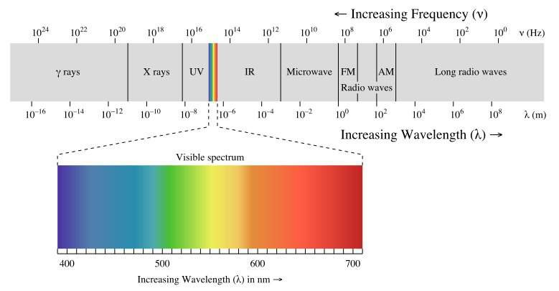
Radiation Electromagnetic Spectrum
Sourc
Wi (2008)
Microwaves:
Ovens
Cellphones (GSM-3G UMTS)
Cordless phones
Wi-Fi (WLAN)
Cellphones Emit Pulsed Microwave radiation
Do not take without permission

Slide 4
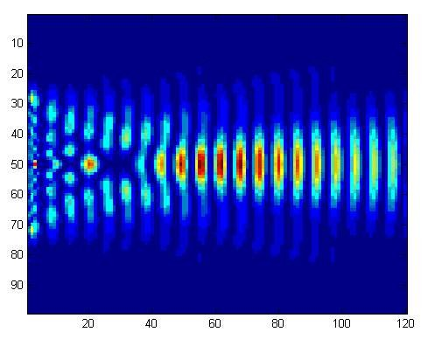

The impact of any form of radiation depends on the nature of the waves
Frequency
Amplitude
Pulse
Wavelength
Information
Courtesy of Margaritis et al
Do not take without permission

Slide 5
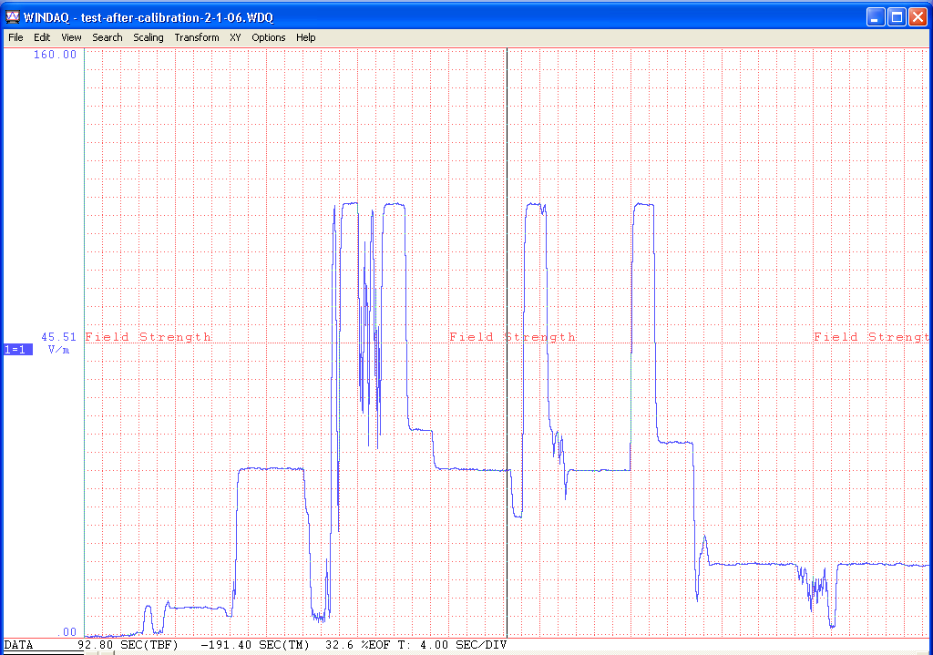


INTENSITY
V/m
SPEAKING
LISTENING
END OF CALL
RINGING
STAND-BY
Time 4 sec/division
Do not take without permission

Slide 6

Standards for cell phones unchanged for 18 years
1997 Average user was military, medical, or business
Average call took less than 6 minutes Employs the head of a 220 lb male Designed to avoid heating

Slide 7
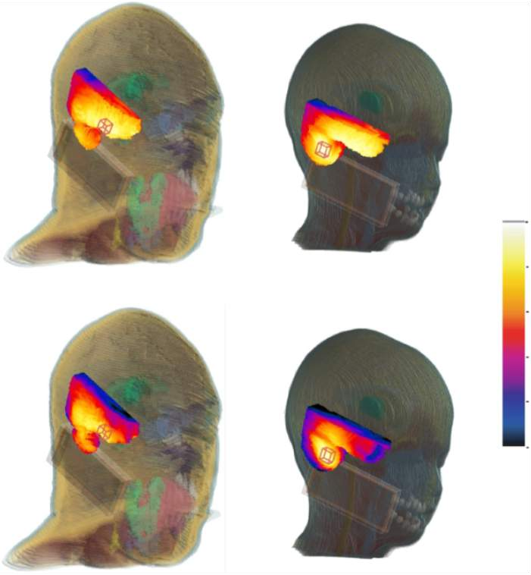


Cell phone standards are developed to avoid
heating a heavy-set man, NOT a young child
900 MHz the SAR maximum occurs in the center of the case
Childrenʼs skull bone absorbs 10x more than adults
Images courtesy of ITʼIS, 2010
1800 MHz SAR max occurs at edge of case, Christ et al, 2010
Do not take without permission

Slide 8
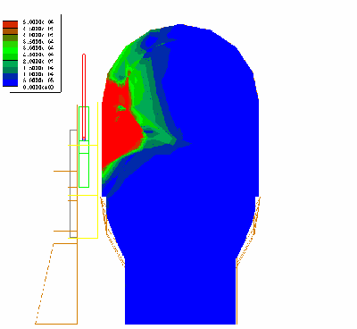
MARGARITIS LH - ISTANBUL WORKSHOP - MAY 2011
8

Slide 9
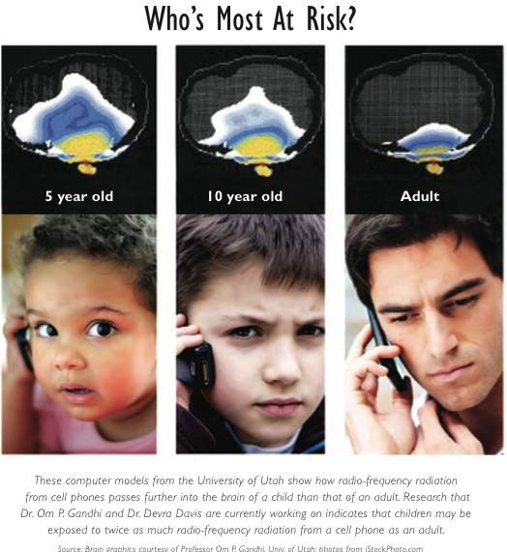

Slide 10
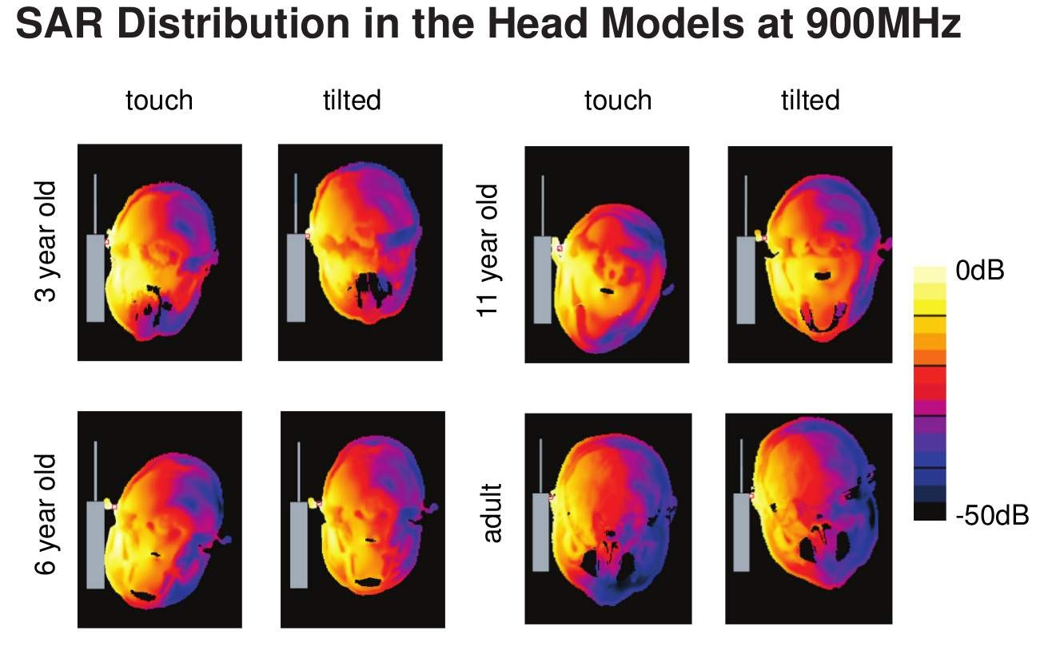
Andreas Christ, 2012

Slide 11
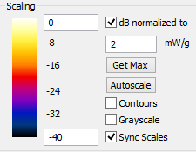
Scaling for University of Porto Alegre/Environmental Health Trust Brain Models

Slide 12
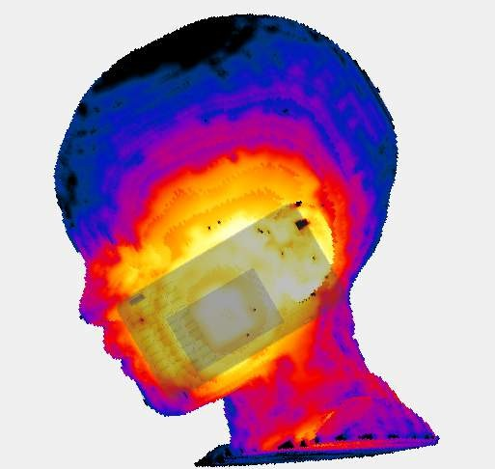
Age-Related Differential Microwave radiation absorption from cell phones (Fernandez et al, 2015)
Six year old anatomically based Model of Porto Allegre
Environmental Health Trust (PAEHT)

Slide 13
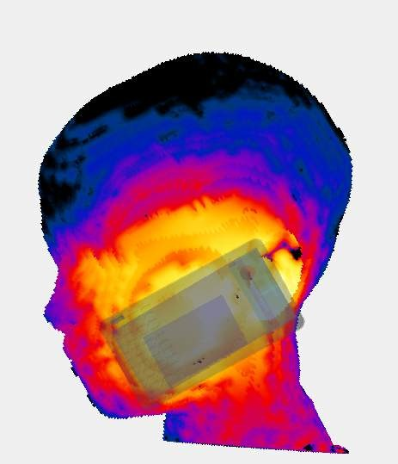
Age-Related Differential Microwave radiation absorption from cell phones (Fernandez et al, 2015)
11 year old anatomically Based Porto Alegre Environmental Health Trust Model PAEHT

Slide 14
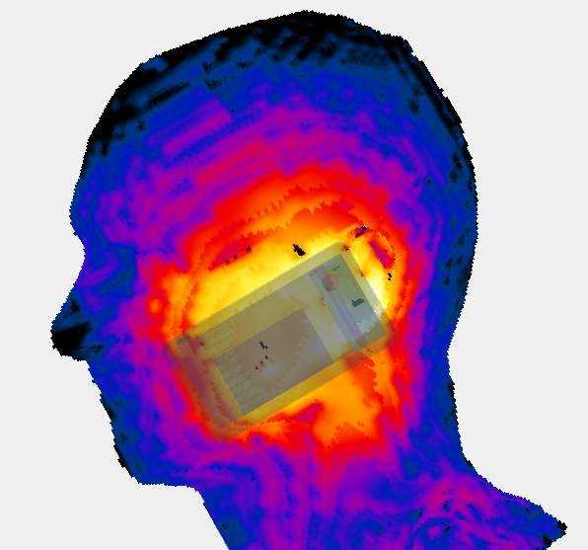
Age-Related Differential Microwave radiation absorption from cell phones (Fernandez et al, 2015)
34 year old Adult male PAEHT

Slide 15
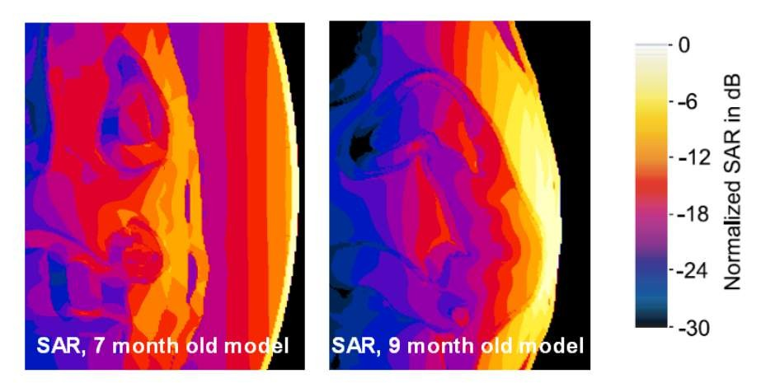
Normalized SAR for the mother and the fetus exposed to a dipole antenna in front of the abdomen (courtesy Andreas Christ, IT’IS, 2013)

Slide 16
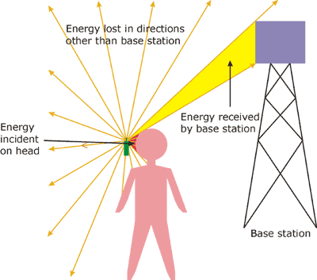

Radiation from phone absorbed into head/body
Hugh Taylor, 2013

Slide 17
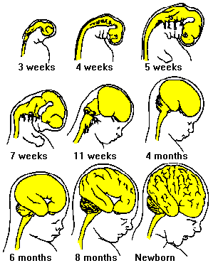
Brain grows rapidly throughout embryonic & early life
Hugh Taylor, 2013

Slide 18
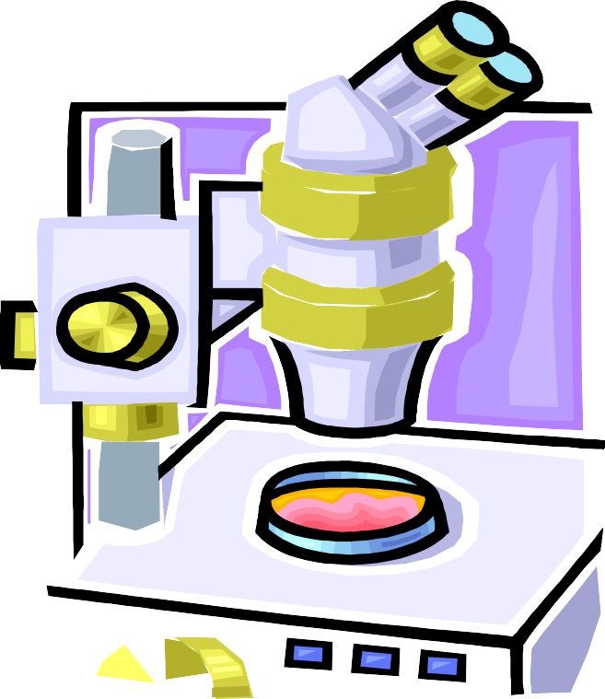
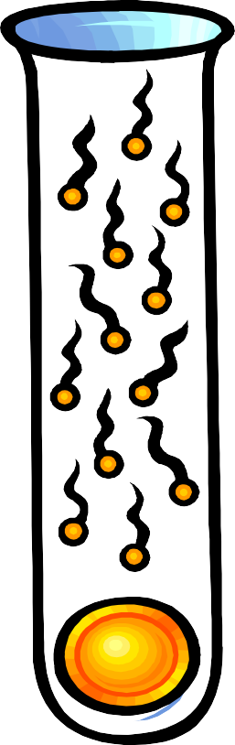

Vulnerability to Toxic Insult
Depends on the rate of cell proliferation
Therefore, younger faster growing cells are more vulnerable, i.e., spermatocytes
neuronal stem cells, mouse embryonic
(all have thinner Membranes!?)

Slide 19
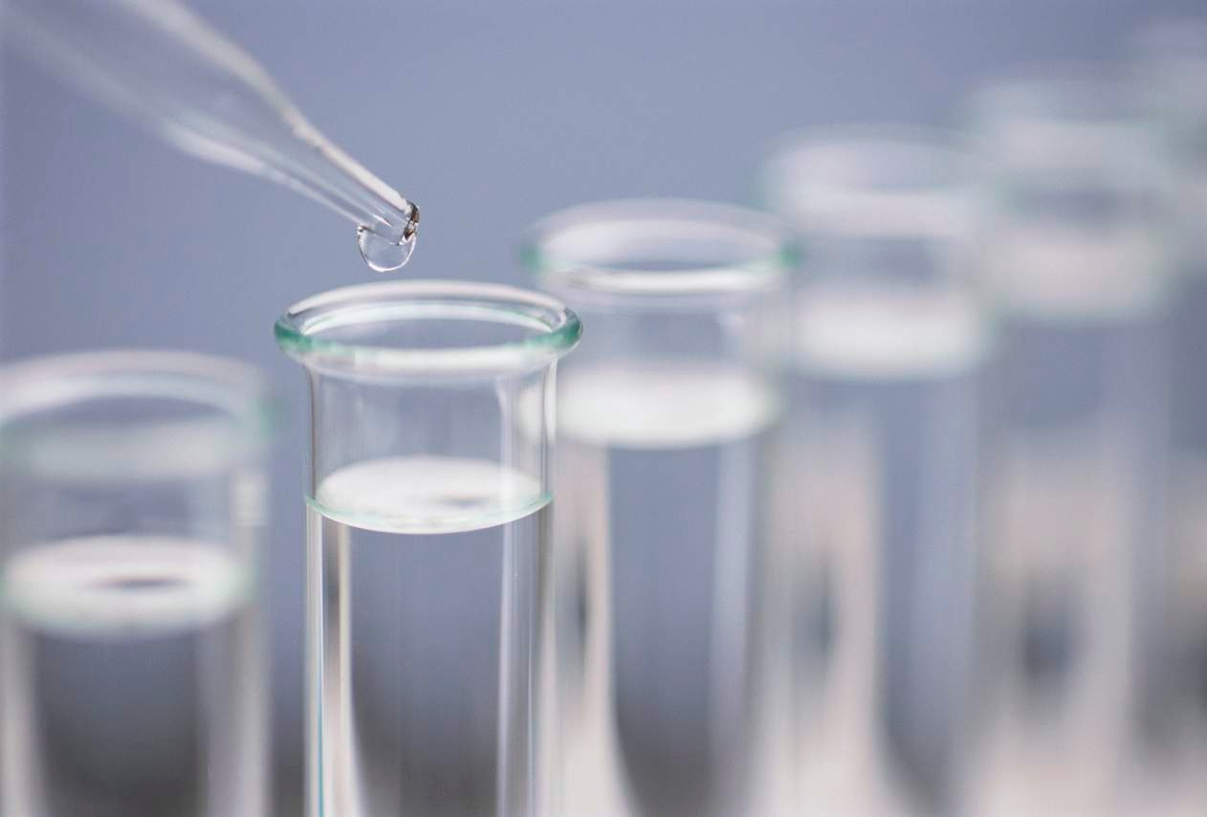
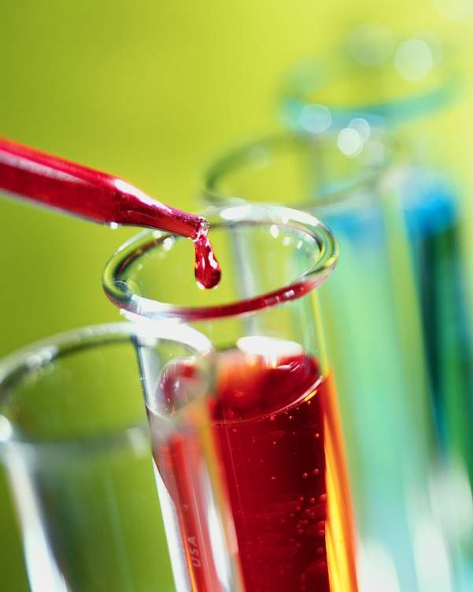
Experiments
with Human Sperm Show Effects not Tied with Heating
Do not take without permission
Cell Phone Exposed
Not Exposed

Slide 20
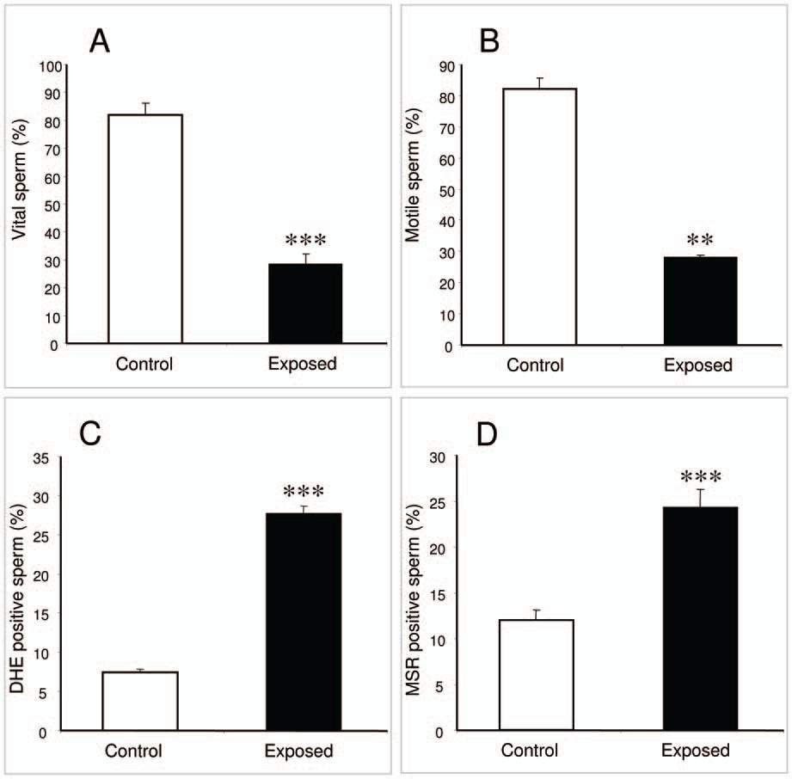


Laureate Professor John Aitken
Do not take without permission
Cell Phone Exposed Sperm Significantly Reduced
& Damaged

Slide 21
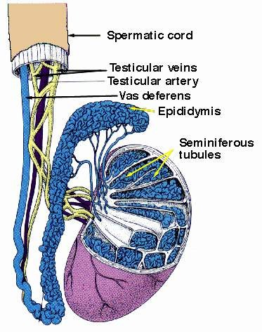

Heavier Cell Phone Users Have Reduced Sperm Count
Millions/ml
100
90
80
70
60
50
40
30
20
10
0
No Use
<2 h/day
2h/day
>4 h/day
Agarawal, Cleveland Clinic, 2008; and seven other studies
www.environmentalhealthtrust.org
Do not take without permission

Slide 22
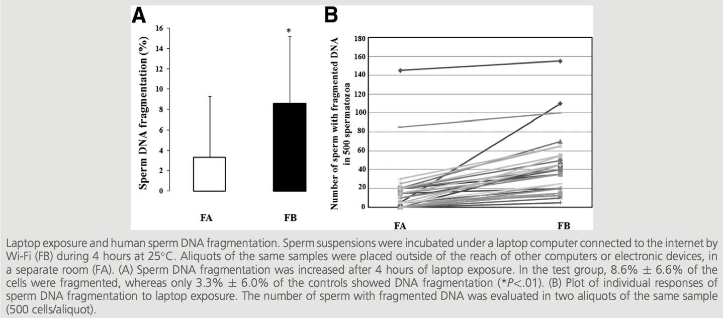

Wifi damages Sperm
Avendano. Laptop usage and sperm quality. Fertil Steril 2012

Slide 23
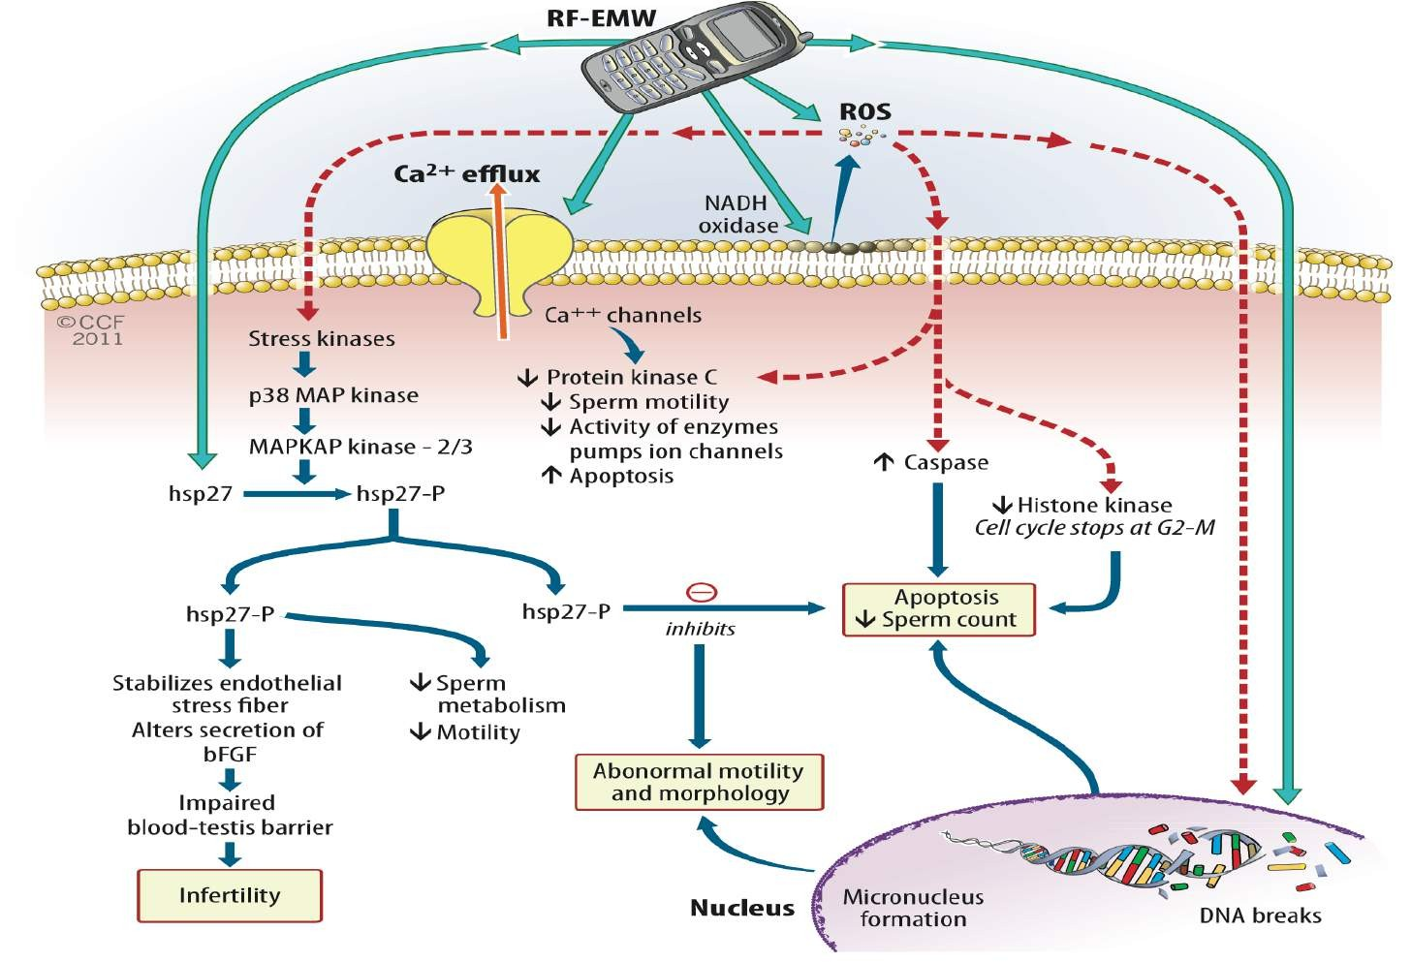
Toxic chemicals
Hamada et al., 2011
23

Slide 24
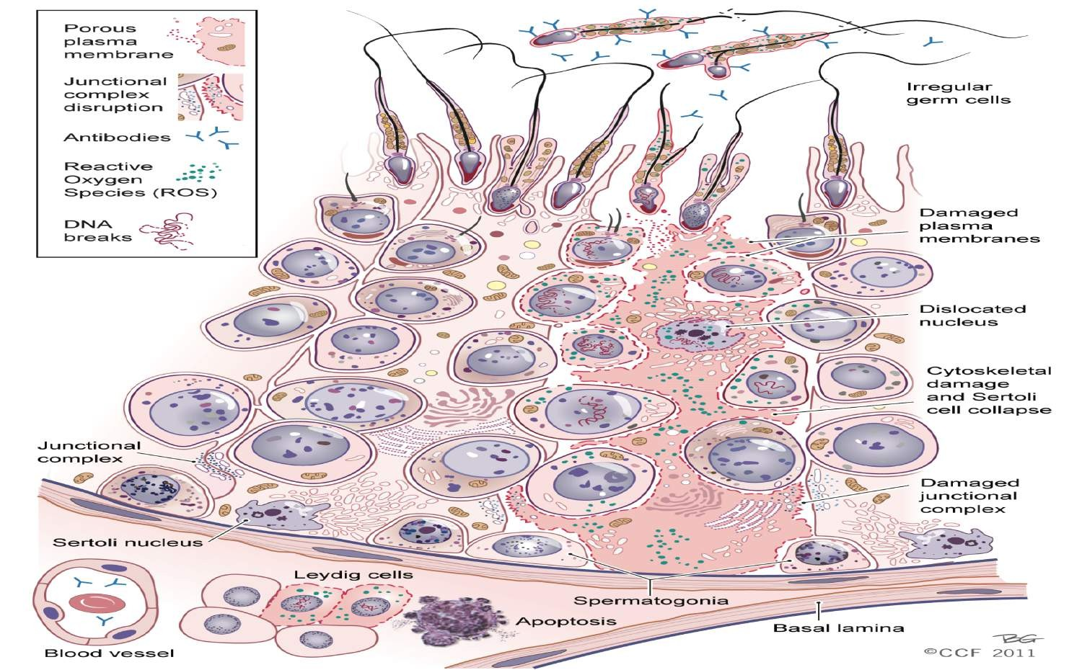
24
Hamada et al, 2011

Slide 25
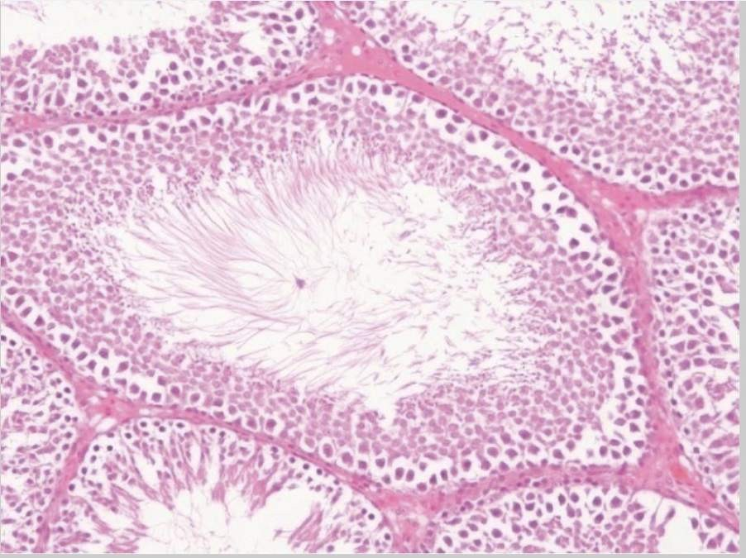
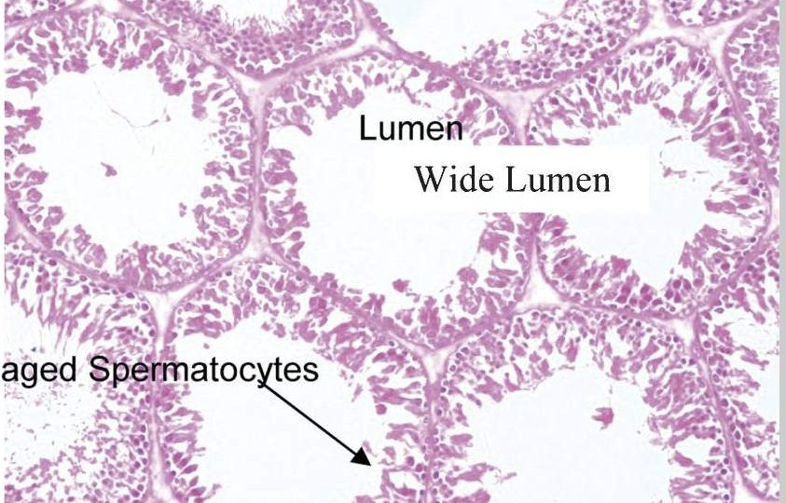
Adult Rat Testes Before and After Cell Phone Exposure
Normal Testes
Damaged Testes
All groups were exposed to the same electromagnetic frequency for 15, 30, and 60 min daily for two weeks
http://www.ncbi.nlm.nih.gov/pmc/articles/PMC3400170/

Slide 26
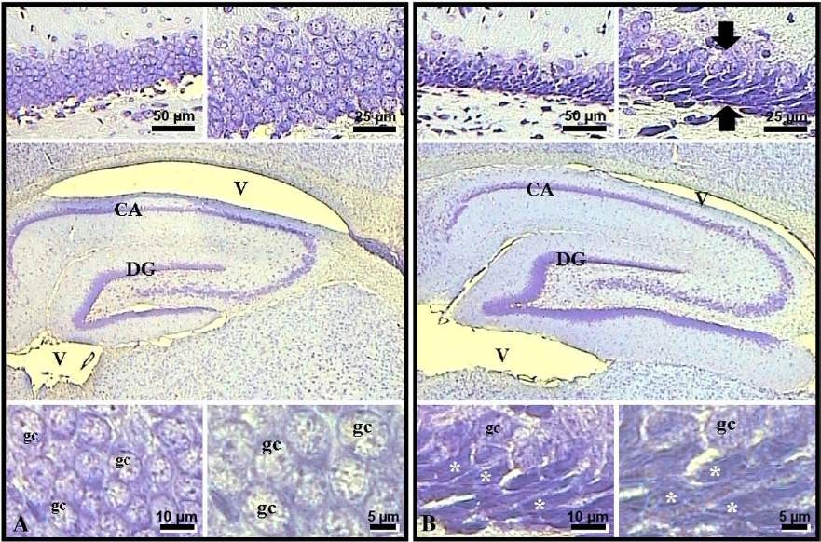
Prenatal exposure to EMF affects the hippocampus and cerebellum of rats
900 Mz
exposed
control
Arrows point to condensed cells. DG, dentate gyrus; V, ventricle; CA, cornu ammonis; DG, dentate gyrus; gc, granular cell
Prenatal EMF exposure caused lower numbers of granule cells in the dentate gyrus of the rats. (Odaci et al, 2008, Brain)
http://www.ncbi.nlm.nih.gov/pubmed/18761003

Slide 27
Fetal radiofrequency radiation exposure from cellular telephones affects neurodevelopment and behavior in mice
Hugh S. Taylor, M.D., Chair of Obstetrics, Gynecology and Reproductive Sciences, Yale School of Medicine
We have shown that behavioral problems in mice that resemble ADHD are caused by cell phone exposure in the womb.
The rise in behavioral disorders in human children may be in part due to fetal cellular telephone irradiation exposure.
http://www.ncbi.nlm.nih.gov/pubmed/22428084

Slide 28
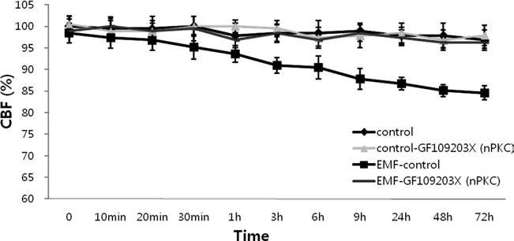
1.8 GHz radiation reduces cilial frequency (mucus clearance capacity)
Human mucosal cells in vitro (In et al, 2012)
Associated with increased enzyme protein kinase C, that digests protein
Reduced ciliary beat frequency
http://www.ncbi.nlm.nih.gov/pubmed/23060235

Slide 29
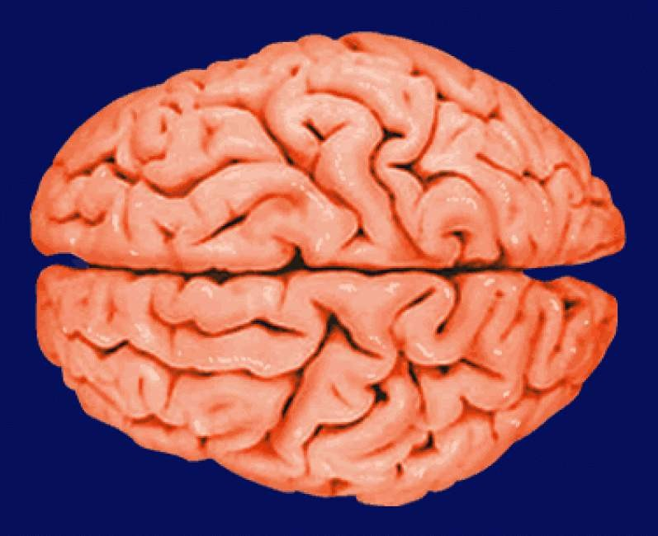
Digital Dementia Diagnosed in South Korean Children
▪▪ Characterized by: memory loss, attention disorders, lack of
eye contact and empathy, difficulty feeling or showing emotions.
▪▪ Children are at the greatest risk because their brains are
▪▪ Dr. Byun Gi-­‐Won a cognitive expert from the Balance Brain Center in Seoul, South Korea states, “Young People who are heavy technology users are likely to have
a properly developed left hemisphere of the brain while the right hemisphere will be unused and underdeveloped.”
still developing.

Slide 30
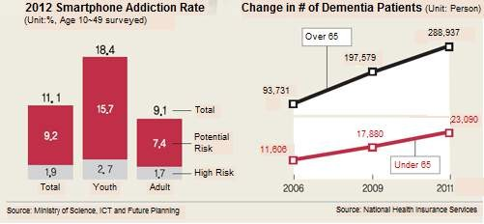
New Korean government reports on smartphone addiction
and dementia

Slide 31

Fetal Radiofrequency Radiation Exposure From 800-­‐1900 Mhz-­‐Rated Cellular Telephones Affects
Neurodevelopment and Behavior in Mice
▪▪ Tamir S. Aldad,
▪▪ Geliang Gan,
▪▪ Xiao-­‐Bing Gao
▪▪ Hugh S. Taylor
▪▪ Scientiﬁc Reports, published
▪▪ March 2012

Slide 32
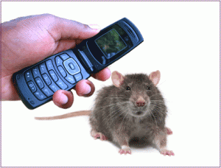
Fetal Brain Programming
Radiation-­‐exposed 33 pregnant mice
42 pregnant controls

Slide 33
Study Design
A muted and silenced 800–1900Mhz cellular phones with a SAR of 1.6W/kg was used.
The phones were positioned above each cage over the feeding bottle area at a distance of 4.5–22.3 cm from each pregnant mouse.
Mice exposed as fetuses were tested

Slide 34
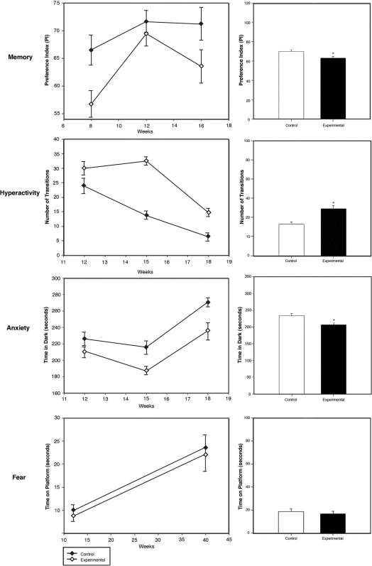
Prenatally RF-Exposed Adults Evidence
Significant Behavioral Impacts
Memory
Hyperactivity Anxiety
Fear

Slide 35
Evidence for mobile phone radiation exposure effects on reproductive pattern of male rats
70 day old male rats (middle-aged) exposed to cellphone radiation 2 hours a day for 45 days
Lower testosterone
Increased enzyme tied with DNA damage (caspase-3)
Overall lower fertility with offspring showing diminished male reproductive capacity
(Kesari and Behari, 2012)
http://www.ncbi.nlm.nih.gov/pubmed/22897402

Slide 36
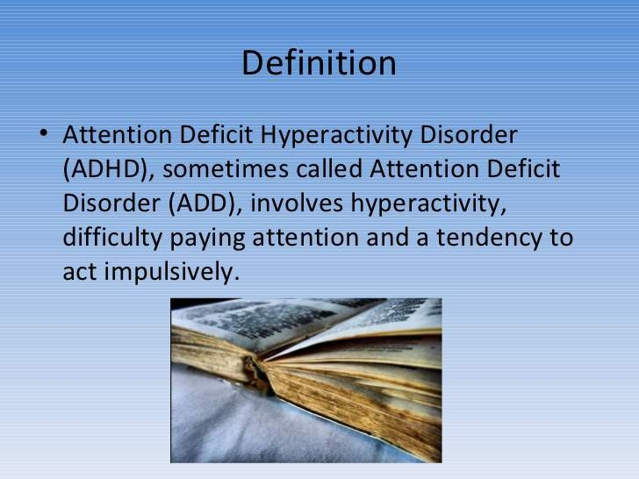

Slide 37
Prenatal 900 MHz EMF Exposure Decreased Hippocampal Granular Cell Number in the Dentate Gyrus of Newborn Rats
The research question:
Do electromagnetic fields (EMFs) inhibit the formation and differentiation of neural stem cells during embryonic development in the hippocampus.
Does Prenatal Cell Phone Exposure Reduce Number of Cells in Thinking Part of Brain????

Slide 38
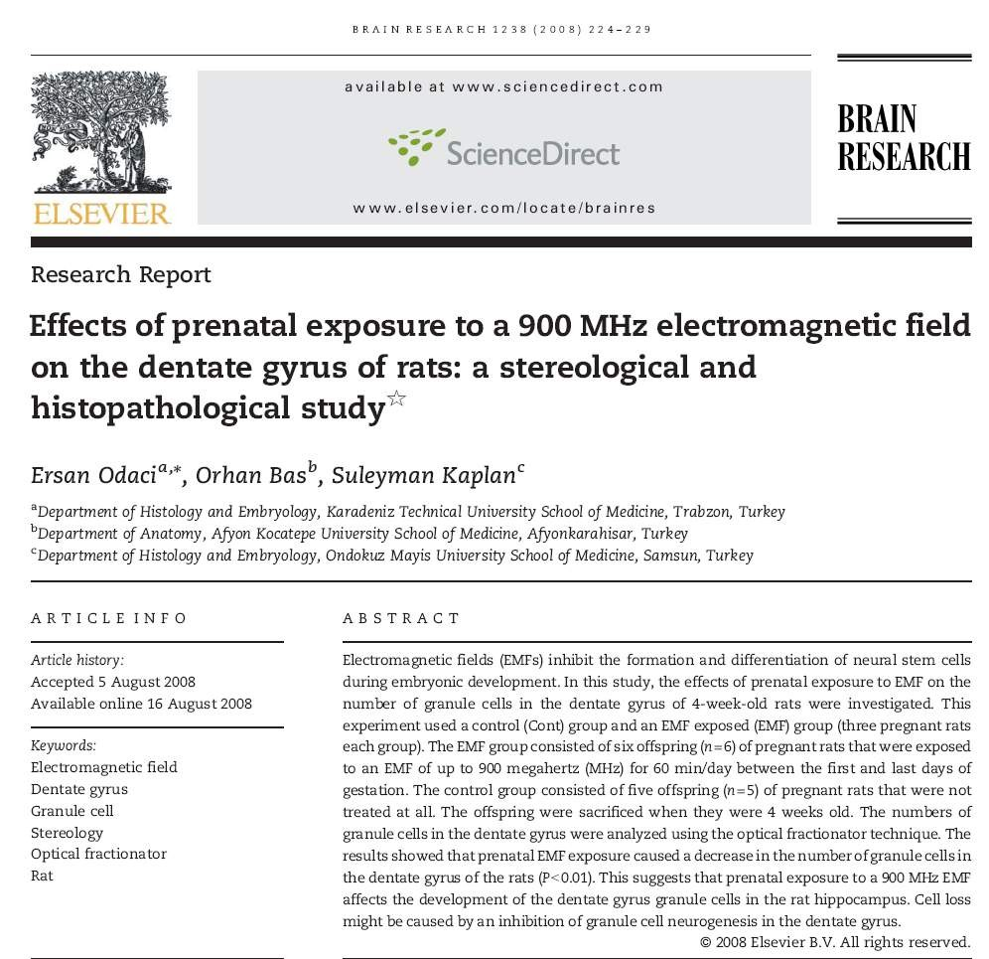
Prenatal 900 MHz EMF exposure decreased hippocampal granular cell number in the dentate gyrus of newborn rats

Slide 39
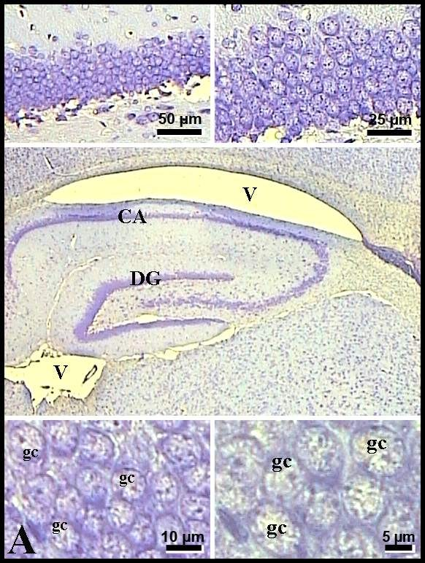
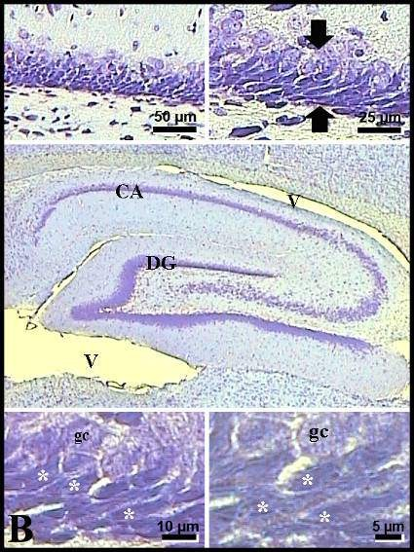
Prenatal 900 MHz EMF exposure decreased hippocampal granular cell number in the dentate gyrus of newborn rats
Controls Exposed

Slide 40
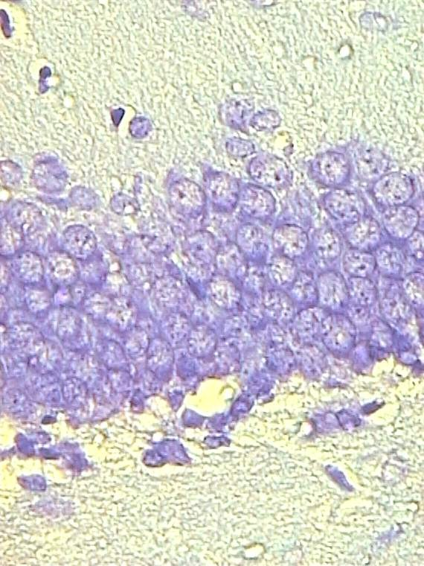
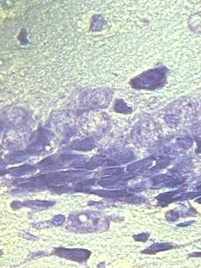
YES Prenatal Cell Phone Exposure Does Reduce Number of Cells in Thinking Part of Brain
Granular cell loss might be caused by an inhibition of granule cell neurogenesis in the dentate gyrus during prenatal life as well as in the postnatal life.
Cont
EMF
Odaci et al, 2009

Slide 41
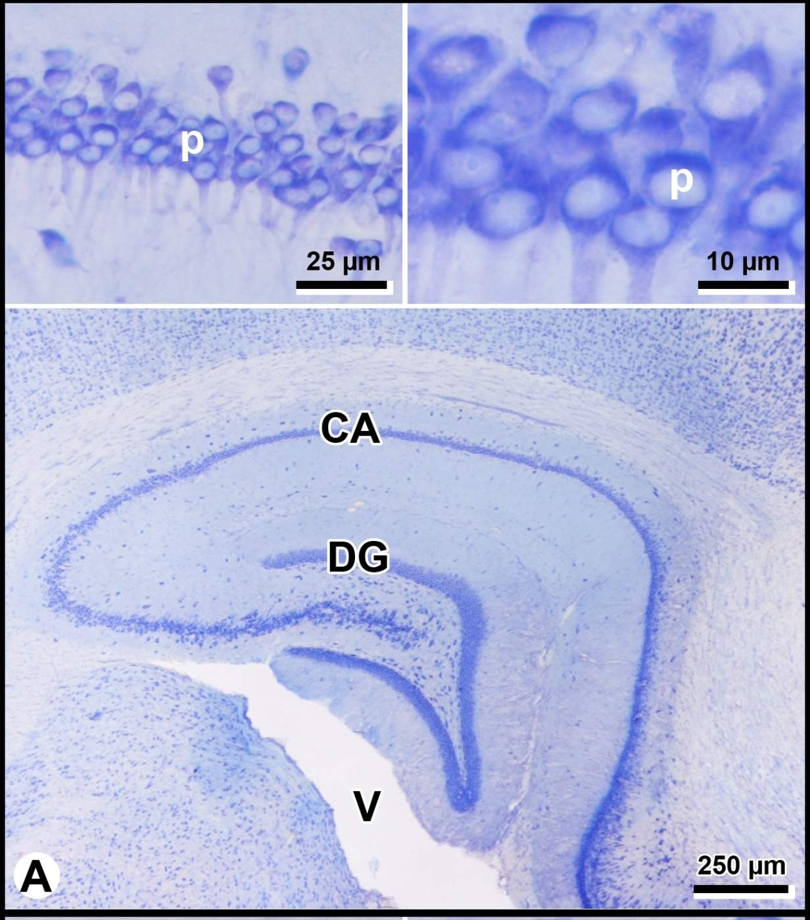
RESULTS
Panoramic views of the Cont (A), Sham
(B) and EMF (C) groups.
Postnatal EMF exposure caused a significant decrease of the pyramidal cell number in the CA of the EMF group in comparison with the Sham or Cont groups.

Slide 42

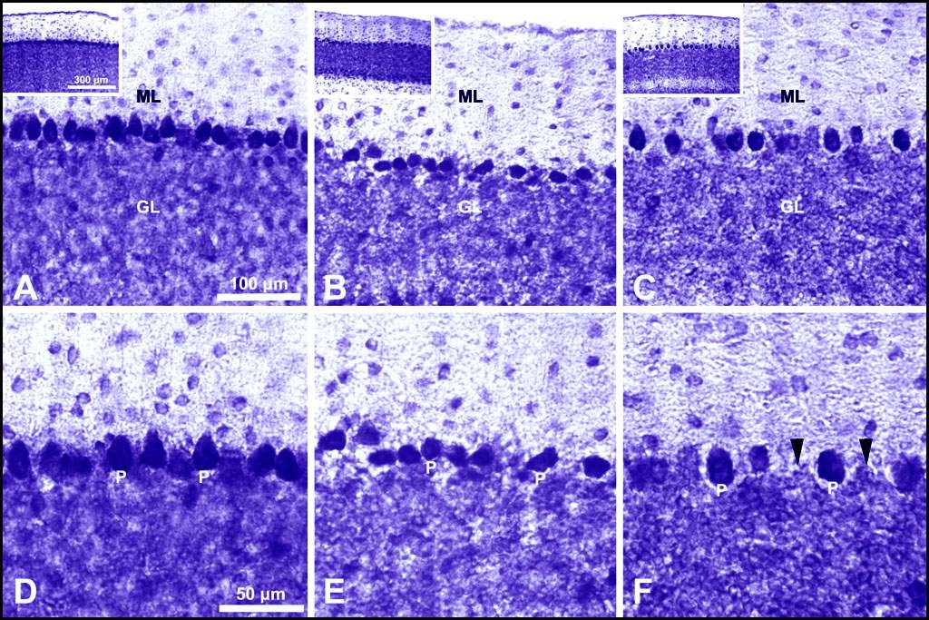
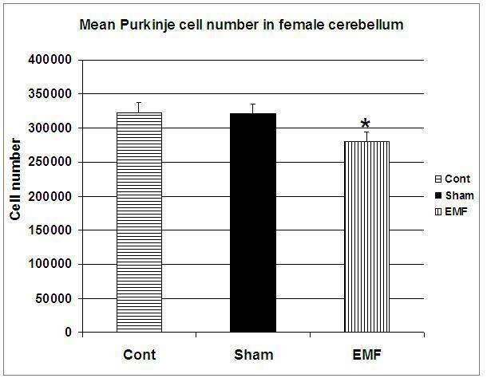
Adult Cell phone exposure kills brain cells tied to balance and other integrative functions

